Slide 1


SESSION : 2
CLASS : III
SUBJECT : SCIENCE
CHAPTER NUMBER : 3
CHAPTER NAME : PRECIOUS SOIL
SUBTOPIC : WHAT DOES SOIL CONTAIN?

Slide 2
LEARNING OBJECTIVE :
To enable the learner to -
analyse and note down the observation.

Slide 3
LET’S RECAPITULATE:
1. Fill in the blanks.
a. The earth was a _________ in the beginning.
b. The sun, wind and rain break up _______ to form soil.
c. The soil is home to millions of tiny ________ , snails, slugs and earthworms.
d. Different kinds of soil have different _________ .
hard rock
rocks
insects
colours

Slide 4
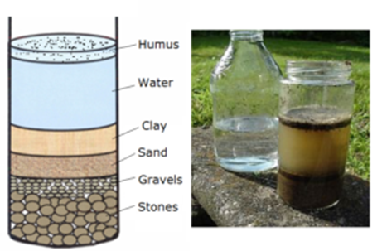
WHAT DOES SOIL CONTAINS (ACTIVITY : 1)
Take some soil from the garden. Put it into an empty jar. Fill the jar with water. Cover it with lid and shake well. Allow the mixture to stand for fifteen minutes. Now look at the jar carefully.
The stone settle down at the bottom.
The grains of sand are seen above the stones.
The clay settles down above the sand.
The water above the top layer is not very clear which contains parts of dead plants and insects are called humus. This experiment shows that soil contains humus, clay, sand and stones.

Slide 5
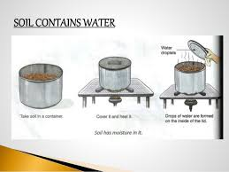
SOIL CONTAINS WATER (ACTIVITY : 2)
Put some soil in a small tin. Cover it with a lid. Heat the tin on a low flame. Open the lid.
You can find drops of water deposited on the lid.
This above experiment shows that soil contains water.

Slide 6
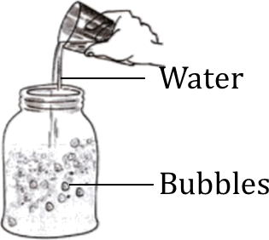
SOIL CONTAINS AIR (ACTIVITY : 3)
Put some soil in a glass jar. Pour water over it. You will see
The bubbles float up.
This above experiment shows that air which was trapped in the soil escapes in the form of bubbles.

Slide 7
UNSCRAMBLE THE LETTERS TO MAKE MEANINGFUL WORDS.
UNSCRAMBLE | ANSWER
STREUMOI
MUUHS
SENSTO
YALC
DSAN
BBUBLES
MOISTURE
HUMUS
STONES
CLAY
SAND
BUBBLES

Slide 8
SUMMARY
The earth was a hard rock in the beginning
The sun, wind and rain break up rocks to form soil
Soil contains humus, clay, sand and stones.
Soil contains water.
Soil contains air.

Slide 9
HOME ASSIGNMENT
Draw and label what does soil contain in Project Record.

Slide 10
LEARNING OUTCOME :
The learners will be able to -
analyse and note down the observation.

Slide 11
THANKING YOU
ODM EDUCATIONAL GROUP

