Slide 1


SESSION : 1
CLASS : III
SUBJECT : SCIENCE
CHAPTER NUMBER : 3
CHAPTER NAME : PRECIOUS SOIL
SUBTOPIC : INTRODUCTION:SOIL FORMATION

Slide 2
LEARNING OBJECTIVE :
To enable the learner to –
What is soil?
How the soil is formed?
Why different kinds of soil have different colours?

Slide 3
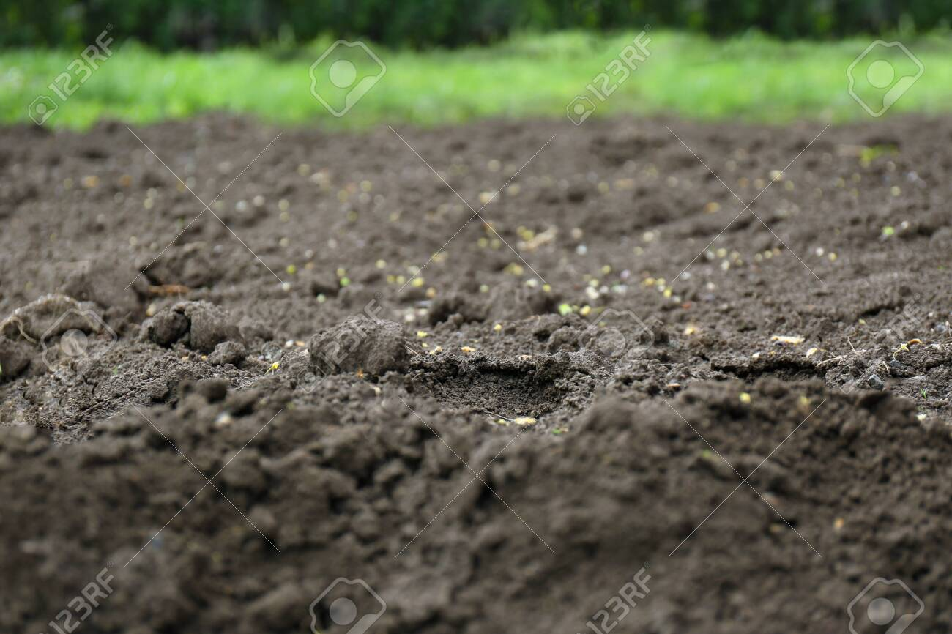
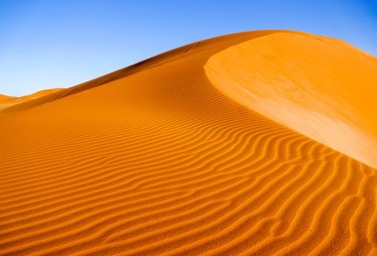
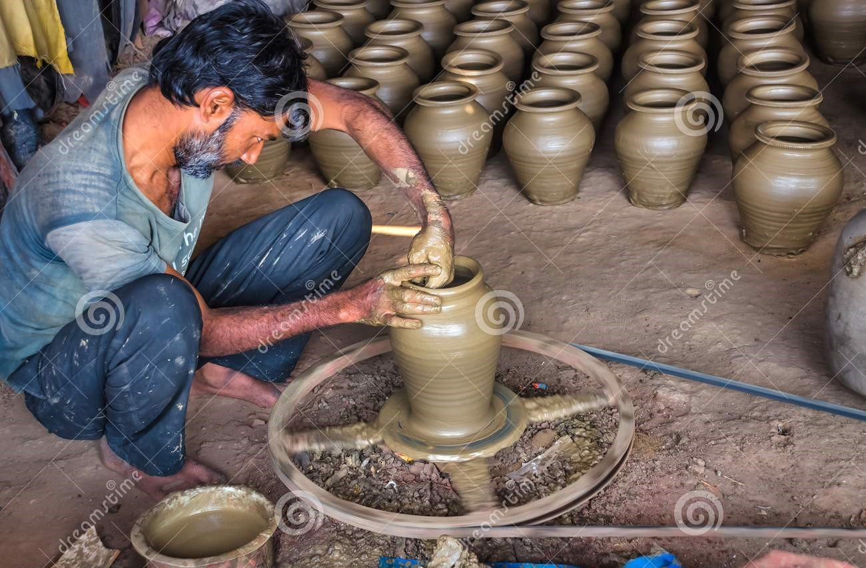
GET SET !
Guess who are we? Unscramble the names.
PICTURE | UNSCRAMBLE THE WORD | FILL IN THE BLANK
 | LOIS | I am the earth’s surface. I am formed by the breaking up of rocks .____________
 | DASN | I mostly found in desert. ____________
 | CALY | Potters use me to make pots and toys._____________
SOIL
SAND
CLAY

Slide 4
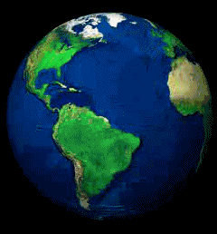
FORMATION OF SOIL
The earth is a beautiful place to live on.
There are hills and plains on the earth.
There are deserts and mountains on the earth.
Also there there is dry land and seas on the earth.
A variety of animals live here.
Different types of plants grow on it.
.
THE EARTH

Slide 5
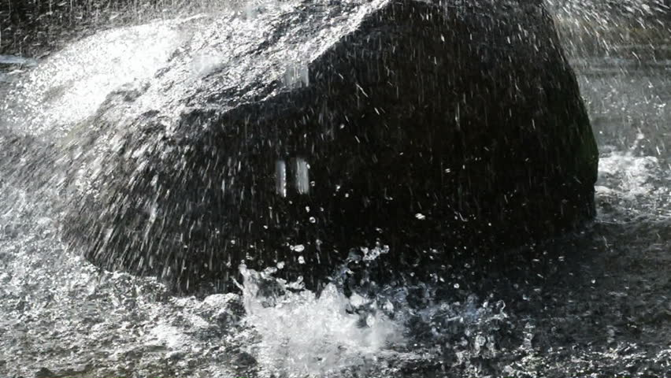
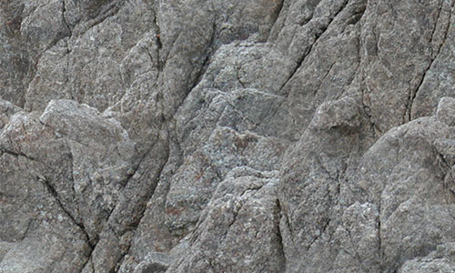
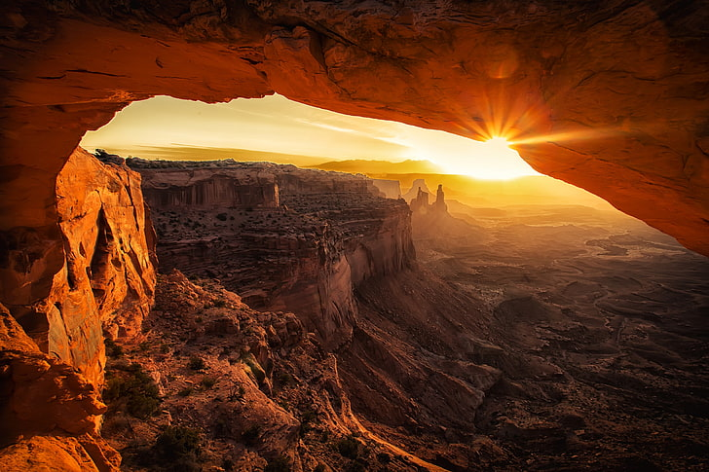
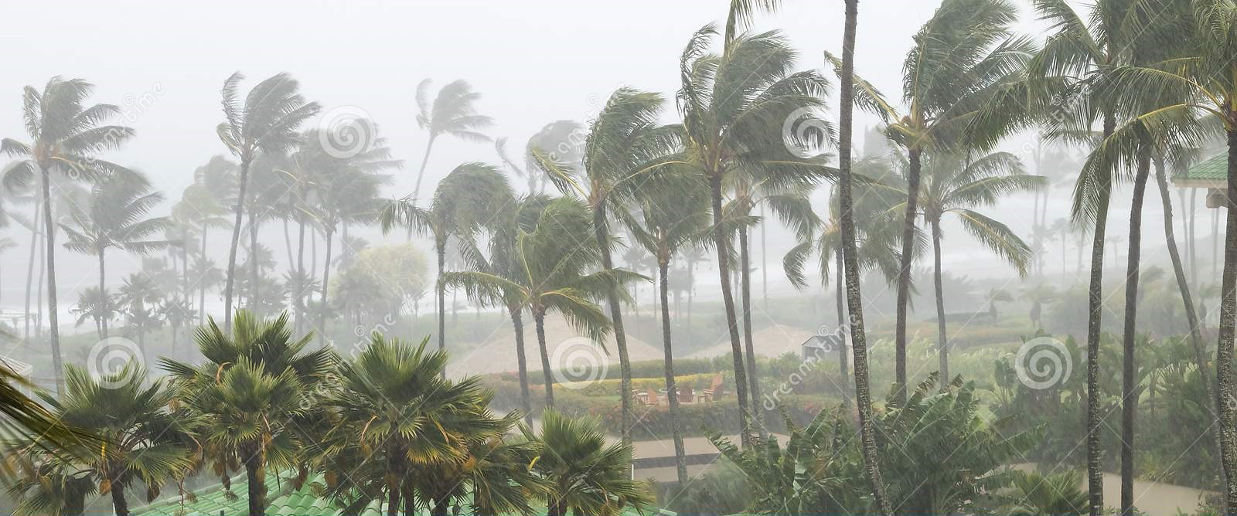
FORMATION OF SOIL
In the beginning there was no life on earth.
It was covered with hard rocks.
The sun heated up the rocks
The rain cooled them.
The wind blew over them.
RAIN COOLING THE ROCKS
EARTH WAS COVERED WITH HARD ROCKS
SUN HEATING THE ROCKS
WIND BLEWING THE ROCKS

Slide 6
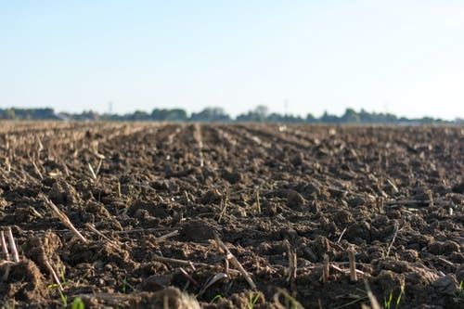
FORMATION OF SOIL
This process continued for millions of years. As a result
The rocks broke up into small pieces.
The small pieces broke further into smaller pieces.
They were carried around by wind and water.
The pieces rubbed against each other till they became tiny particles of soil.
The action of the sun, the rain and the wind broke up the rocks to make soil.
SOIL

Slide 7
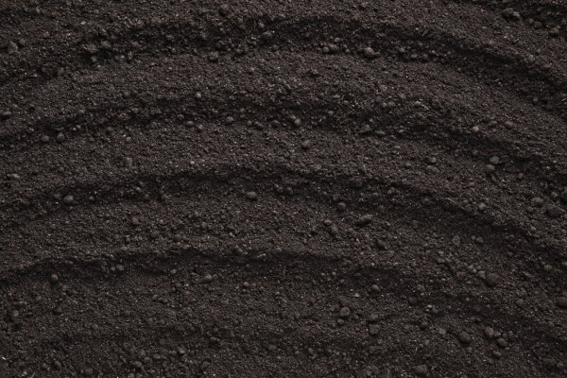
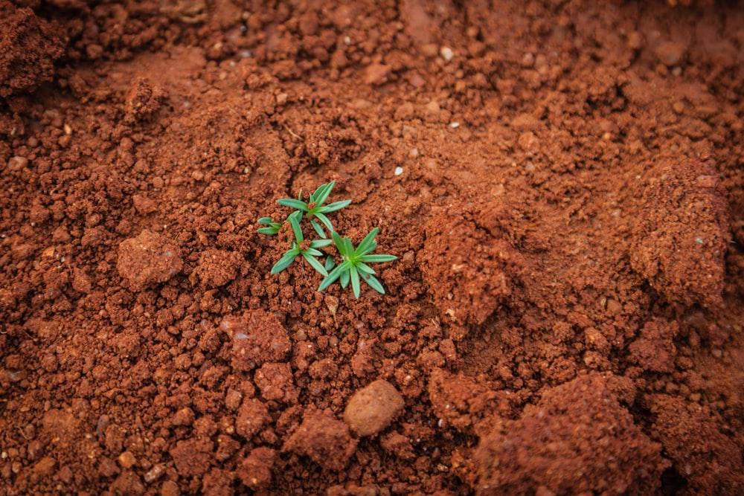
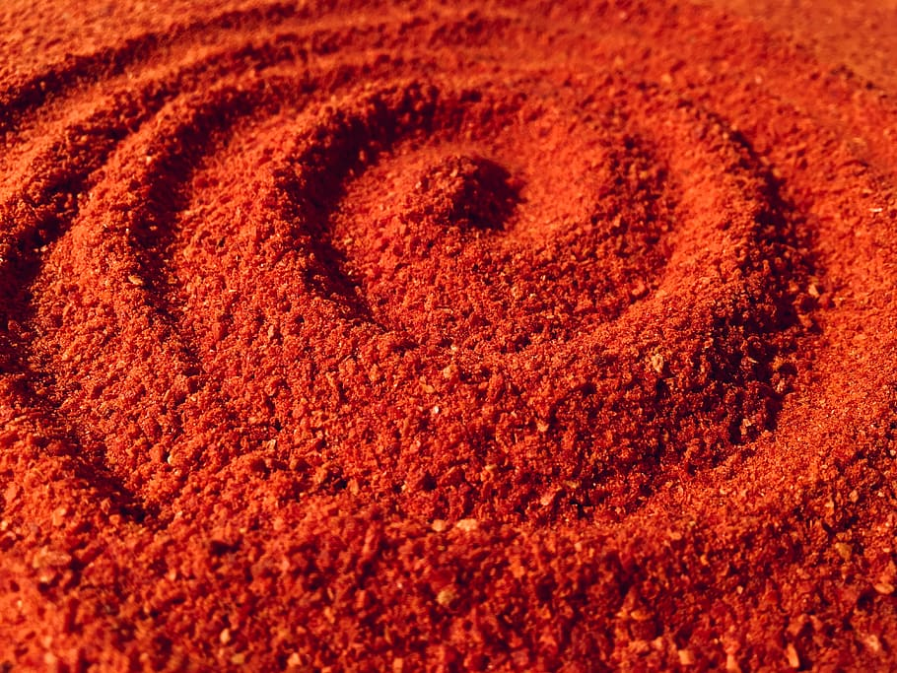
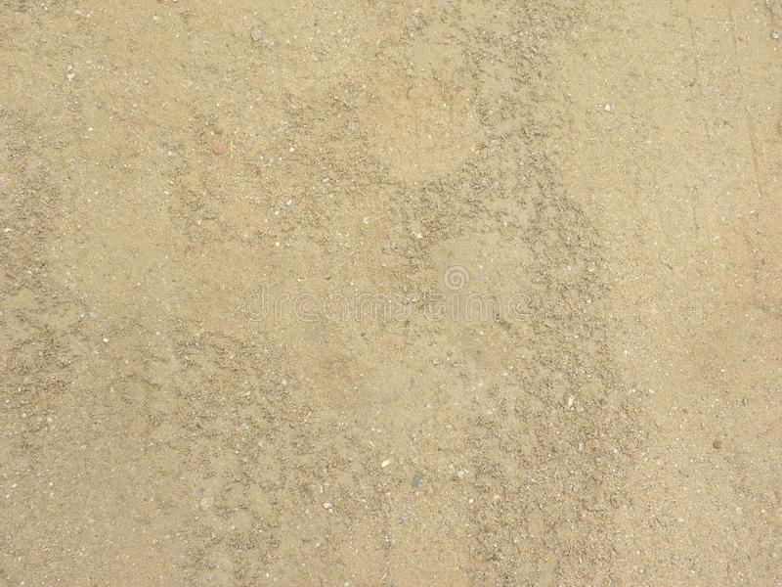
FORMATION OF SOIL
Different kinds of soil have different colours.
One kind may be light brown colour.
Another kind may be dark brown or black in colour.
Other may be another like red colour.
Different types of soil have particles of different size.
LIGHT BROWN SOIL
BLACK SOIL
DARK BROWN SOIL
RED SOIL

Slide 8
ACTIVITY :
MATCH COLUMN A WITH COLUMN B:
COLUMN A | COLUMN B
SUN | Blew over the rock
RAIN | Formation of soil
WIND | Colour of the soil
MILLIONS OF YEARS | Cooled the rock
LIGHT BROWN | Heated up the rock

Slide 9
ONLINE GAME
https://thewordsearch.com/puzzle/2569275/precious-soil/

Slide 10
LEARNING OUTCOME :
The learner will be able to know –
What is soil?
How the soil is formed?
Why different kinds of soil have different colours?

Slide 11
THANKING YOU
ODM EDUCATIONAL GROUP

