Slide 1


SESSION : 3
CLASS : III
SUBJECT : SCIENCE
CHAPTER NUMBER : 12
CHAPTER NAME : GOING INTO SPACE
SUB-TOPIC : SPACE TRAVEL, NEW WORDS

Slide 2
LEARNING OBJECTIVE :
Learners will be able to know–
about Space Travel,
about Ms. Kalpana Chawla & Ms. Sunita Williams

Slide 3
LET’S RECAPITULATE:
Fill in the blanks.
_______ is beyond the layer of air around the earth.
The force of attraction of the earth is called ______ .
A ___________ puts a spacecraft into space.
Man went to the moon for the first time in the year _______ .
Your weight on the moon will be ____________ of your weight on earth.
There is no air or water on the _________ .
Space
gravity
space rocket
1969
one-sixth
moon

Slide 4
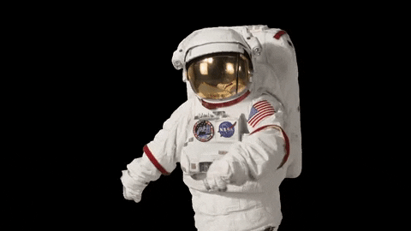
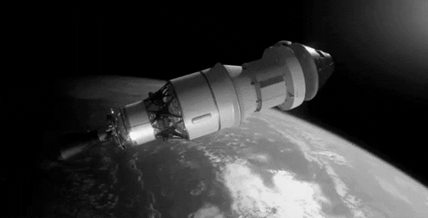
SPACE TRAVEL
The astronauts go into space in a spacecraft.
They wear special suits that contain a supply of air and also protects them from harmful rays.
They conduct experiments in the spacecraft.
They even have to repair the spacecraft when needed, while in space.

Slide 5
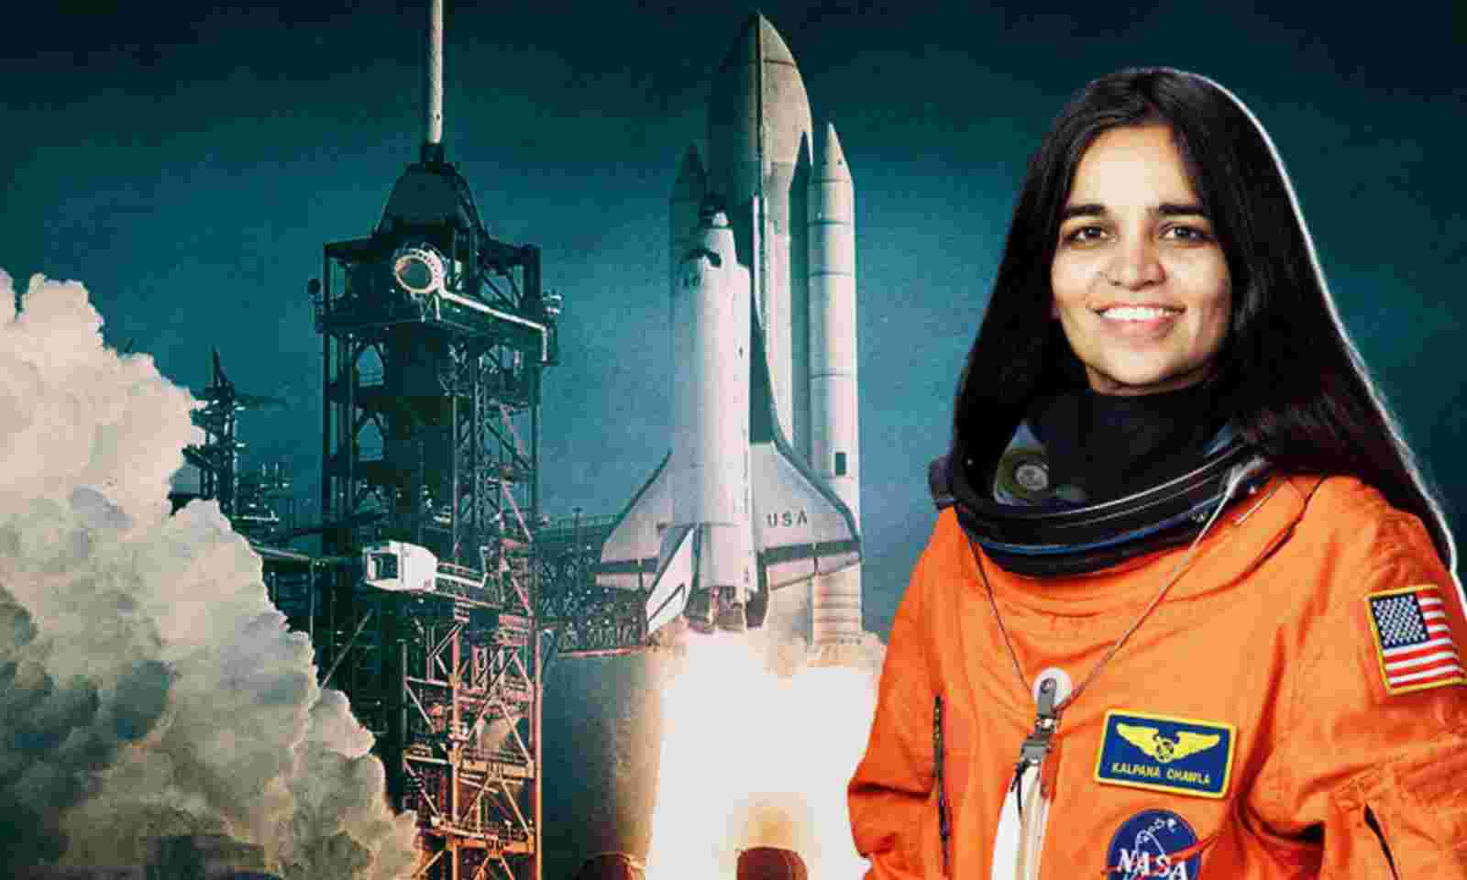
KALPANA CHAWLA
Kalpana Chawla was the first Indian woman to go into space. She went in 1997 in the space shuttle, Columbia.
She went into space again January 2003. However, she died on 1st February 2003, when her space shuttle crashed on the return journey.

Slide 6
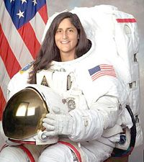
SUNITA WILLIAMS
Sunita Williams was the second woman of Indian origin to go into space.
She stayed in space in her spacecraft for 195 days.

Slide 7
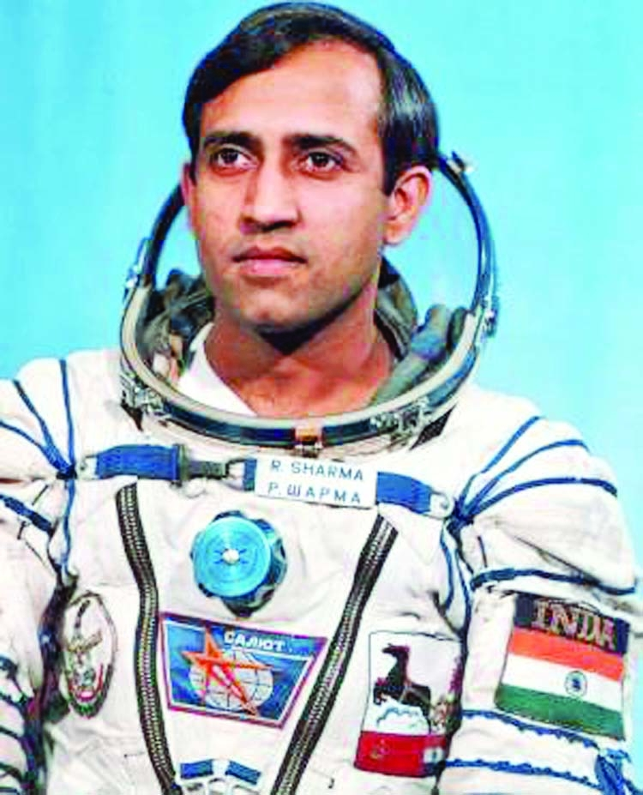
DO YOU KNOW?
Wing Commander Rakesh Sharma was the first Indian and 138th person to travel to space. He spent 7 days, 21 hours and 40 minutes aboard the Salyut 7 space station.

Slide 8
NEW WORDS
1. Space | 6. Gravitational
2. Surrounded | 7. Experiment
3. Gravity | 8. Astronauts
4. spacecraft | 9. Crashed
5. craters | 10. Attraction

Slide 9
LEARNING OUTCOME:
Learners will come to know -
about space travel,
about Kalpana Chawla & Sunita Williams

Slide 10
THANKING YOU
ODM EDUCATIONAL GROUP

