Slide 1


SESSION : 2
CLASS : III
SUBJECT : SCIENCE
CHAPTER NUMBER : 12
CHAPTER NAME : GOING INTO SPACE
SUB-TOPIC : MAN ON THE MOON, LIFE ON THE MOON

Slide 2
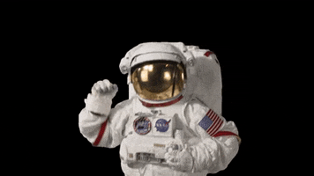
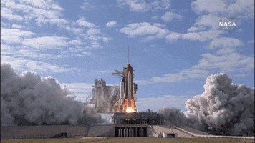
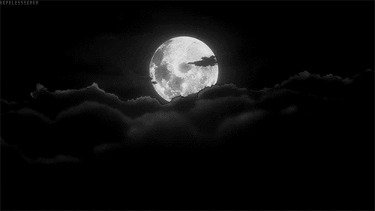
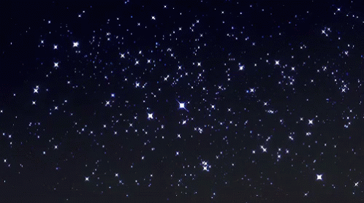
MATCH “COLUMN A” WITH “COLUMN B”
WHERE DO WE FIND ALL THESE ?
COLUMN A | COLUMN B
 | STARS
 | AUSTRONAUT
 | ROCKET
 | MOON

Slide 3
LEARNING OBJECTIVE :
Learners will be able to know about –
men who went to the moon and
the life on the moon.

Slide 4
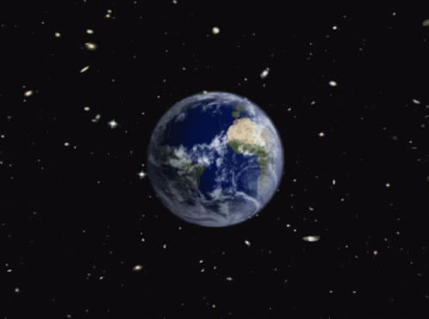
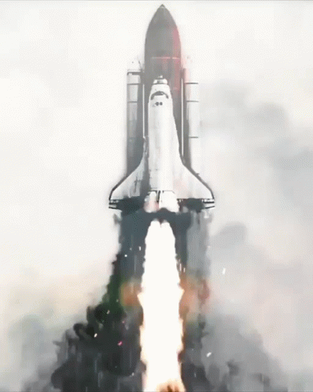
WHAT IS SPACE?
The earth is surrounded by air.
Beyond this layer of air is space.
If any thing thrown into the air it will fall back on the ground, why?
This is because of pull or force of attraction which also known as force of gravity.
We need special vehicles which have the power and space to take us away from the earth’s gravitational force.
A space rocket puts a spacecraft into space.

Slide 5
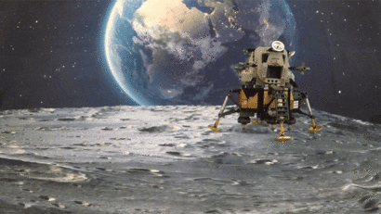
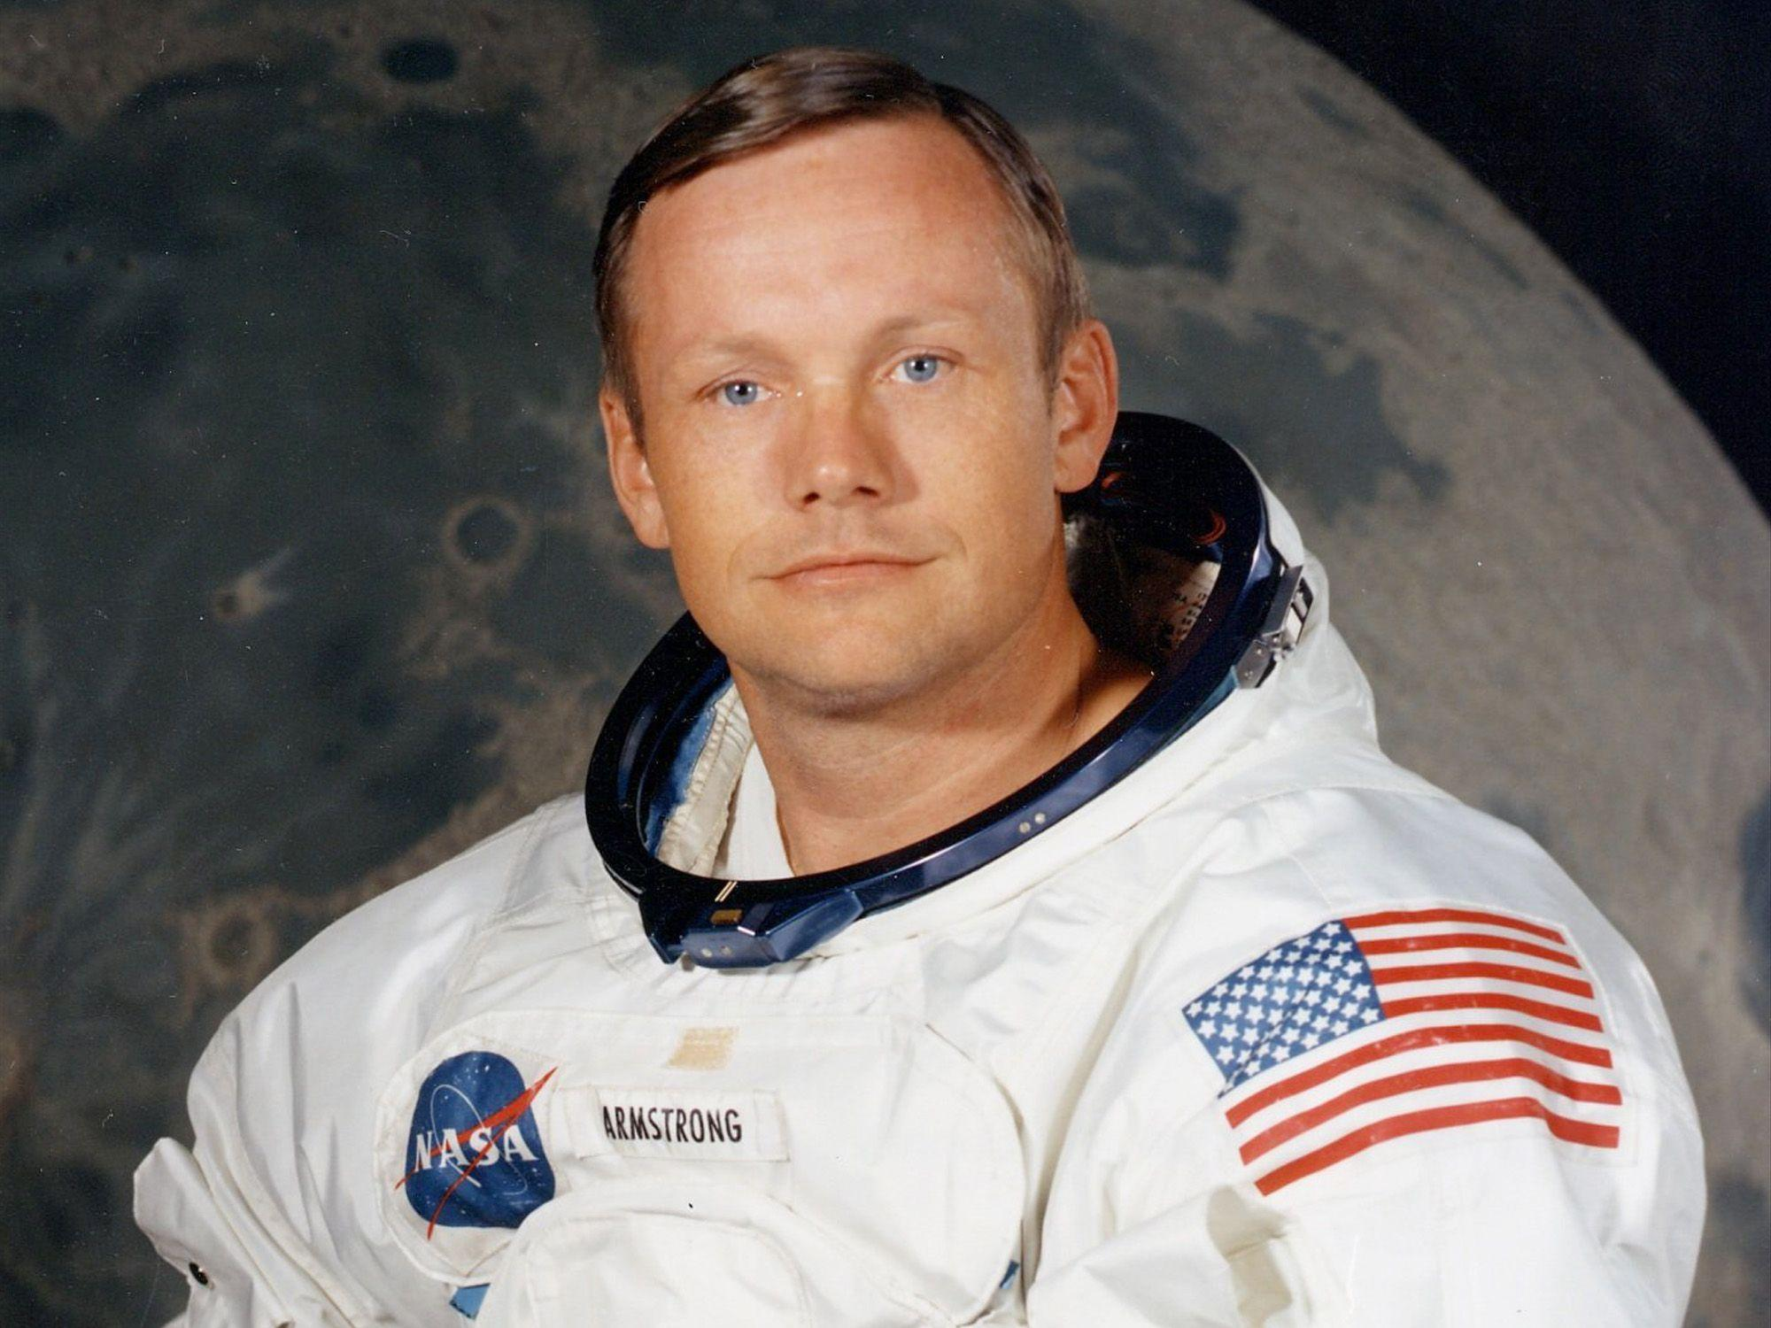
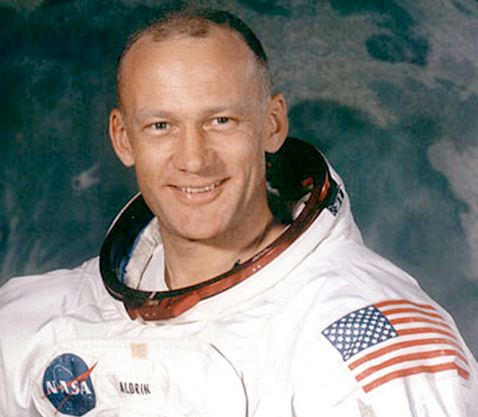
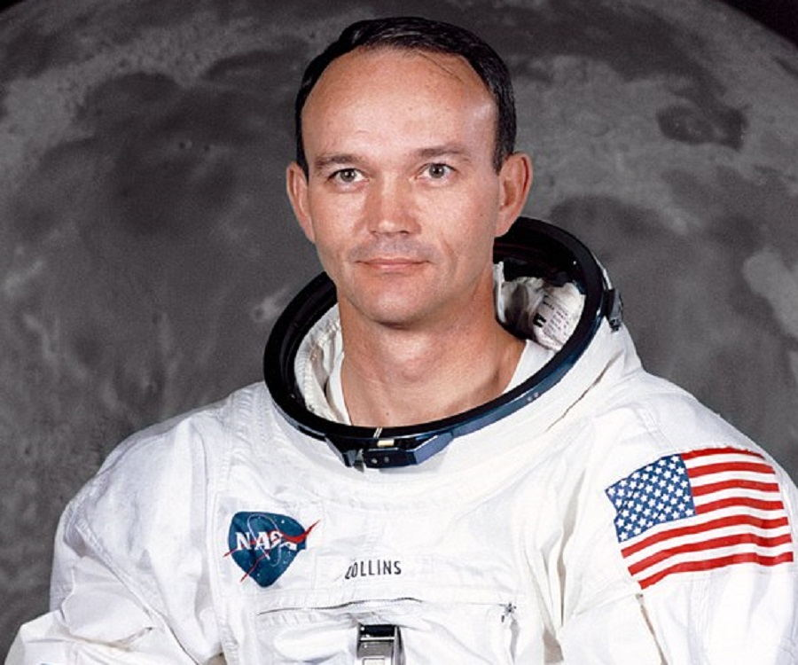
MAN ON THE MOON
Man went to the moon for the first time in a spacecraft called Apollo 11 in the year 1969.
The first man who stepped on the surface of the moon was Mr. Neil Armstrong. The first words he said on landing on the moon were, ‘That’s one small step for man, but a giant leap for mankind”.
Mr. Edwin Aldrin and Mr. Michael Collins were the other two who travelled in the spacecraft with Neil Armstrong.
Neil Armstrong
Edwin Aldrin
Michael Collins

Slide 6
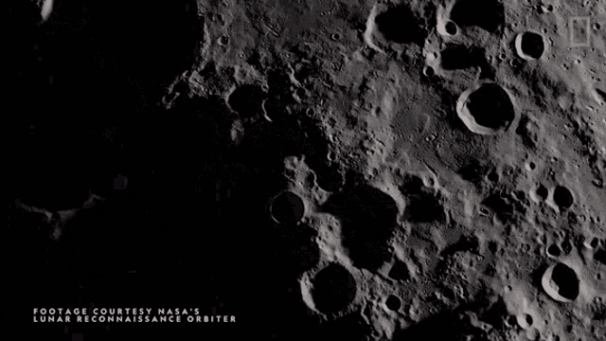
LIFE ON THE MOON
There is no air or water on the moon.
So there are no plants or animals or people.
There are huge potholes called craters on the moon’s surface.
The craters on the surface of the moon are much bigger than the potholes on our roads.
The gravitational pull of the moon is less then that of the earth.
Your weight on the moon will be one-sixth of your weight on earth, an object weighing 30 kg on the earth will weigh only 5 kg on moon.

Slide 7
Let’s Answer:
Answer the following:
3. What is special vehicle?
Ans: Special vehicles means vehicles designed for special purposes such as fire engine, ambulance, bulldozer, crane etc.
4. What are craters?
Ans: Craters are large holes on the moon’s surface.
5. Rina weighs 42 kgs on earth. What will be her weight on the moon?
Ans: Rina weighs only 7 kgs on the moon.

Slide 8
HOME ASSIGNMENTS
Do oral questions of book page-105 in notebook.

Slide 9
LEARNING OUTCOME:
Learners will come to know -
What is space?
Men who went to the moon and
the life on the moon.

Slide 10
THANKING YOU
ODM EDUCATIONAL GROUP

