Slide 1

LET’S TEASE OUR BRAIN:
Solve the riddles.
1. I am the star in the middle. I am big and bright. I shine in the sky and heat the earth.
2. I am called the red planet. I am the 4th planet from the sun. What planet am I?
3. I am the biggest planet ever discovered. What planet am I?
4. I am the 1st planet. I am a small planet. Venus comes after me. What planet am I?
5. I am the third planet from the sun and I am the only planet that has people living on it. What am I?
The Sun
The Mars
Jupiter
Mercury
The Earth

Slide 2

SESSION : 1
CLASS : III
SUBJECT : SCIENCE
CHAPTER NUMBER : 12
CHAPTER NAME : GOING INTO SPACE
SUB-TOPIC : INTRODUCTION, WHAT IS SPACE ?

Slide 3
LEARNING OBJECTIVE :
Learners will be able to know –
What is space?

Slide 4
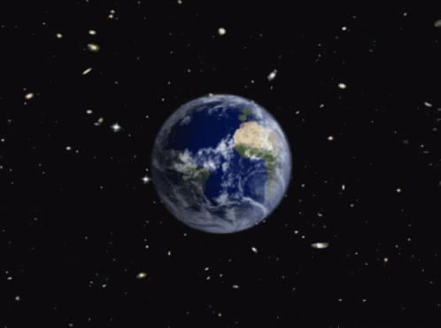
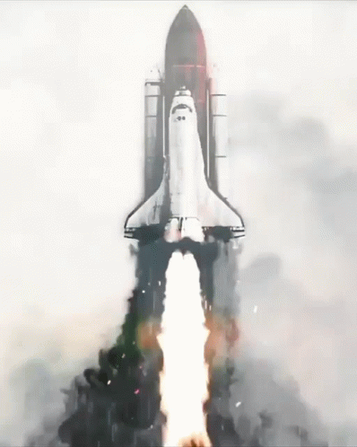
WHAT IS SPACE?
The earth is surrounded by air.
Beyond this layer of air is space.
If any thing thrown into the air it will fall back on the ground, why?
This is because of pull or force of attraction which also known as force of gravity.
We need special vehicles which have the power and space to take us away from the earth’s gravitational force.
A space rocket puts a spacecraft into space.

Slide 5
Let’s Answer:
Answer the following:
1. What is space?
Ans. The area outside the earth is the space. In space, there are various celestial objects like planets, meteors, stars etc.
2. What is force of gravity?
Ans. Force of gravity is a force of attraction with which all the physical bodies attract each other.

Slide 6
LEARNING OUTCOME:
Learners will come to know -
What is space?

Slide 7
THANKING YOU
ODM EDUCATIONAL GROUP

