Slide 1


SESSION : 3
CLASS : III
SUBJECT : SCIENCE
CHAPTER NUMBER : 9
CHAPTER NAME : MEASUREMENT
SUB-TOPIC : MEASUREMENT OF TIME AND TEMPERATURE
NEW WORDS AND WORD MEANINGS

Slide 2
LEARNING OBJECTIVE :
To enable the learners to learn about–
measurement of Time and Temperature,
new words and word meanings.

Slide 3
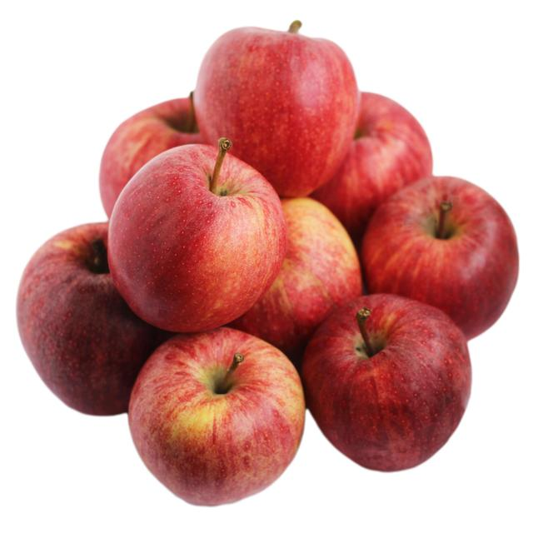
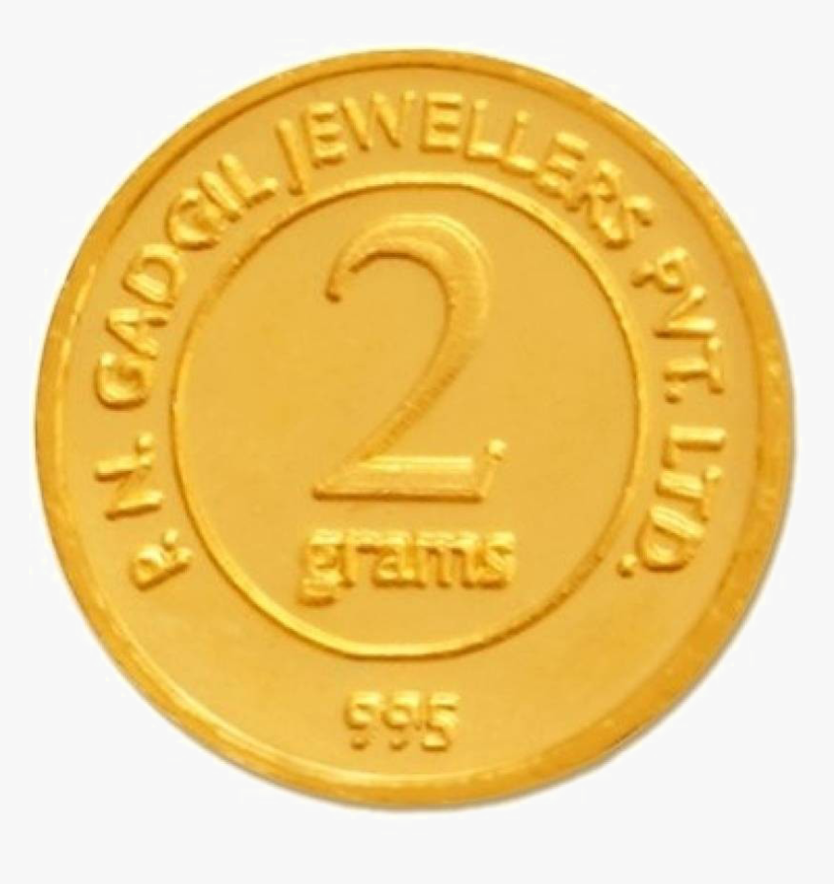
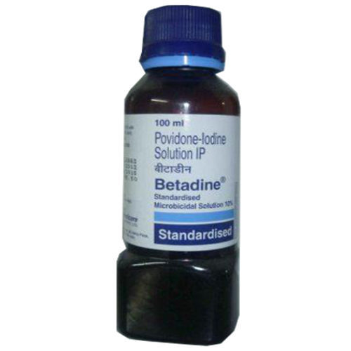

LET’S RECAPITULATE: Match Column A with Column B.
Column A | Column B
 | Small object measured in Gram
 | Units for measuring capacity
 | Large amount of oil in liters
 | Units for measuring weight
 | Small amount of medicine in milliliters
 | Heavy object measured in Kilogram
.
Kilogram and gram
Liter and Milliliter

Slide 4
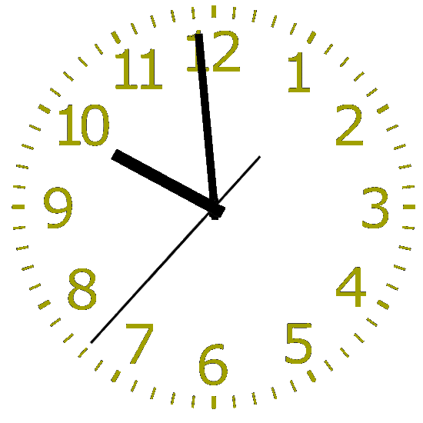
MEASUREMENT OF TIME.
The watch or clock helps us to measure time in hours
minutes and seconds.
60 seconds make 1 minute
60 minutes make 1 hour
Measuring time became an important aspect in our daily
life.
The wall clock

Slide 5
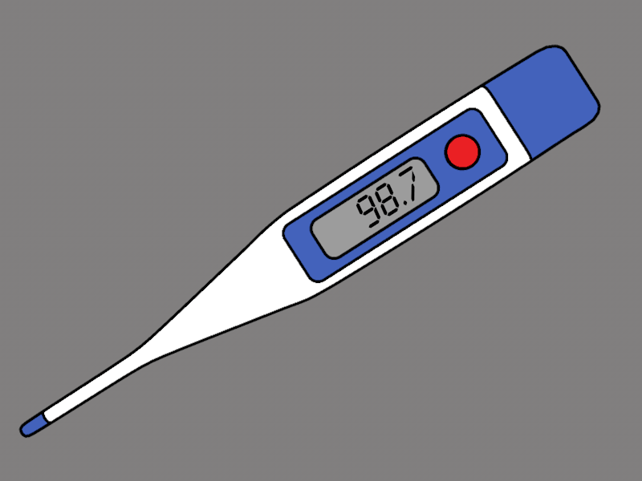
MEASUREMENT OF TEMPERATURE.
The thermometer helps us to measure temperature.
Temperature is measured on Centigrade scale or on
Fahrenheit scale.
In India the centigrade scale is used.
The digital thermometer

Slide 6
NEW WORDS AND WORD MEANINGS.
S.No | New word | Word Meaning
1 | Handspan | The maximum distance between the tips of the thumb and little finger
2 | Cubit | Equal to the length of a forearm
3 | Foot span | The distance between the point of the toe and the heel of the foot
4 | Meter Rods | A metal rod used for measuring lengths up to one metre
5 | Measuring Tape | A long, thin piece of plastic or metal that is marked with units of length

Slide 7
NEW WORDS AND WORD MEANINGS.
S.No | New word | Word Meaning
6 | Standard Unit | A unit of measurement which has a fixed value
7 | Kilogram | Unit of measurement of weight for weighing heavy objects
8 | Millilitres | Unit of measurement of small amount of liquid.
9 | Thermometer | An instrument for measuring the body temperature
10 | Electronic balance | A balance used for measuring the weight of vegetables and sweets.

Slide 8
SUMMARY
The watch or clock helps us to measure time in hours
minutes and seconds.
The thermometer helps us to measure temperature.
Temperature is measured on Centigrade scale or on
Fahrenheit scale.
In India the centigrade scale is used.

Slide 9
LEARNING OUTCOME:
The learners will able to learn about-
measurement of Time and Temperature,
new words and word meanings.

Slide 10
HOME ASSIGNMENTS
List out the things used for measuring weight and capacity in notebook.

Slide 11
THANKING YOU
ODM EDUCATIONAL GROUP

