Slide 1


SESSION : 2
CLASS : III
SUBJECT : SCIENCE
CHAPTER NUMBER : 9
CHAPTER NAME : MEASUREMENT
SUB-TOPIC : MESUREMENT OF WEIGHT
MEASUREMENT OF CAPACITY

Slide 2
LEARNING OBJECTIVE :
To enable the learners to know about–
the units of weight and units of measuring capacity.

Slide 3
LET’S RECAPITULATE: Unscramble the letters in the bracket and fill in the blanks.
1 Handspan, cubit and footspan are known as __________ (onn daranstn) units.
2. The cloth merchant measures cloth in ____________(restem).
Sunitha wants a ___________ (lreur) for her drawing class.
4. The carpenter measured the length of the door with a ____________ (epat gnirusaem).
Seema’s pencil is two ____________ (sertemitcen) shorter than that of Reema’s.
6. Robin’s ___________ (napsdnah) is smaller than his father’s __________ (tibuc).
non-standard
metres
ruler
measuring tape
centimetres
handspan
cubit

Slide 4
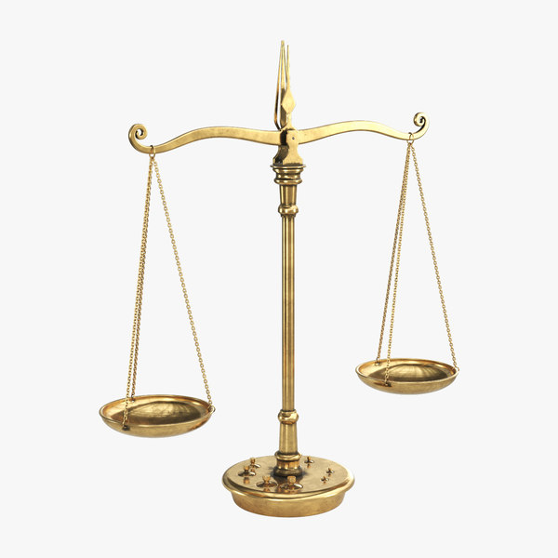
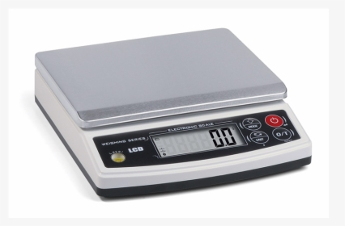
MEASUREMENT OF WEIGHT.
The weight of any object is measured by
The common balance
The electronic balance
The commonly used units for measuring weights are
grams
Kilograms
Light objects are measured in grams (g).
Heavy objects are measured in kilograms (kg).
The common balance
The electronic balance

Slide 5
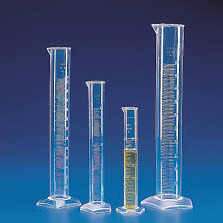
MEASUREMENT OF CAPACITY.
Capacity is the quantity of a liquid which a vessel
can hold.
A small bucket holds less water as compared to a
large bucket then we say smaller bucket has less
capacity.
Small amounts of liquids are measured in
millilitres(ml).
Large amounts of liquids are measured in litres (l).

Slide 6
Write the correct unit for measuring the following.
The length of a cloth –
The weight of a packet of sugar –
The amount of milk in a bottle –
The height of your school building –
The amount of orange juice in a small cup -
The length of your bed -
metre
gram/kilogram
Millilitre/litre
metre
millilitre
Metre

Slide 7
SUMMARY:
Weight is the measure of how heavy or light an object is.
The standard unit of weight is the kilogram.
We measure smaller weights in grams.
Capacity is measured in millilitres and litres.

Slide 8
LEARNING OUTCOME:
Learners will be able to learn -
about the units of weight and units of measuring capacity.

Slide 9
THANKING YOU
ODM EDUCATIONAL GROUP

