Slide 1


SESSION : 9
CLASS : III
SUBJECT : SCIENCE
CHAPTER NUMBER : 6
CHAPTER NAME : PARTS OF A PLANT
SUBTOPIC : ACTIVITY ON PLANTS, CLASS TEST

Slide 2
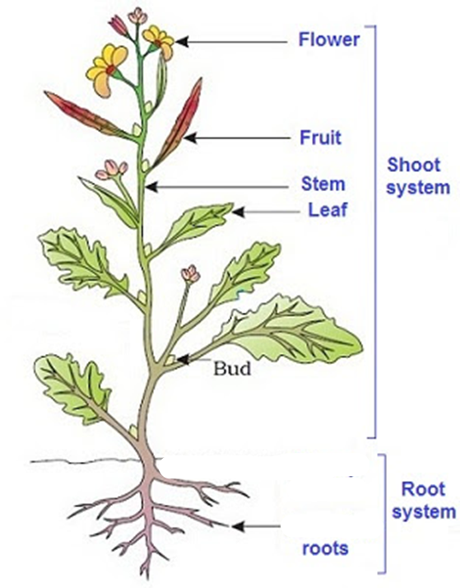
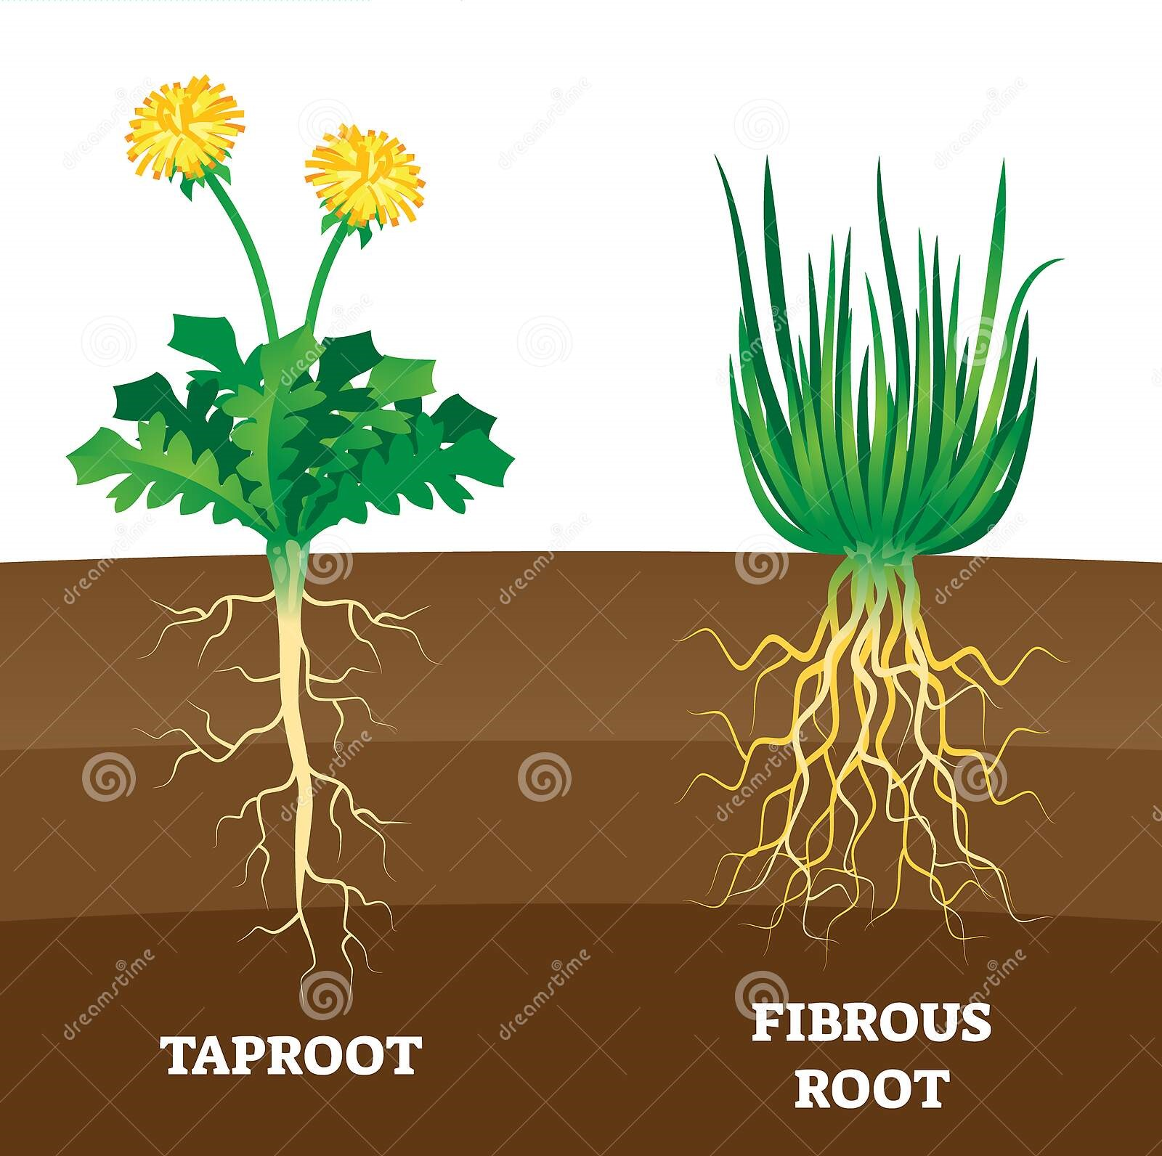
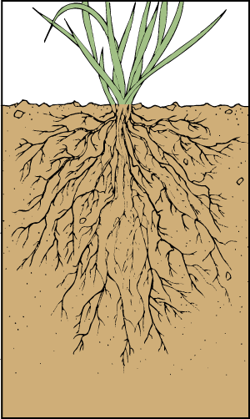
LET’S RECAPITULATE: Click on the picture
Plants have either tap roots or fibrous roots.
The root fixes the plant in the soil. They take in water and salts from the soil.
The different parts of a plant are root , stem,leaves,flowers,fruits and seeds

Slide 3
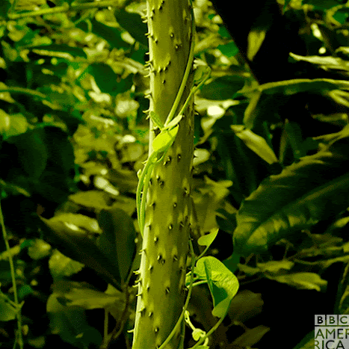
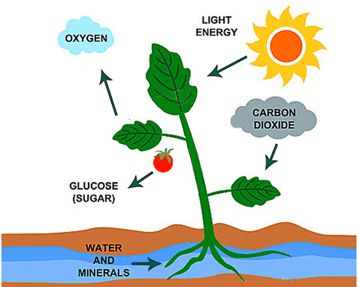
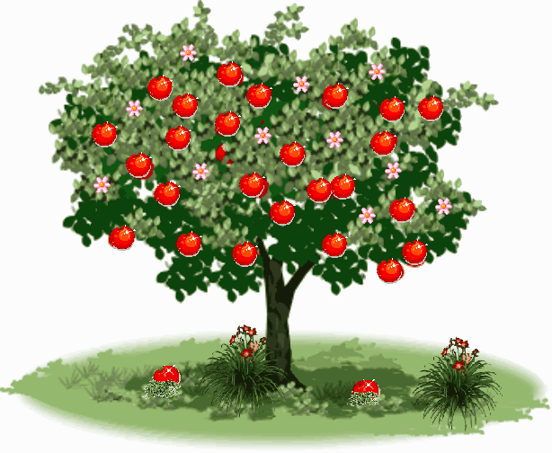
LET’S RECAPITULATE: Click on the picture
The stem supports the branches.
The leaf makes food for the plant.
The flower grows into the fruit . The fruit has seed inside it.

Slide 4
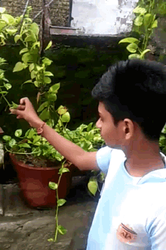
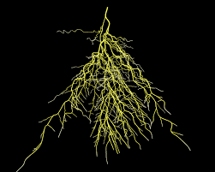

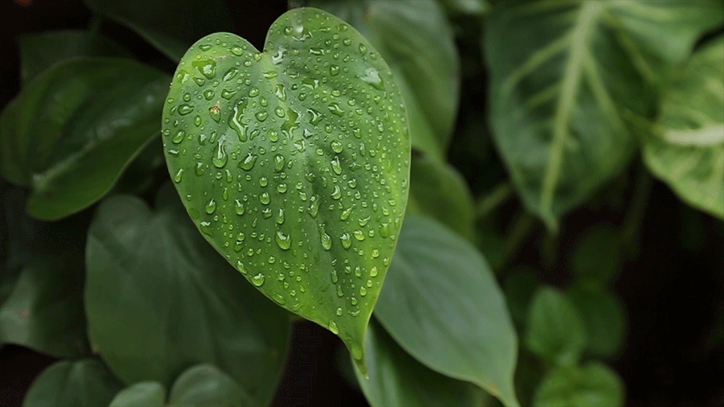
LET’S RECAPITULATE:
Each picture is having three statements. Lock the correct one.
A. Kartik touching a trunk.
B. Kartik touching a root.
C. Kartik touching a weak stem.
A. It is a fibrous root. I B. It is a tap root.
C. It is a stem.
A. It prepares food for the plant.
B. It helps plant to breathe.
C. Both A & B

Slide 5
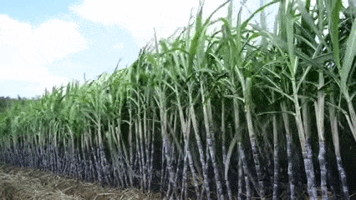
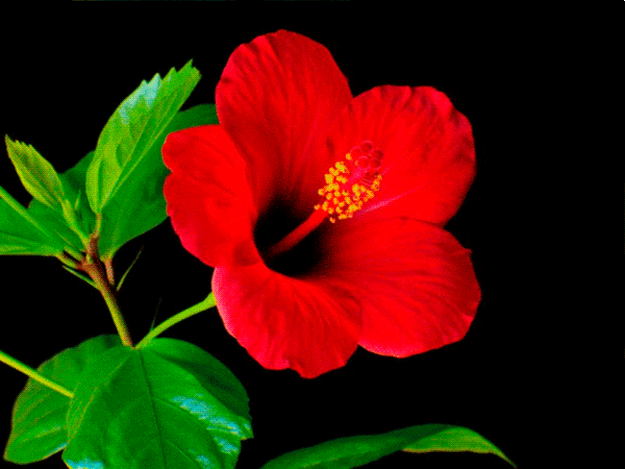
LET’S RECAPITULATE:
Each picture is having three statements. Lock the correct one.
A. Food stored in the stem.
B. Food stored in the leaf.
C. Food stored in the root.
A. This is found in root.
B. This grows into fruits.
C. This is called food factory.

Slide 6
LEARNING OBJECTIVE :
To enable the learners to –
assess themselves on the topic.

Slide 7
CLASS TEST:
Fill in the blanks selecting the answers from the box.
1. Roots are classified into ________ parts.
2. Carrots and Radish have __________ roots.
3. The stem of a mango tree is called _________.
4. The main vein is found in ________ of the leaf.
5. Cabbage & spinach stores food in the _______.
two
swollen
two
middle
trunk
leaf
middle
swollen
trunk
leaf

Slide 8
Write ‘T’ for TRUE and ‘F’ for FALSE statement:
The root of a plant fixes the plant in the soil.
2. A papaya has two seeds.
3. Stem turn into fruits.
4. The leaf of the plant is called its kitchen.
5. Onion plant has fibrous root.
TRUE
FALSE
FALSE
TRUE
TRUE

Slide 9
Summary
Roots are of two types – Tap roots and Fibrous roots.
Green leaves prepare food for the plant with the help of air, water and sunlight.
Flowers grow into fruits and the fruit has seeds inside it.
Some vegetables like carrots and beetroot have thick swollen roots. We eat the roots of such plant.
The stem of some plants are very weak and soft. They need support to stay upright.

Slide 10
LEARNING OUTCOME:
The learners will be able to–
assess themselves through the class test.

Slide 11
THANKING YOU
ODM EDUCATIONAL GROUP

