Slide 1


SESSION : 5
CLASS : III
SUBJECT : SCIENCE
CHAPTER NUMBER : 6
CHAPTER NAME : PARTS OF A PLANT
SUBTOPIC : SHORT Q & A – TICK THE CORRECT ANSWER, MATCH THE FOLLOWING,
CHOOSE THE CORRECT PICTURE

Slide 2
LEARNING OBJECTIVE :
To enable the learner to –
solve the short question and answer.

Slide 3

Let Us Answer:
A. Tick ( ) the correct answer.
1. In addition to the stem, branches, leaves and buds, the shoot of a plant bears
a] flowers and roots. b] fruits and roots c] flowers and fruits
2. We eat the leaves of this plant.
a] potato b] tomato c] spinach
3. The stem of this plant is soft, green and weak.
a] neem b] coconut c] money plant
4. The leaf of a plant is called its
a] bathroom b] kitchen c] bedroom
5. Most fruits have these inside them.
a] beads b] seeds c] seats

Slide 4
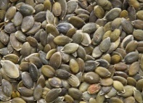
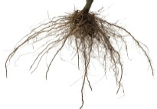

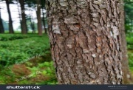
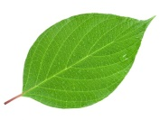
Let Us Answer:
B. Match the statement with the correct picture.
1. | It fixes the plant in the soil.
2. | It takes water from the roots to the leaf.
3. | It makes food for the plant
4. | It changes into a fruit.
5. | It grows into a new plant

Slide 5
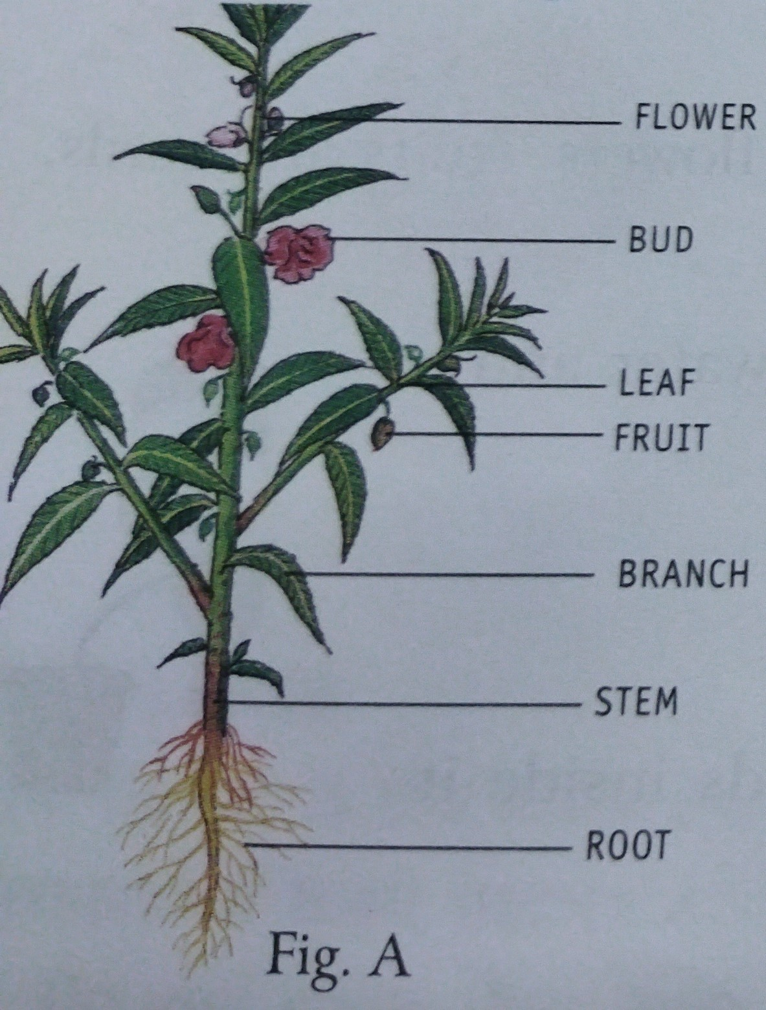
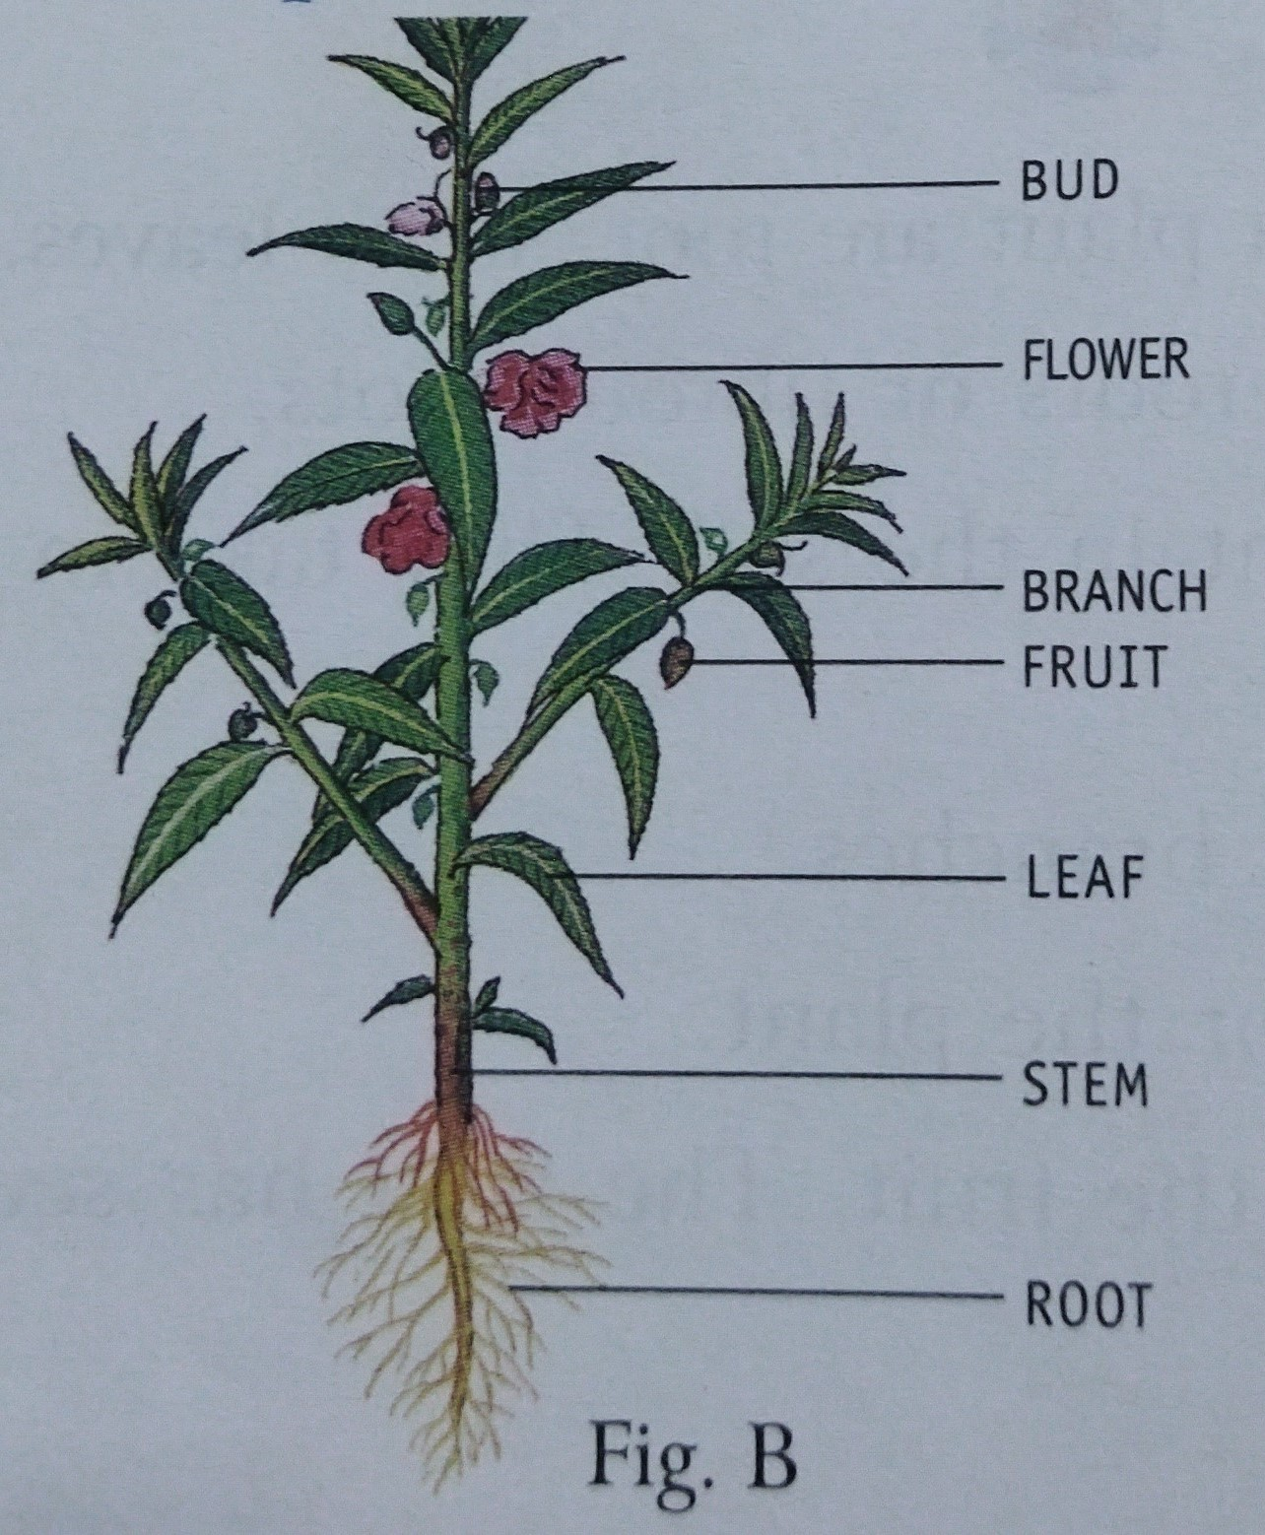
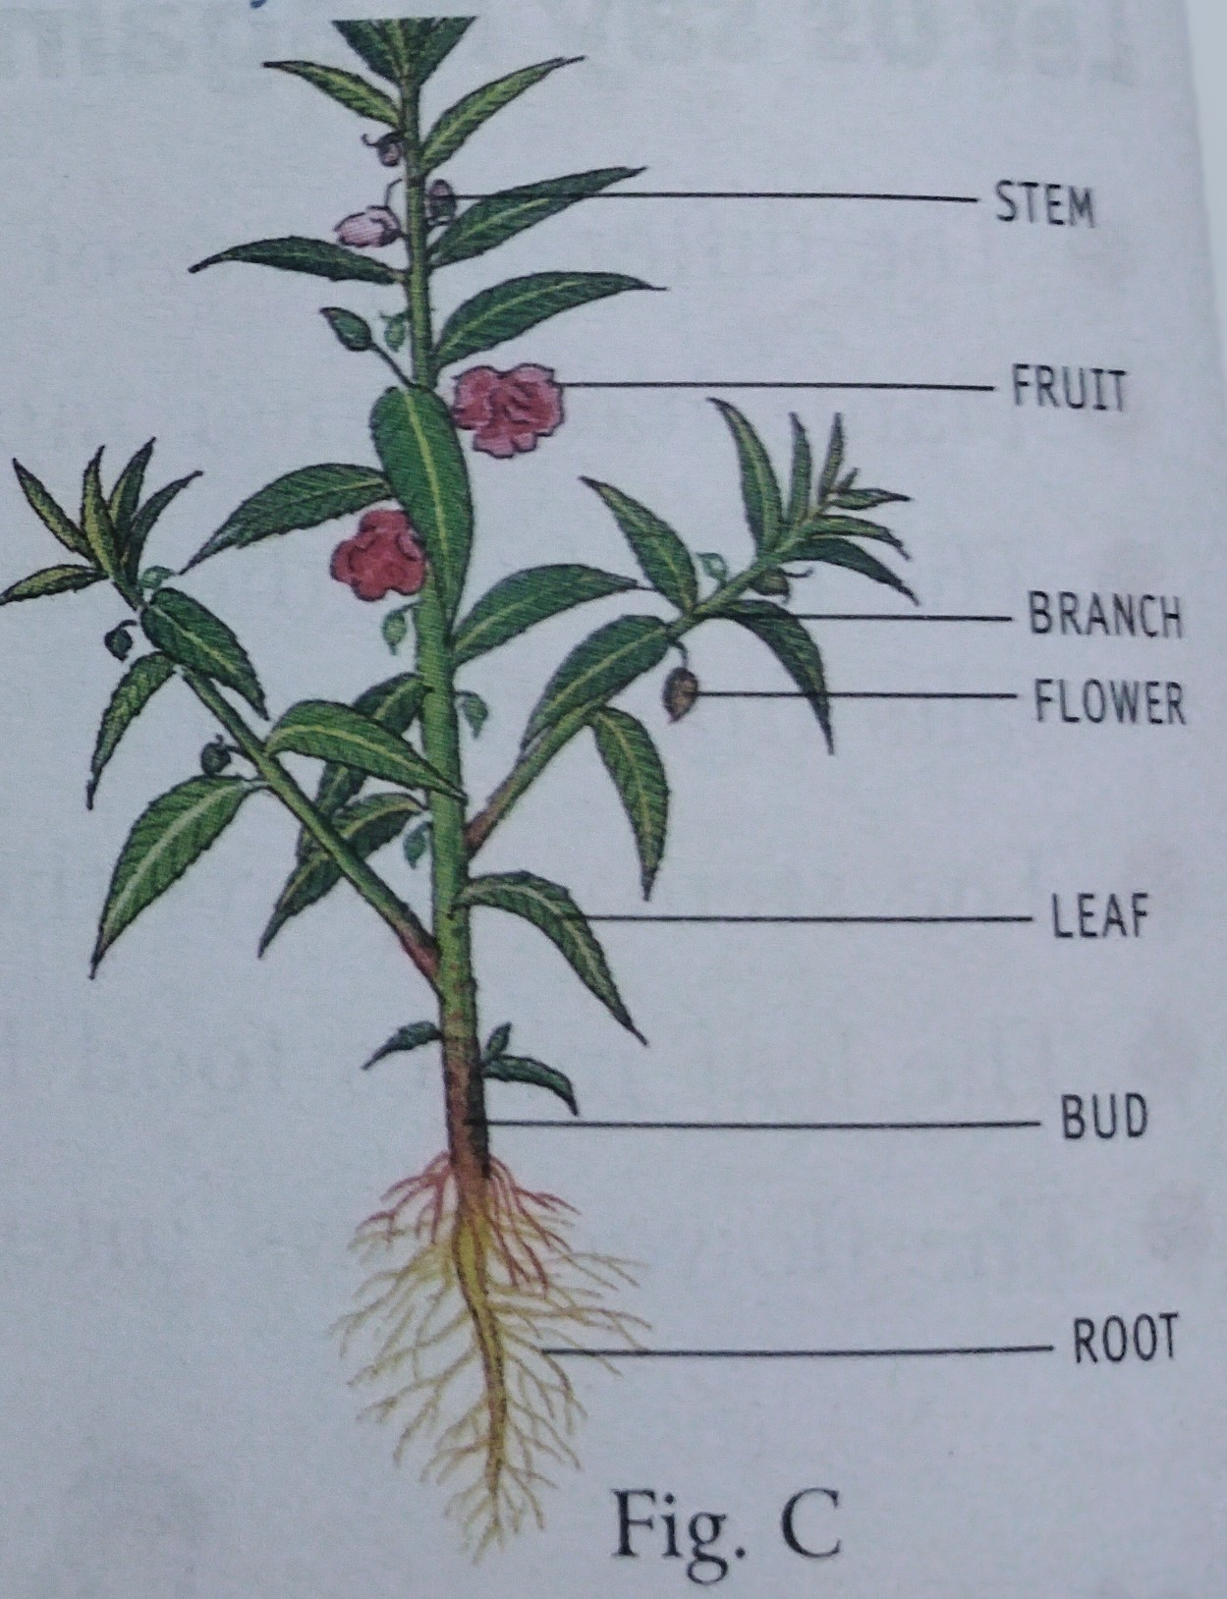
Let Us Answer:
C. In which figure are the parts of the plant correctly labelled?
Ans. : Fig B

Slide 6
LEARNING OUTCOME:
The learners will be able to–
solve the question Short questions A,B & C ?

Slide 7
HOME ASSIGNMENT:
Learn and practice the whole chapter.

Slide 8
THANKING YOU
ODM EDUCATIONAL GROUP

