Slide 1


SESSION : 3
CLASS : III
SUBJECT : SCIENCE
CHAPTER NUMBER : 6
CHAPTER NAME : PARTS OF A PLANT
SUBTOPIC : THE LEAF, THE FLOWER, FRUITS AND SEEDS

Slide 2
LEARNING OBJECTIVE :
To enable the learner to know about:
the different parts of the leaf and their functions.
the flower, fruits, and seeds.
how do most of the plants grow from seeds?

Slide 3
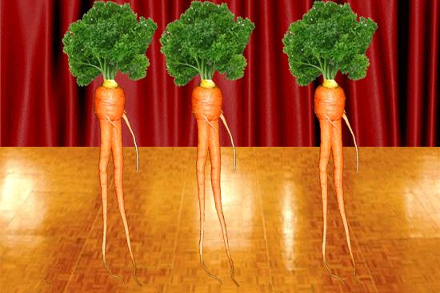
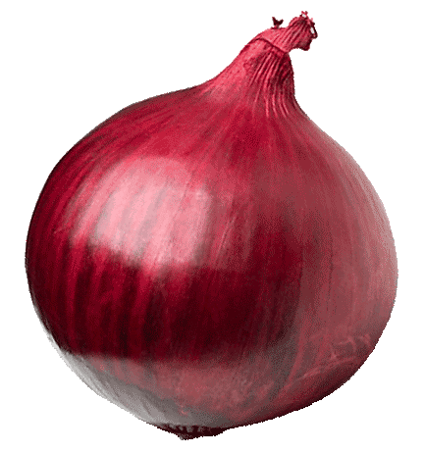
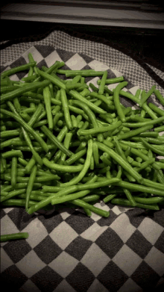
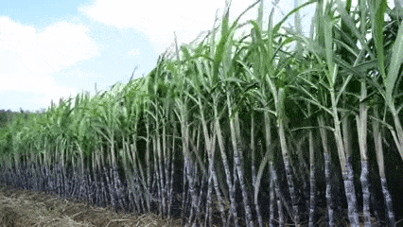

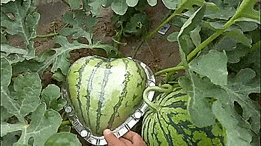
LET’S RECAPITULATE: Select the correct description from the box
and match with the image.
1.____________ 2. ___________ 3. __________
4.___________ 5.___________ 6.__________
I am having a tap root.
I store my food in stem.
My stem is called as Trunk.
I do have weak stem
I have a swollen root.
My root is fibrous.
I have a swollen root
My root is fibrous
I am having a tap root
I store my food in stem
My stem is called as Trunk
I do have weak stem

Slide 4
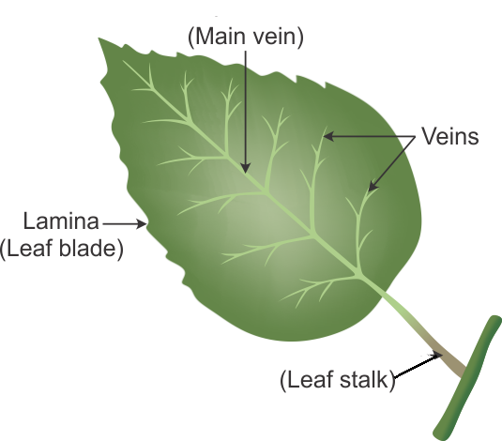
THE LEAF
The most important part of shoot is the leaf.
Most living plants have green leaves.
The flat and broad part of leaf is called the leaf blade or lamina.
In the middle of the leaf is the main vein.
A number of side veins branch out from the main vein.
The veins carry water to the leaf.

Slide 5
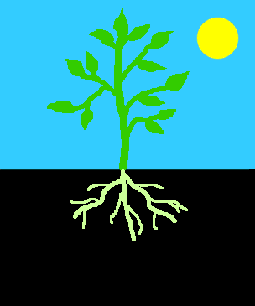
THE LEAF
A plant like all other living things needs food to grow and live.
A green leaf makes food for the plant with the help of air, water and sunlight.
The process is called photosynthesis.
The leaf is called the kitchen or the food factory of a plant.
In some plants, such as cabbage, spinach and lettuce, the leaves store food. We eat the leaves of such plants.
Leaves help a plant to
a. prepare its own food. b. breathe and
c. give out extra water
Photosynthesis

Slide 6

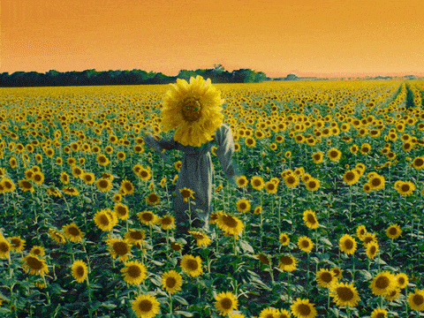
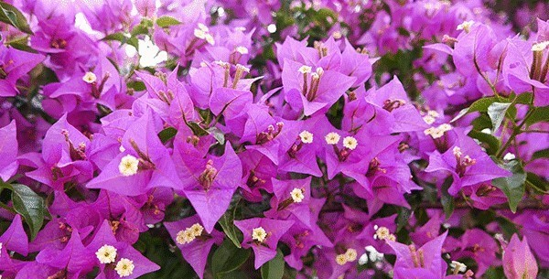
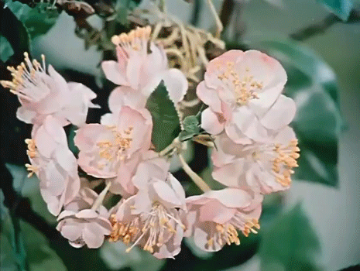
THE FLOWER
ROSE
The flower is the most beautiful part of a plant.
Most of the flowers grows into fruit.
The farmer feels happy when he sees flowers on the mango tree. He knows that these flowers will turn into fruits.
SUN FLOWER
BOUGAINVILLEA
FLOWER GROWS INTO FRUIT

Slide 7
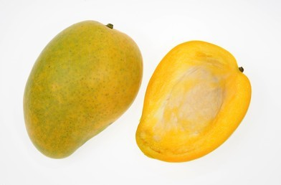
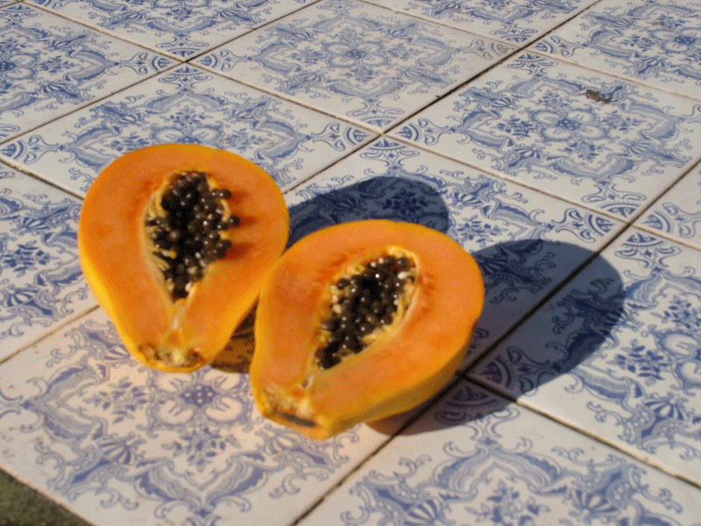
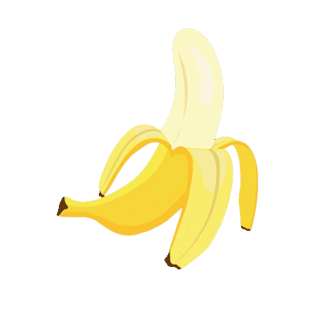
FRUITS AND SEEDS
Fruits have seeds inside them.
Some fruits like mango have one seed.
Some fruits like orange and papaya has many seeds.
There are very few fruits like banana that have no seeds.
MANGO WITH ONE SEED
PAPAYA WITH MANY SEEDS
BANANA WITH NO SEED

Slide 8
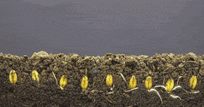
MOST PLANTS GROWS FROM SEED
Most new plants grow from seeds.
Seeds are usually protected inside the fruit.
There is a baby plant and its food inside the seed of the mother plant.
When the seed gets enough air , water and warmth, the baby plant starts growing into a fully grown plant.
Banana seeds do not grow into new plants.
PLANTS GROWING FROM SEED

Slide 9
FILL IN THE BLANKS :
The flat and broad part of a leaf is called ____________.
The most important part of the shoot is the ___________.
The process of making food for the plant with the help of air , water and sunlight is called _________________.
The leaf is called as the _______________.
In cabbage plant the food is stored in ____________
Leaves help a plant to prepare its own food, __________ and give out extra water.
leaf blade or lamina
leaf
photosynthesis
food factory or kitchen
leaf
breathe

Slide 10
Fill in the blanks selecting the correct word from the
answers.
1. Most of the flowers grows into _____________.
a. leaf b. seeds c. fruit d. none of these
2. Mango fruit has _______ seed/seeds.
a. many b. few c. one d. no
3. ___________ fruit has no seed.
a. mango b. apple c. orange d. banana
4. Seeds are protected inside the ___________.
a. flower b. root c. leaf d. fruit
5. The baby plant grows into a plant with the help of ______________.
a. air, water & warmth b. flower, leaf & stem c. fruit, root & shoot.
d. none of these.
Ans: fruit
Ans: one
Ans: banana
Ans: fruit
Ans: air, water & warmth

Slide 11
LEARNING OUTCOME:
The learner will be able to know about:
the different parts of the leaf and its functions,
the flower, fruits and seeds
how most of the plants grow from seeds?

Slide 12
HOME ASSIGNMENT:
Draw and label a leaf in Project Record.

Slide 13
THANKING YOU
ODM EDUCATIONAL GROUP

