Slide 1


SESSION : 2
CLASS : III
SUBJECT : SCIENCE
CHAPTER NUMBER : 6
CHAPTER NAME : PARTS OF A PLANT
SUBTOPIC : THE STEM

Slide 2
LEARNING OBJECTIVE :
To enable the learner to know about:
the stem and its function.

Slide 3
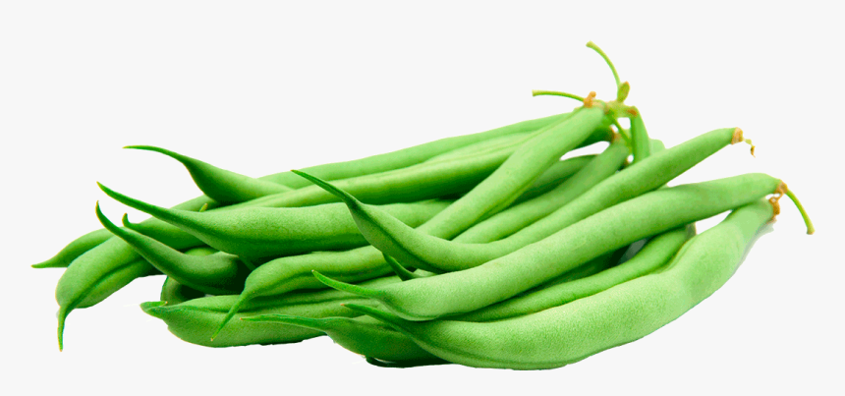
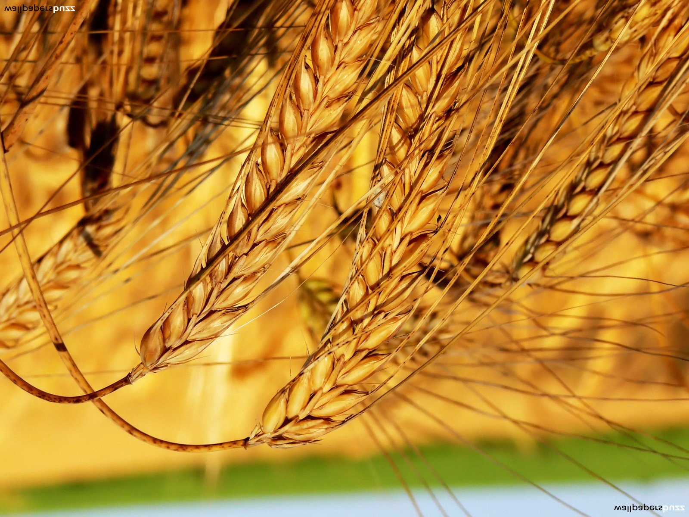
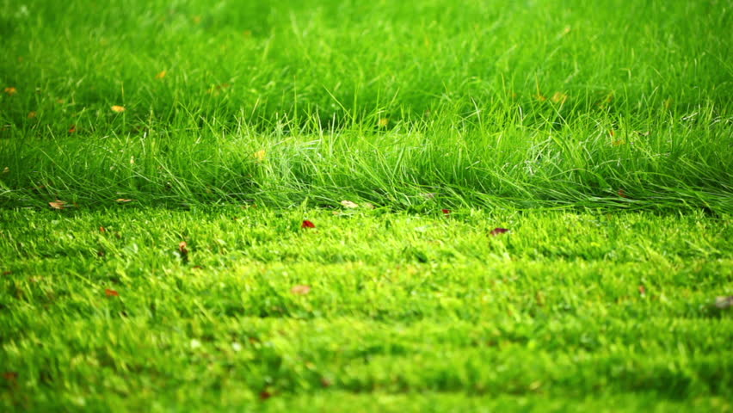
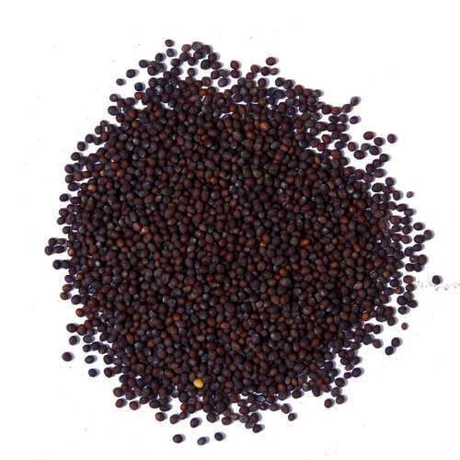
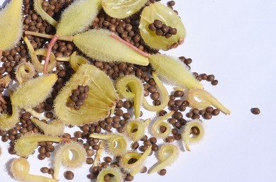
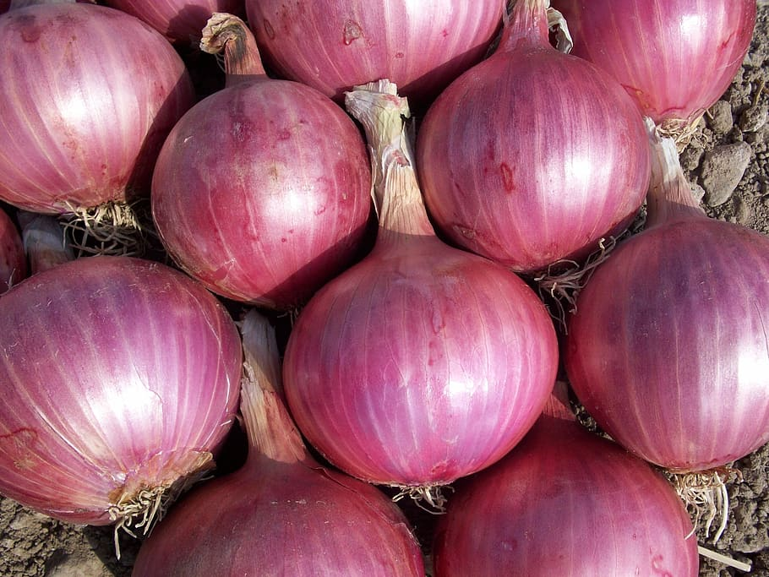
LETS RECAPTILATE : ARRANGE THE PICTURES ACCORDING
TO THEIR ROOTS
1
TAP ROOT | FIBROUS ROOT
1.BEANS
3.GRASS
2.WHEAT
5.BALSAM
4.MUSTARD
6.ONION

Slide 4
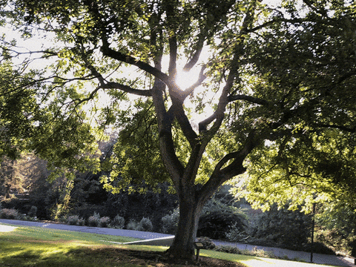
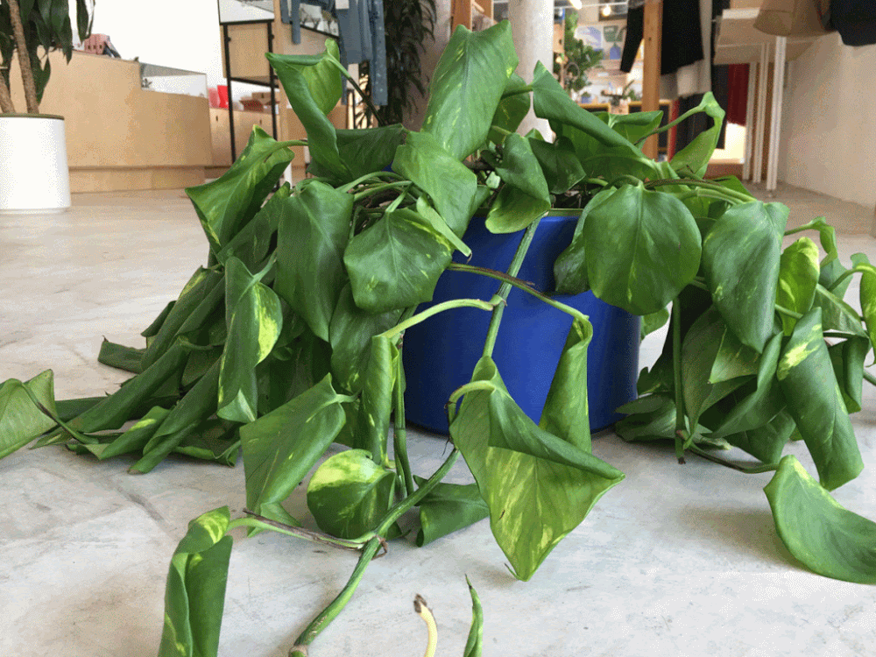
THE STEM
The stem grows above the ground. The main function of the stem is to hold the plant upright and support its branches.
The stem of the neem and coconut trees are hard , strong and woody. They keep the trees upright. Such a stem is called a trunk.
The stem of the money plant is soft , green and weak. It needs support to stay upright.
Trunk of a neem tree
Stem of a money plant

Slide 5
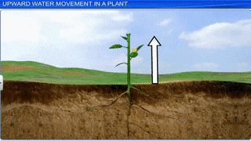
THE STEM
The stem also carries water to the leaves from the root.
The stem carries the food made by the leaves to different parts of the plant.
In the plants like sugarcane, extra food is stored in the stem. In the plants like potato and the ginger the stem grows underground and stores extra food. That is the reason we eat the stem of sugarcane , potato and ginger.
Stem as a carrier

Slide 6
LEARNING OUTCOME :
Students able to understood –
regarding different parts of the plant.
what is shoot and root?
what are different kind of roots?

Slide 7
HOME ASSIGNMENT:
Do oral questions of page no 48.

Slide 8
THANKING YOU
ODM EDUCATIONAL GROUP

