Slide 1


SESSION : 7
CLASS : 3
SUBJECT- SCIENCE
CHAPTER NUMBER: 11
CHAPTER NAME : OUR EARTH AND ITS NEIGHBOURS
SUBTOPIC : ACTIVITY

Slide 2


SOLVE THE RIDDLES
S | T | A | R | S | T | Z | L | E | R
A | Y | T | V | T | A | O | O | W | I
S | U | M | A | G | E | L | L | A | N
T | C | O | A | S | T | J | K | T | E
R | D | S | W | E | A | H | P | E | D
O | O | P | E | A | W | F | L | R | A
N | P | H | R | J | G | C | N | Q | S
A | I | E | A | R | T | H | M | A | D
U | T | R | I | K | F | B | O | Z | E
T | O | E | P | L | D | N | I | X | W
There are millions of these in the night sky.

Slide 3

SOLVE THE RIDDLES
S | T | A | R | S | T | Z | L | E | R
A | Y | T | V | T | A | O | O | W | I
S | U | M | A | G | E | L | L | A | N
T | C | O | A | S | T | J | K | T | E
R | D | S | W | E | A | H | P | E | D
O | O | P | E | A | W | F | L | R | A
N | P | H | R | J | G | C | N | Q | S
A | I | E | A | R | T | H | M | A | D
U | T | R | I | K | F | B | O | Z | E
T | O | E | P | L | D | N | I | X | W
A vast water body.

Slide 4

SOLVE THE RIDDLES
S | T | A | R | S | T | Z | L | E | R
A | Y | T | V | T | A | O | O | W | I
S | U | M | A | G | E | L | L | A | N
T | C | O | A | S | T | J | K | T | E
R | D | S | W | E | A | H | P | E | D
O | O | P | E | A | W | F | L | R | A
N | P | H | R | J | G | C | N | Q | S
A | I | E | A | R | T | H | M | A | D
U | T | R | I | K | F | B | O | Z | E
T | O | E | P | L | D | N | I | X | W
People who travel to space

Slide 5

SOLVE THE RIDDLES
S | T | A | R | S | T | Z | L | E | R
A | Y | T | V | T | A | O | O | W | I
S | U | M | A | G | E | L | L | A | N
T | C | O | A | S | T | J | K | T | E
R | D | S | W | E | A | H | P | E | D
O | O | P | E | A | W | F | L | R | A
N | P | H | R | J | G | C | N | Q | S
A | I | E | A | R | T | H | M | A | D
U | T | R | I | K | F | B | O | Z | E
T | O | E | P | L | D | N | I | X | W
The planet on which we live

Slide 6

SOLVE THE RIDDLES
S | T | A | R | S | T | Z | L | E | R
A | Y | T | V | T | A | O | O | W | I
S | U | M | A | G | E | L | L | A | N
T | C | O | A | S | T | J | K | T | E
R | D | S | W | E | A | H | P | E | D
O | O | P | E | A | W | F | L | R | A
N | P | H | R | J | G | C | N | Q | S
A | I | E | A | R | T | H | M | A | D
U | T | R | I | K | F | B | O | Z | E
T | O | E | P | L | D | N | I | X | W
Three-fourths of the Earth is covered with this

Slide 7

SOLVE THE RIDDLES
S | T | A | R | S | T | Z | L | E | R
A | Y | T | V | T | A | O | O | W | I
S | U | M | A | G | E | L | L | A | N
T | C | O | A | S | T | J | K | T | E
R | D | S | W | E | A | H | P | E | D
O | O | P | E | A | W | F | L | R | A
N | P | H | R | J | G | C | N | Q | S
A | I | E | A | R | T | H | M | A | D
U | T | R | I | K | F | B | O | Z | E
T | O | E | P | L | D | N | I | X | W
The layer of air that surrounds the Earth

Slide 8
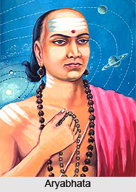
WHO AM I ?
ARYABHATA

Slide 9

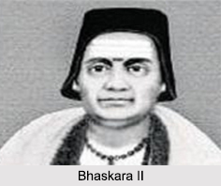
WHO AM I ?
Bhaskara

Slide 10
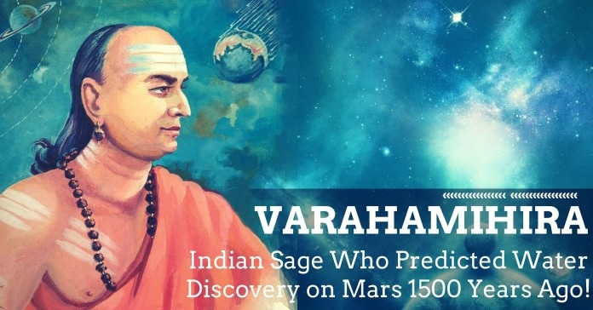
WHO AM I ?
VARAHAMIHIRA
This Photo by Unknown Author is licensed under CC BY-SA-NC

Slide 11
LEARNING OUTCOME :
Learner will able to know
to solve the questions

Slide 12

HOME ASSIGNMENT
Do the crossword puzzle of page no-101 Q-H in project record.

Slide 13
THANKING YOU
ODM EDUCATIONAL GROUP

