Slide 1


SESSION : 6
CLASS : 3
SUBJECT- SCIENCE
CHAPTER NUMBER: 11
CHAPTER NAME : OUR EARTH AND ITS NEIGHBOURS
SUBTOPIC : LONG Q/A

Slide 2

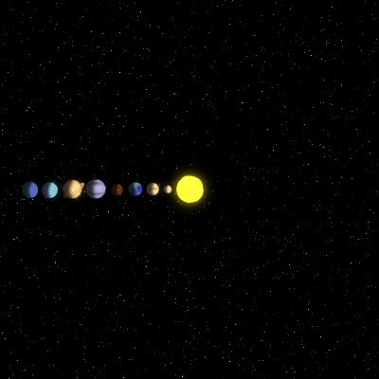
The solar system
The Earth move around the sun.
Like the Earth there are many other heavenly bodies move around the sun.
The sun and the eight planets that go around it form the solar system.
They are
mercury,
venus,
Earth
Mars
Jupiter
Saturn
Uranus
Neptune

Slide 3
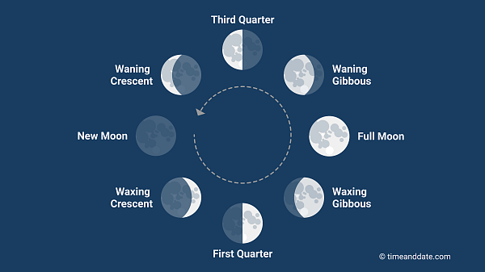
THE MOON
When the moon is between the earth and the sun we do not see it at all. This is called the new moon.
The different phases of moon are new moon, crescent moon, first quarter, gibbous moon and full moon.

Slide 4
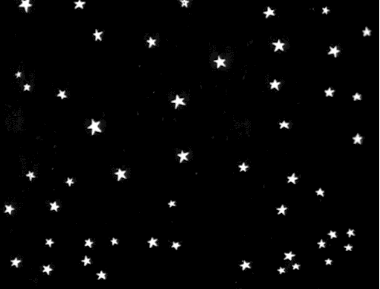
STARS
Most of the bright twinkling objects you see in the sky at night are stars.
Stars are huge balls of hot, burning gas.
They give out heat and light.

Slide 5
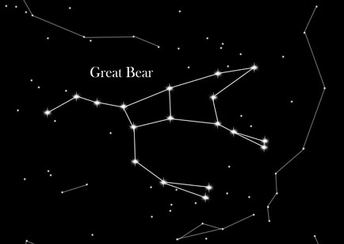
CONSTELLATIONS
Some of the stars appear to form beautiful pattern in the sky, such a group of stars is called a constellation.
Some of the constellation are easy to spot are Orion, the great bear and leo.
Constellation are usually named after people, animal, or famous characters in stories.

Slide 6
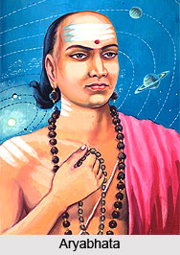
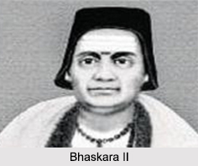
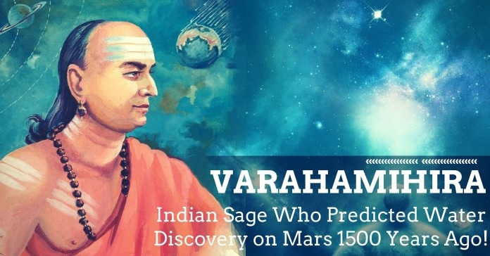
INDIAN ASTRONOMERS
Astronomers are people who study the sun, the moon, the stars and the planets.
Name of the astronomers are--
Aryabhata
Varahamihira
Bhaskara etc.

Slide 7
D. Answer the following
Why does the earth appear flat to us?
Ans: The earth appear flat to us because it is very big in size and we see only a tiny part of the huge earth. This tiny part appears flat to us.
2. What does the rotation of the earth cause?
Ans: The rotation of the earth causes day and night. It completes one rotation in about 24 hours.

Slide 8
C: Answer the following
3. The moon is visible in the sky because of the sun. how?
Ans: The moon is visible in the sky because of the sun. It has no light of its own and shines only because it reflects the light of the sun.
4. Name any three constellations.
Ans: Three constellations are Ursa Major, Scorpius and Orion.
5. Who are astronomers?
Ans- Astronomers are people who study the sun, the moon, the stars and the planets. The name of some astronomers are Aryabhata, Varahamihira and Bhaskara.

Slide 9

LEARNING OUTCOME:
The Learner will be able to know about:
long question answers of the chapter.

Slide 10

THANKING YOU
ODM EDUCATIONAL GROUP

