Slide 1


SESSION : 5
CLASS : 3
SUBJECT- SCIENCE
CHAPTER NUMBER: 11
CHAPTER NAME : OUR EARTH AND ITS NEIGHBOURS
SUBTOPIC : SHORT Q/A

Slide 2

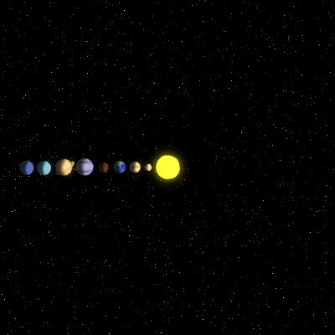
The solar system
The Earth move around the sun.
Like the Earth there are many other heavenly bodies move around the sun.
The sun and the eight planets that go around it form the solar system.
They are
mercury,
venus,
Earth
Mars
Jupiter
Saturn
Uranus
Neptune

Slide 3
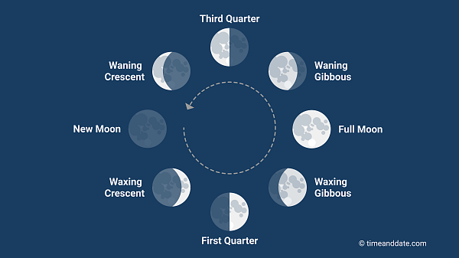
THE MOON
When the moon is between the earth and the sun we do not see it at all. This is called the new moon.
The different phases of moon are new moon, crescent moon, first quarter, gibbous moon and full moon.

Slide 4

STARS
Most of the bright twinkling objects you see in the sky at night are stars.
Stars are huge balls of hot, burning gas.
They give out heat and light.

Slide 5
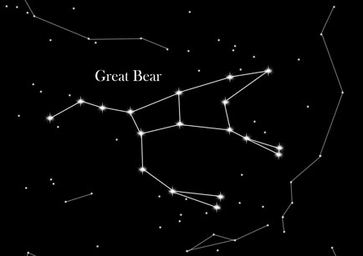
CONSTELLATIONS
Some of the stars appear to form beautiful pattern in the sky, such a group of stars is called a constellation.
Some of the constellation are easy to spot are Orion, the great bear and leo.
Constellation are usually named after people, animal, or famous characters in stories.

Slide 6
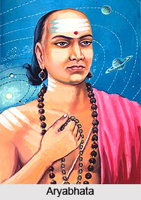
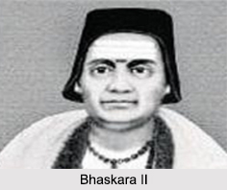

INDIAN ASTRONOMERS
Astronomers are people who study the sun, the moon, the stars and the planets.
Name of the astronomers are--
Aryabhata
Varahamihira
Bhaskara etc.

Slide 7

Short Q/A
A. Tick ( ) the correct answer
1. These do not have a light of their own.
a. stars b. planets c. stars and planets
2. This has a shape similar to the earth.
a. A football b. a shoebox c. a square table top
3. Constellations are the patterns formed by
a. planets b. stars c. moons
4. He was the first astronomer to inform the world that the earth is round.
a. Bhaskara b. Varahamihira c. Aryabhata

Slide 8
Short Q/A
B. Write the time taken for one
1. rotation of the earth on its axis
2. revolution of the earth around the sun
3. rotation of the moon around the earth
24 hours
365 ¼ days
27 1/3 days

Slide 9

LEARNING OUTCOME:
The Learner will be able to know about:
short question answers of the chapter.

Slide 10
HOME ASSIGNMENT
Draw the different phases of moon in project record.

Slide 11

THANKING YOU
ODM EDUCATIONAL GROUP

