Slide 1


SESSION : 3
CLASS : 3
SUBJECT: SCIENCE
CHAPTER NUMBER: 11
CHAPTER NAME: OUR EARTH AND ITS NEIGHBOURS
SUBTOPIC: THE SUN AND THE MOON

Slide 2

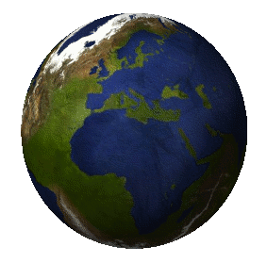
MOVEMENT OF THE EARTH

Slide 3
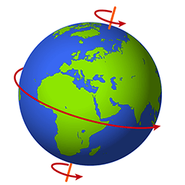
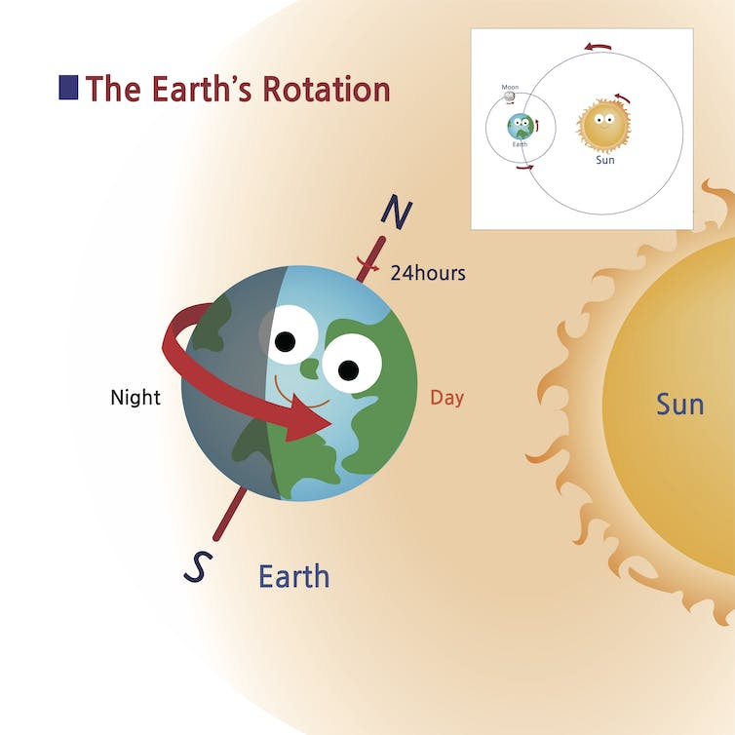
ROTATION
The earth move around the sun as well as on its axis.
This movement is called rotation.
The earth spins from west to east.
The earth completes one rotation in about 24 hours.
The other movement of earth is called its revolution.

Slide 4
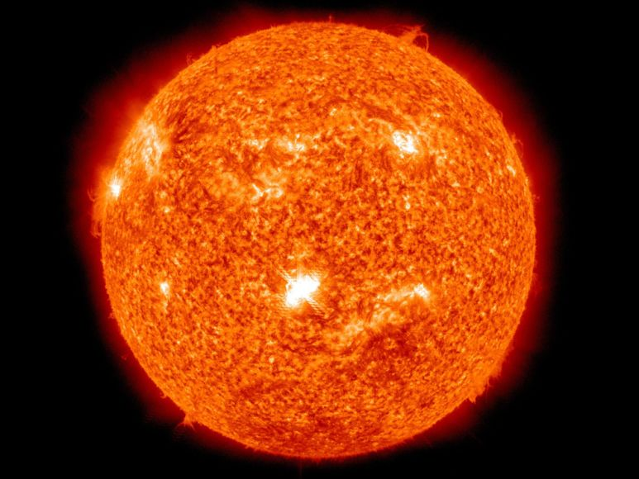
THE SUN
The sun is a very big ball of hot gases.
It has its own light and heat.
The earth and the other planets go round the sun.

Slide 5
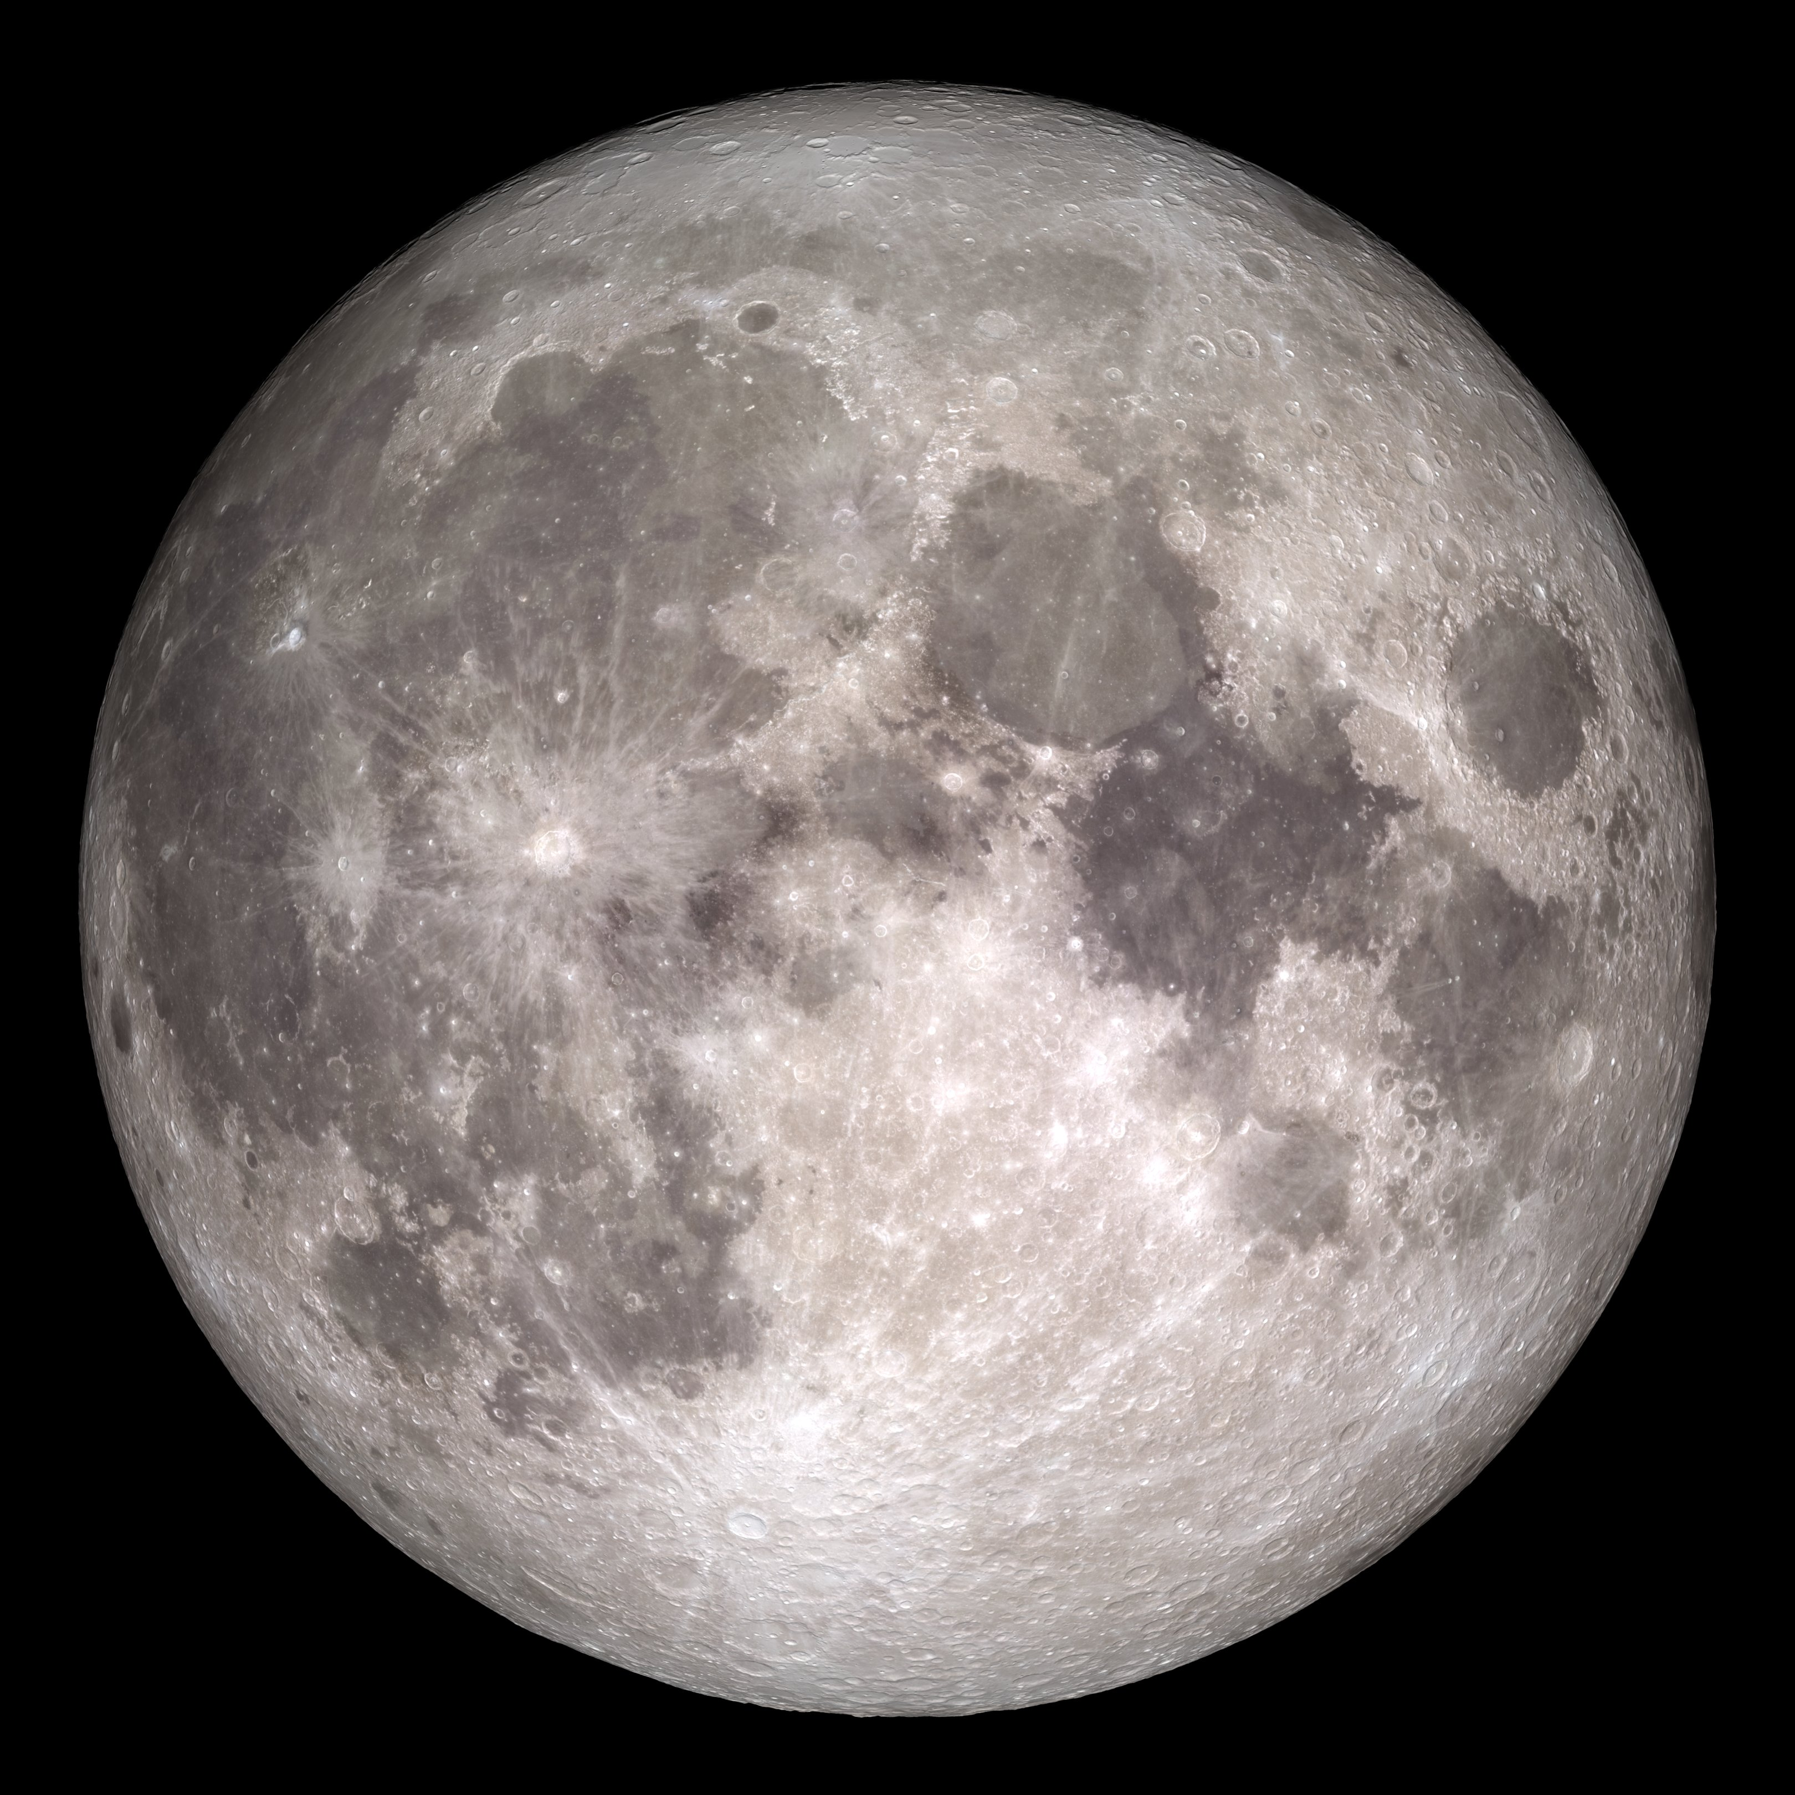
THE MOON
The moon is a natural satellite of earth because it moves around the earth.
The moon completes one rotation on its axis in 24 1/3 days.
It takes the same time to complete one revolution around the earth.

Slide 6
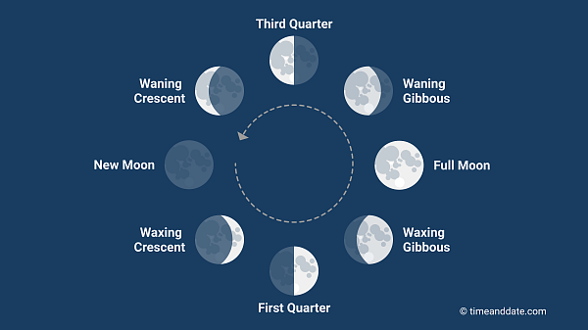
THE MOON
When the moon is between the earth and the sun we do not see it at all. This is called the new moon.
The different phases of moon are new moon, crescent moon, first quarter, gibbous moon and full moon.

Slide 7

Summary
The sun is a very big ball of hot gases.
It has its own light and heat.
The different phases of moon are new moon, crescent moon, first quarter, gibbous moon and full moon.

Slide 8
HOMEWORK
Do oral question of book page-97 in notebook.

Slide 9
Learning outcome
Learner will be able to know about--
the sun and moon
different phases of moon.

Slide 10
THANKING YOU
ODM EDUCATIONAL GROUP

