Slide 1


SESSION : 2
CLASS : 3
SUBJECT: SCIENCE
CHAPTER NUMBER: 11
CHAPTER NAME: OUR EARTH AND ITS NEIGHBOURS
SUBTOPIC: MOVEMENT OF THE EARTH

Slide 2

INTRODUCTION
LETS THINK SOME ANSWERS TO THE GIVEN QUESTIONS:-
WHICH IS THE MOST COMFORTABLE PLACE TO LIVE?
WHO TAKES CARE OF YOU ALL THROUGHOUT THE DAY?
STUDENTS, AS OUR PARENTS, SPECIALLY OUR MOTHER TAKES CARE OF US WHOLE DAY.
OUR EARTH IS ALSO CALLED OUR MOTHER, AS IT TAKES CARE OF US, FULFILLS OUR NEED.

Slide 3

MOVEMENT OF THE EARTH

Slide 4
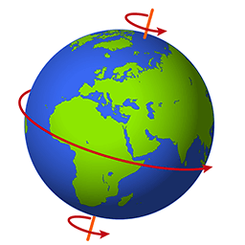
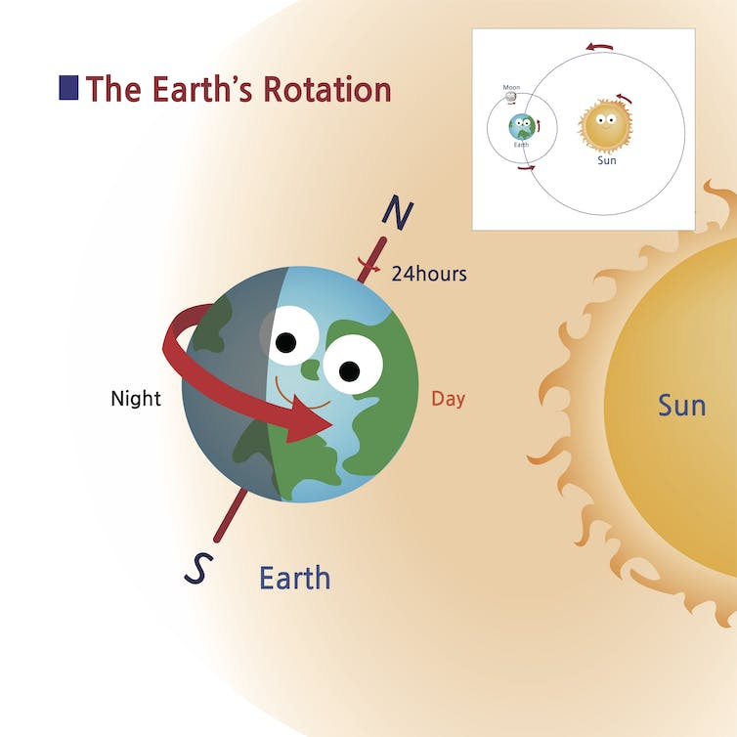
ROTATION
The earth move around the sun as well as on its axis.
This movement is called rotation.
The earth spins from west to east.
The earth completes one rotation in about 24 hours.
Thus, the rotation of the earth on its axis causes days and nights.

Slide 5
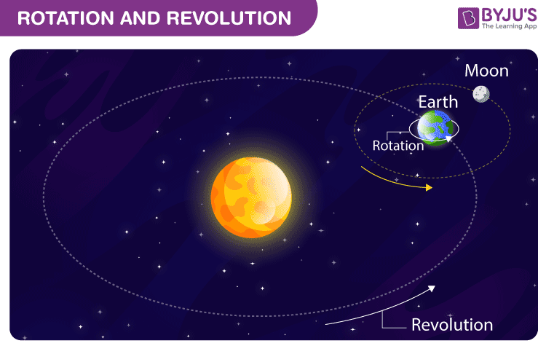
REVOLUTION
The other movement of earth is called its revolution.
While the earth spins on its axis it also goes around the sun in a fixed path is called orbit.
The time taken by the earth to complete one revolution around the sun is 365 ¼ days.

Slide 6

NEW WORDS
Earth
Neighbours
Planets
Reflect
Universe
Astronauts
Rotation
Revolution

Slide 7
Orbit
Satelite
Crescent
Gibbous
Constellation
Astronomers
Aryabhata
Varahamihira
Bhaskara
Jantar Mantar

Slide 8

Summary
The earth move around the sun as well as on its axis.
This movement is called rotation.
The other movement of earth is called its revolution.

Slide 9
Learning outcome
Learner will be able to know about--
the movement of the earth and
about rotation and revolution.

Slide 10
THANKING YOU
ODM EDUCATIONAL GROUP

