Slide 1


SESSION : 1
CLASS : 3
SUBJECT: SCIENCE
CHAPTER NUMBER: 11
CHAPTER NAME: OUR EARTH AND ITS NEIGHBOURS
SUBTOPIC: INTRODUCTION, PLANETS AND THE SHAPE OF
THE EARTH

Slide 2

INTRODUCTION
LETS THINK SOME ANSWERS TO THE GIVEN QUESTIONS:-
WHICH IS THE MOST COMFORTABLE PLACE TO LIVE?
WHO TAKES CARE OF YOU ALL THROUGHOUT THE DAY?
STUDENTS, AS OUR PARENTS, SPECIALLY OUR MOTHER TAKES CARE OF US WHOLE DAY.
OUR EARTH IS ALSO CALLED OUR MOTHER, AS IT TAKES CARE OF US, FULFILLS OUR NEED.

Slide 3
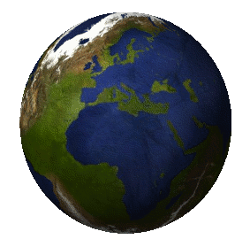
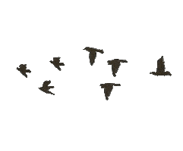
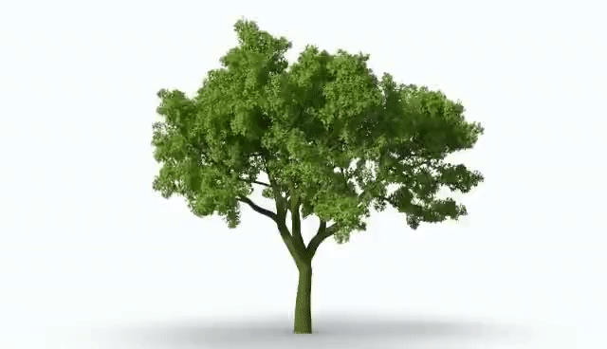
HOME FOR ALL LIVING THINGS
EARTH

Slide 4
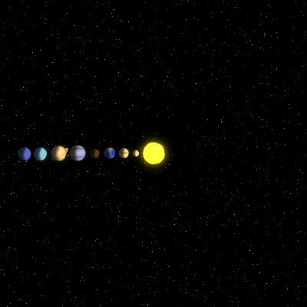
The solar system
The Earth move around the sun.
Like the Earth there are many other heavenly bodies move around the sun.
The sun and the eight planets that go around it form the solar system.
They are
mercury,
venus,
Earth
Mars
Jupiter
Saturn
Uranus
Neptune

Slide 5
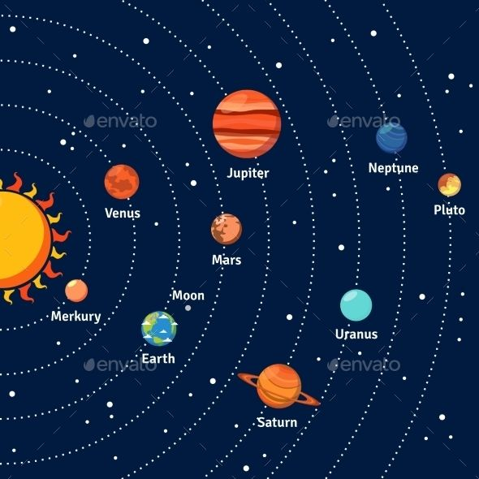
THE PLANETS

Slide 6
Easy way to remember the planets name.
My Very Energetic Mother Just Served Us Noodles.
My - Mercury
Very - Venus
Energetic - Earth
Mother - Mars
Just - Jupiter
Served - Saturn
Us - Uranus
Noodles - Neptune

Slide 7
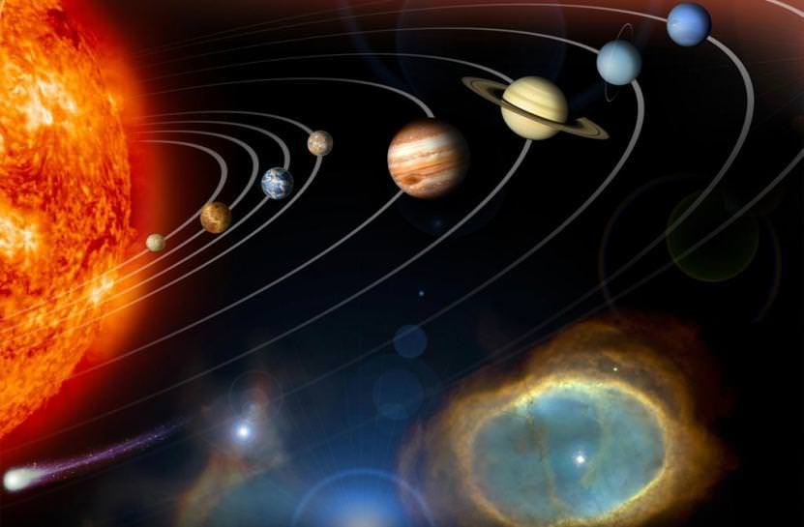
PLANET
A PLANET IS A CELESTIAL OR HEAVENLY BODY THAT GO AROUND A STAR.
PLANETS DO NOT HAVE LIGHT OR HEAT OF THEIR OWN.

Slide 8
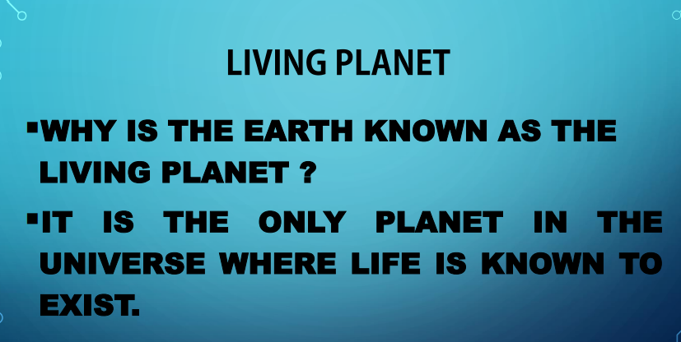
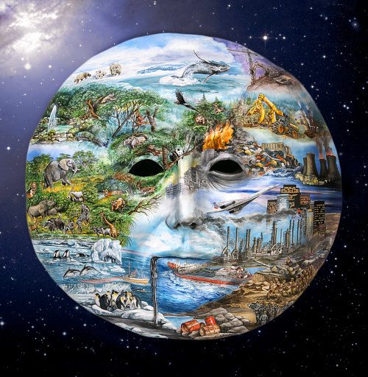

Slide 9
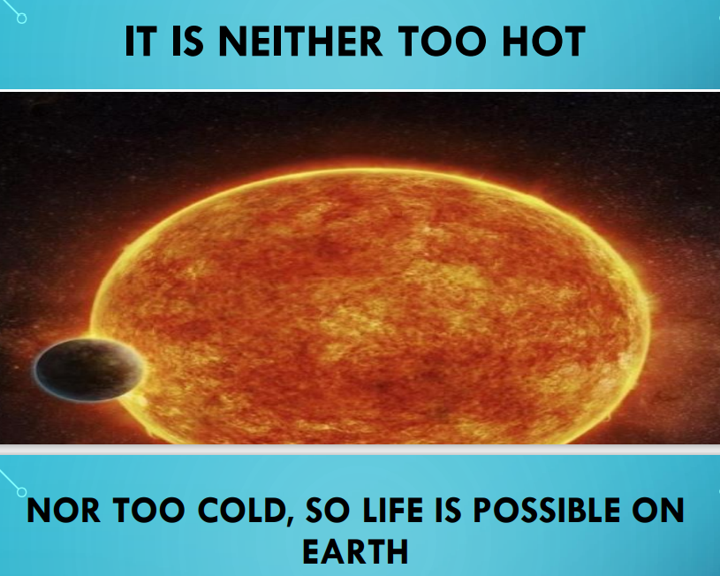

Slide 10

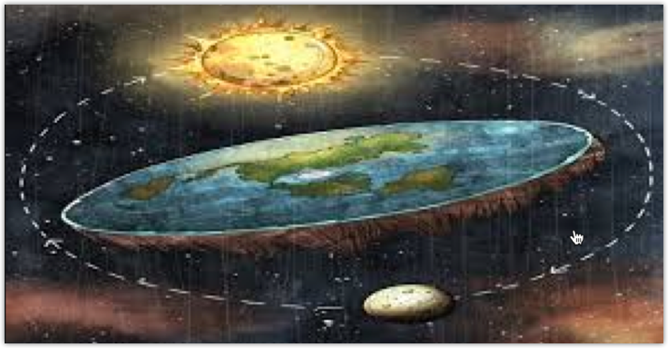
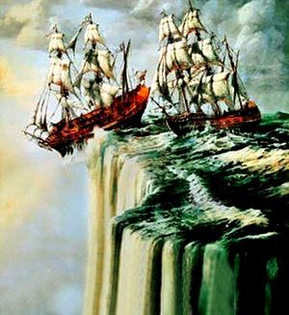
The Shape of the Earth
Long ago people used to think that the Earth was flat.
They feared that if they will travel, they will fall off from the edge.
People used to think that the Earth was flat and that they could fall the edge of the Earth

Slide 11
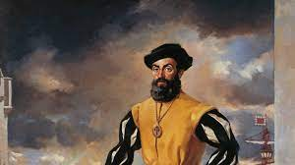
But is the Earth really flat?
About 500 years ago, Ferdinand Magellan, a Portuguese sailor, set with a fleet of ships on a long voyage from Spain.
He kept sailing in One direction. After three years, his ships reached the same place from where they had started.
Magellan proved that the Earth is round like a ball, not flat as people earlier thought.

Slide 12
QUIZ TIME
Q2.Our Earth is a planet.
Non-living
man-made
living
Ans- living

Slide 13
QUIZ TIME
Q1. What does the atmosphere consist of?
A. Air
B. Weather
C. Land
D. Planet
Ans- air

Slide 14
QUIZ TIME
Q3. During long ago, some people thought that the Earth was .
flat
square
triangle
Ans- flat

Slide 15

Summary
Earth is called unique planet.
Earth is called blue planet and living planet.
A layer of air surrounded the earth called atmosphere.

Slide 16
Learning outcome
Learner will be able to know
about the earth and different planets and
about the shape of the earth.

Slide 17
THANKING YOU
ODM EDUCATIONAL GROUP

