Slide 1


SESSION : 3
CLASS : 3
SUBJECT : MATHEMATICS
CHAPTER NUMBER: 7
CHAPTER NAME : GEOMETRY
SUBTOPIC : TANGRAMS

Slide 2
GEOMETRY
TANGRAMS
These are some 2 - D shapes?

Slide 3
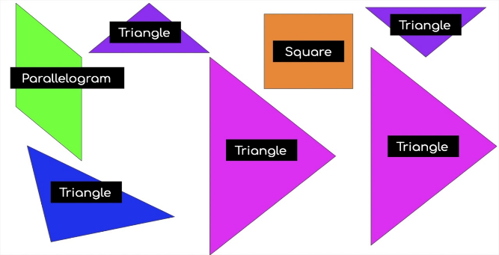
GEOMETRY
TANGRAMS
Can you name these shapes?

Slide 4
GEOMETRY
TANGRAMS
What is a tangram?
A Tangram is a puzzle or a tricky set of seven geometric shapes made up of two small triangles, one medium triangle, two large triangles (total five triangles), a square, and a parallelogram.

Slide 5
GEOMETRY
TANGRAMS
Now let us arrange and see?
2
4
1
5
6
3
7

Slide 6
GEOMETRY
TANGRAMS
Now let us make some shapes out of Tangrams.

Slide 7
GEOMETRY
TANGRAMS

Slide 8
GEOMETRY
TANGRAMS

Slide 9
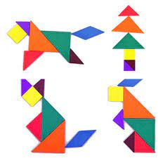
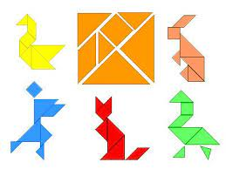
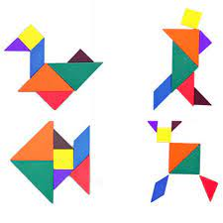
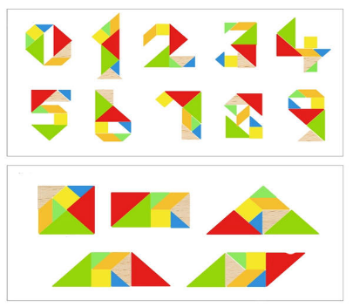

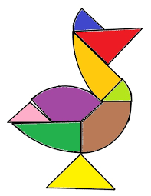


GEOMETRY
TANGRAMS
These are some of the shapes made using TANGRAMS

Slide 10

GEOMETRY
TANGRAMS
Exercise-7 B in the notebook.
M A T H S

Slide 11
GEOMETRY
TANGRAMS
Answer the following questions:
1) How many peices are there in a tangram puzzle ?
(a) 9 (b) 7 (c) 6 (d) 8
2) Which of the following is not a tangram pieces.
(a) (b) (c) (d)

Slide 12
GEOMETRY
TANGRAMS
3) How many triangles are there in a tangram puzzle ?
(a) 7 (b) 4 (c) 2 (d) 5
4) Tangrams originated in which of the following countries ?
(a) Europe (b) Japan (c) China (d) India
5) Which of the following is a tangram pieces?
(a) (b) (c) (d)

Slide 13

GEOMETRY
TANGRAMS
Class Work :
Exercise-7 B in the notebook.

Slide 14
LEARNING OUTCOME:
Children recognizes the 7 shapes that make a square. Learn about tangrams that are great tools for geometry, area, perimeter, and fractions. Practice and create shapes using Tangram pieces. Use problem solving skills to create animal Tangrams. Build fine motor skills.

Slide 15
THANKING YOU
ODM EDUCATIONAL GROUP

