Slide 1


SESSION : 2
CLASS : 3
SUBJECT : MATHEMATICS
CHAPTER NUMBER: 7
CHAPTER NAME : GEOMETRY
SUBTOPIC : 3-D SHAPES OR SOLIDS

Slide 2
GEOMETRY
3-D SHAPES OR SOLIDS
Can you name this 2-D shapes?
CIRCLE
OVAL

Slide 3
GEOMETRY
3-D SHAPES OR SOLIDS
TRIANGLE
RECTANGLE
SQUARE
HEXAGON
RHOMBUS

Slide 4
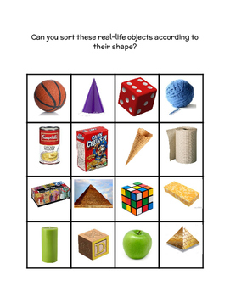
GEOMETRY
3-D SHAPES OR SOLIDS
These shapes are related to the3-D (three-dimensional) shapes. They are solid shapes that have three dimensions including length, depth and width.

Slide 5
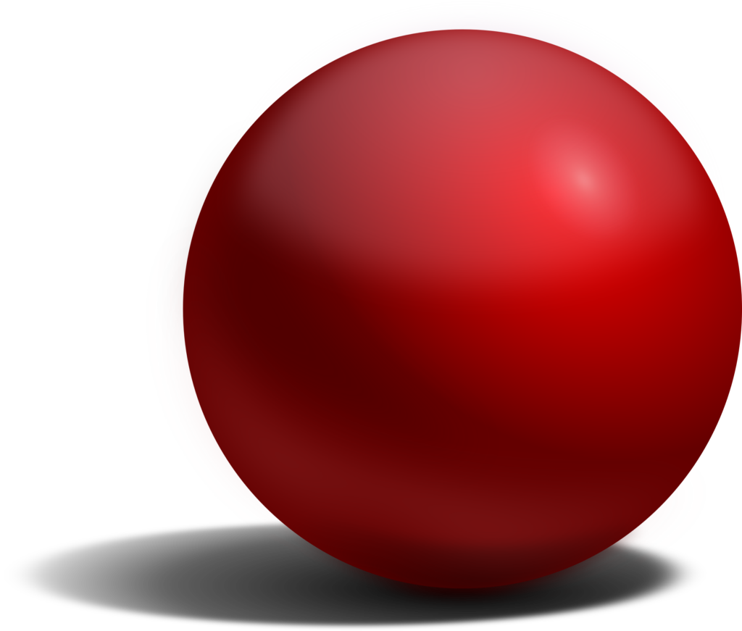
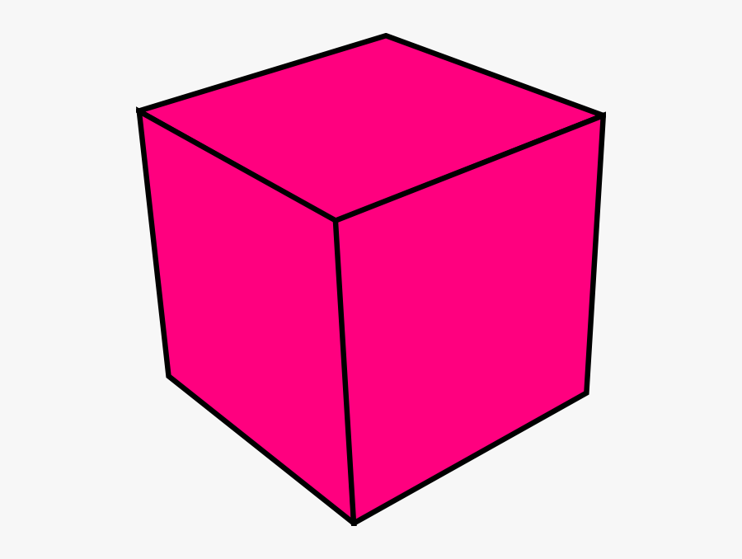
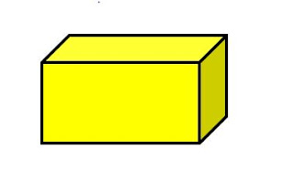
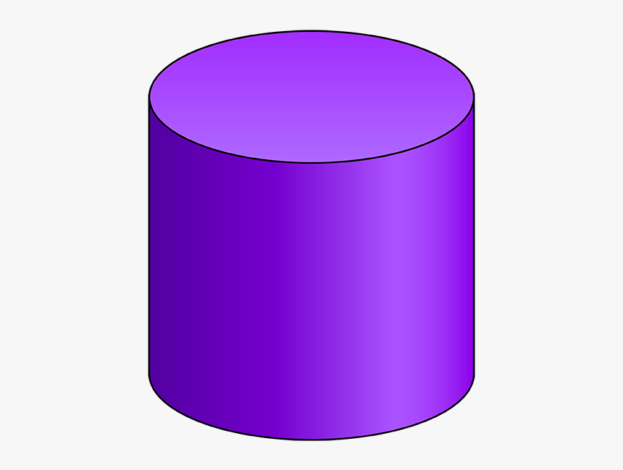
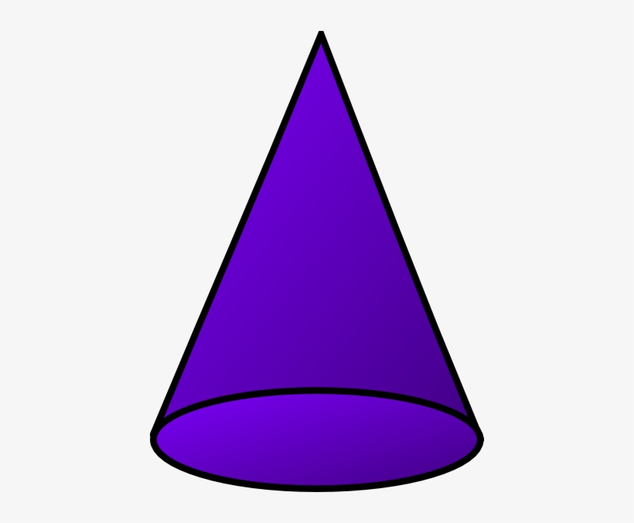
GEOMETRY
3-D SHAPES OR SOLIDS
3 - D Shapes
'3D', or 'three-dimensional', simply means that the shape is a solid object.
“Three Dimensional” means Length, Width and height.
Examples of 3-D shapes-
－ CUBE
－ CUBOID
－ SPHERE
－ CYLINDER
－ CONE

Slide 6
GEOMETRY
3-D SHAPES OR SOLIDS
KEY WORDS
FLAT FACES
CURVED FACES
STRAIGHT EDGES
CURVED EDGES
VERTEX (VERTICES)

Slide 7
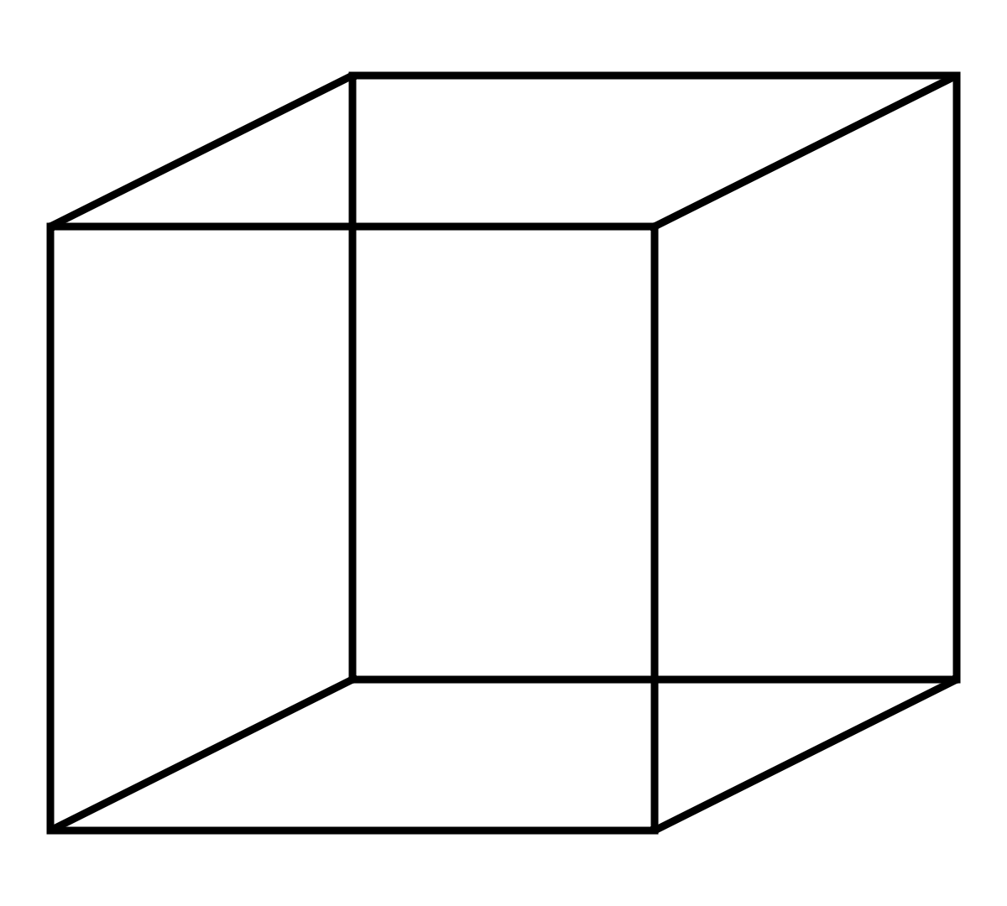
GEOMETRY
3-D SHAPES OR SOLIDS
Now let us see the 3 - D Shapes one by one in details.
VERTEX
CUBE
A Cube has 8 vertices, 12 edges and 6 faces. The faces are flat and edges are straight of a cube.
FLAT FACE
EDGE

Slide 8
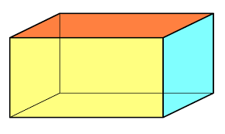
GEOMETRY
3-D SHAPES OR SOLIDS
FLAT FACE
VERTEX
A Cuboid has 8 vertices, 12 edges and 6 faces. The faces are flat and edges are straight of a cuboid.
EDGE
CUBOID

Slide 9
GEOMETRY
3-D SHAPES OR SOLIDS
CURVED SURFACE
A Sphere has only one curved surface.
SPHERE

Slide 10
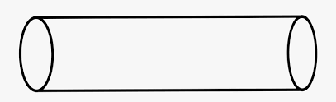
GEOMETRY
3-D SHAPES OR SOLIDS
CURVED SURFACE
A Cylinder has 2 curved edges and 3 faces.1 curved face and 2 flat faces are there of a cylinder.
FLAT SURFACE
EDGE

Slide 11
GEOMETRY
3-D SHAPES OR SOLIDS
CONE
VERTEX
A Cone has 1 vertex, 1 curved edge,1 flat face and 1 curved face.
CURVED SURFACE
EDGE
FLAT SURFACE

Slide 12
GEOMETRY
3-D SHAPES OR SOLIDS
Vertices
Straight edges
Curved edges
Flat faces
Curved faces
Cube
Cuboid
Sphere
Cylinder
Cone
SHAPES
8
8
0
0
1
12
12
0
0
0
0
0
0
2
1
6
6
0
2
1
0
0
1
1
1

Slide 13

GEOMETRY
3-D SHAPES OR SOLIDS
Exercise-7 A Q. No A
in the notebook.
M A T H S

Slide 14
GEOMETRY
3-D SHAPES OR SOLIDS
Answer the following :
1) Name of figures with only length and width ___________.
2-D shapes
2) Name a shape with 3 sides ________ .
triangle
3) Name the solid which has three faces ___________
cylinder
4) Name the solid with one vertex ___________.
cone

Slide 15
GEOMETRY
3-D SHAPES OR SOLIDS
5) Name the solid which has only one faces __________.
sphere
6) How many edges does a cube have _____.
12
7) Name a 2-D shape with no diagonals ________.
triangle
8) Name a solid with two faces ________.
Cone

Slide 16

GEOMETRYng 4-digit numbers
3-D SHAPES OR SOLIDS
Class Work :
Exercise-7 A Q. No A in the notebook.
Home Work :
Complete Exercise-7 A Q. No B in the
notebook.

Slide 17
LEARNING OUTCOME:
Children are confident to learn about shapes, learn to identify and understand what the different shapes are, as well as their parts are important concepts. Also be exposed to shapes in their environment in everyday life. Learn to see and interact with them everywhere daily. They need to be able to recognize shapes, verbalize what they see, and understand why they are there.

Slide 18
THANKING YOU
ODM EDUCATIONAL GROUP

