Slide 1


SESSION : 1
CLASS : 3
SUBJECT : MATHEMATICS
CHAPTER NUMBER: 7
CHAPTER NAME : GEOMETRY
SUBTOPIC : CURVED LINE, STRAIGHT LINE, 2-D SHAPES

Slide 2
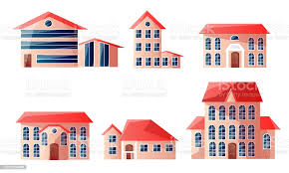
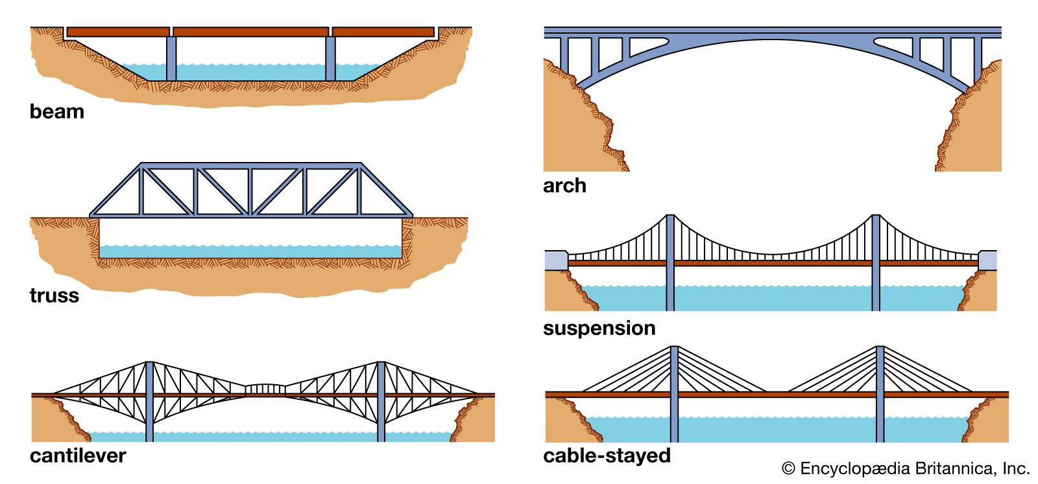
GEOMETRY
CURVED LINE, STRAIGHT LINE, 2-D SHAPES
Do you know what GEOMETRY mean???
Geometry is a branch of mathematics that deals with measurements and properties of different points, lines, surfaces, solids, angles and deals with some basic shapes. Geometry is a kind of mathematics that deals with shapes and figures. Geometry explains how to build or draw shapes, measure them, and compare them. People use geometry in many kinds of work, from building houses and bridges to planning space travel.

Slide 3
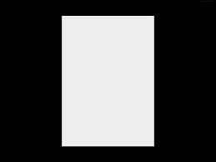
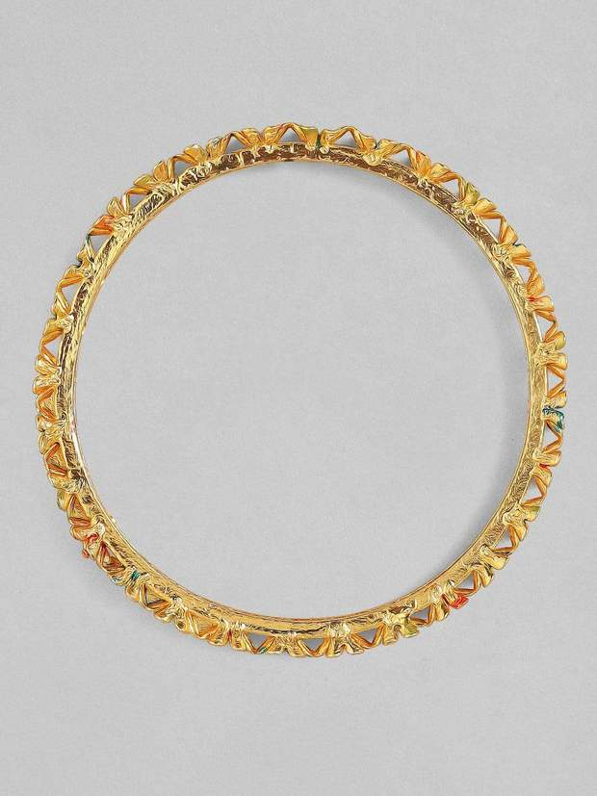
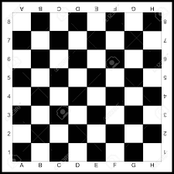

GEOMETRY
CURVED LINE, STRAIGHT LINE, 2-D SHAPES
A SHEET OF PAPER
BANGLE
CLOCK
CHESS BOARD
Now tell me the shape of each object......................
Can you say whether it is having straight line or curved line..........
STRAIGHT LINE, CURVED LINE, CURVED LINE, STRAIGHT LINE

Slide 4
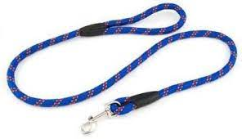
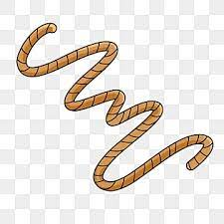
GEOMETRY
CURVED LINE, STRAIGHT LINE, 2-D SHAPES
What are these?
These are ropes. They are forming curves.
Curved Line
A smoothly bent line which is not straight is called a Curved Line.

Slide 5
GEOMETRY
CURVED LINE, STRAIGHT LINE, 2-D SHAPES
Straight Line
The shortest line that joins any two points is called a Straight Line.

Slide 6
GEOMETRY
CURVED LINE, STRAIGHT LINE, 2-D SHAPES
2 - D Shapes
'2D', or 'two-dimensional', simply means that the shape is flat.
“Two Dimensional” means Length and Width
Examples of 2-D shapes-
－ TRIANGLE
－ SQUARE
－ RECTANGLE
－ CIRCLE
－ RHOMBUS
－ HEXAGON
－ OVAL

Slide 7
GEOMETRY
CURVED LINE, STRAIGHT LINE, 2-D SHAPES
KEY WORDS
CORNER OR VERTEX (VERTICES)
DIAGONALS
STRAIGHT LINES
CURVED LINES
SIDES

Slide 8

GEOMETRY
CURVED LINE, STRAIGHT LINE, 2-D SHAPES
Book page 90 in notebook.
M A T H S

Slide 9
GEOMETRY
CURVED LINE, STRAIGHT LINE, 2-D SHAPES
Now let us see the 2 - D Shapes one by one in details.
TRIANGLE
CORNER OR VERTEX
A Triangle has 3 sides. Sides may be equal and also may not. There are 3 vertices in a triangle.
SIDES

Slide 10
GEOMETRY
CURVED LINE, STRAIGHT LINE, 2-D SHAPES
Now let us see the 2 - D Shapes one by one in details.
SQUARE
DIAGONALS
A Square has 4 equal sides and all the angles formed are right angles.There are 4 vertices in a square and has 2 diagonals.
SIDES
CORNER OR VERTEX

Slide 11
GEOMETRY
CURVED LINE, STRAIGHT LINE, 2-D SHAPES
RECTANGLE
A Rectangle has 4 equal sides and all the angles formed are right angles.There are 4 vertices in a rectangle and has 2 diagonals.
DIAGONALS
SIDES
CORNERS OR VERTICES

Slide 12
GEOMETRY
CURVED LINE, STRAIGHT LINE, 2-D SHAPES
A Rhombus has 4 equal sides but all the angles formed are not right angles.There are 4 vertices in a rhombus and has 2 diagonals.
CORNERS OR VERTICES
SIDES
DIAGONALS
RHOMBUS

Slide 13
GEOMETRY
CURVED LINE, STRAIGHT LINE, 2-D SHAPES
The 2 - D Shapes with no corners, sides or diagonals.
CIRCLE
OVAL

Slide 14
GEOMETRY
CURVED LINE, STRAIGHT LINE, 2-D SHAPES
Vertices
Sides
Diagonals
Straight Lines
Curved Lines
Square
Rectangle
Rhombus
Triangle
Hexagon
Circle
Oval
SHAPES
4
4
4
3
6
0
0
4
4
4
3
6
0
0
2
2
2
0
3
0
0
4
4
4
3
6
0
0
0
0
0
0
0
1
1

Slide 15

GEOMETRY
CURVED LINE, STRAIGHT LINE, 2-D SHAPES
Class Work :
Book page 89 and 90

Slide 16
LEARNING OUTCOME:
Children are confident learn about the need for geometry, identify various geometric shapes, know the concept of geometry, learn to identify, name, and describe 2-dimensional shapes, sort shapes into categories based on their attributes, draw various shapes and compare and contrast shapes.

Slide 17
THANKING YOU
ODM EDUCATIONAL GROUP

