Slide 1


SESSION : 22
CLASS : 3
SUBJECT : MATHEMATICS
CHAPTER NUMBER: 5,6
CHAPTER NAME : CH - 5 MULTIPLICATION AND CH - 6 DIVISION
SUBTOPIC : ORAL REVISION (MULTIPLICATION TABLES 10 TO 16)

Slide 2
LEARNING OBJECTIVE :
To know how far the students have acquired the knowledge related to different topics from the three chapters and make them ready for their half yearly evaluation.

Slide 3

CH - 5 MULTIPLICATION, CH - 6 DIVISION
ORAL REVISION WORK
ORAL REVISION WORK

Slide 4













MULTIPLICATION TABLE- 10 to 16
11 x 5
10 x 9
14 x 5
55
12 x 8
70
90
96
12 x 7
84
11 x 4
16 x 4
44
14 x 2
13 x 2
64
28
26
13 x 9
117

Slide 5
MULTIPLICATION TABLE- 10 to 16
11 x 7
77
12 x 9
20
42
108
10 x 2
14 x 3
14 x 6
13 x 6
84
78

Slide 6
MULTIPLICATION TABLE- 10 to 16
Find out the answer and colour the grid accordingly:
a) 12 x 4 = ____ (red)
b) 15 x 5 = ____ (yellow)
c) 16 x 2 = ____ (blue)
d) 13 x 3 = ____ (green)
e) 15 x 9 = ____ (pink)
f) 14 x 7 = ____ (brown)
g) 12 x 6 = ____ (purple)
h) 13 x 8 = ____ (orange)
104
104 | 14 | 126 | 30 | 98
22 | 15 | 32 | 19 | 39
17 | 48 | 120 | 35 | 135
72 | 31 | 133 | 41 | 37
42 | 11 | 75 | 29 | 22
98
48
M
A
T
H
S
75
32
39
32
39
48
135
135
72
98
72
75
104

Slide 7

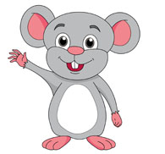
MULTIPLICATION TABLE- 10 to 16
16 x 5
13 x 7
15 x 6
15 x 8
11 x 3
90
80
91
33
120
M
A
T
H
S
12 x 2
14 x 4
24
56
14 x 9
16 x 7
126
112
15 x 3
45

Slide 8
MULTIPLICATION TABLE- 10 to 16
MULTIPLICATION TABLES 16
36
80
3
8
12
10
96
16
6
15
13
2
30
4
52

Slide 9

CH - 5 MULTIPLICATION, CH - 6 DIVISION
ORAL REVISION WORK
Class Work :
Oral revision work
Home Work :
Revise for half yearly exam

Slide 10
LEARNING OUTCOME:
Cildren are able to solve sums orally related to the chapters and we are able to know the understanding ability of the students and how far they are ready to appear for their test.

Slide 11
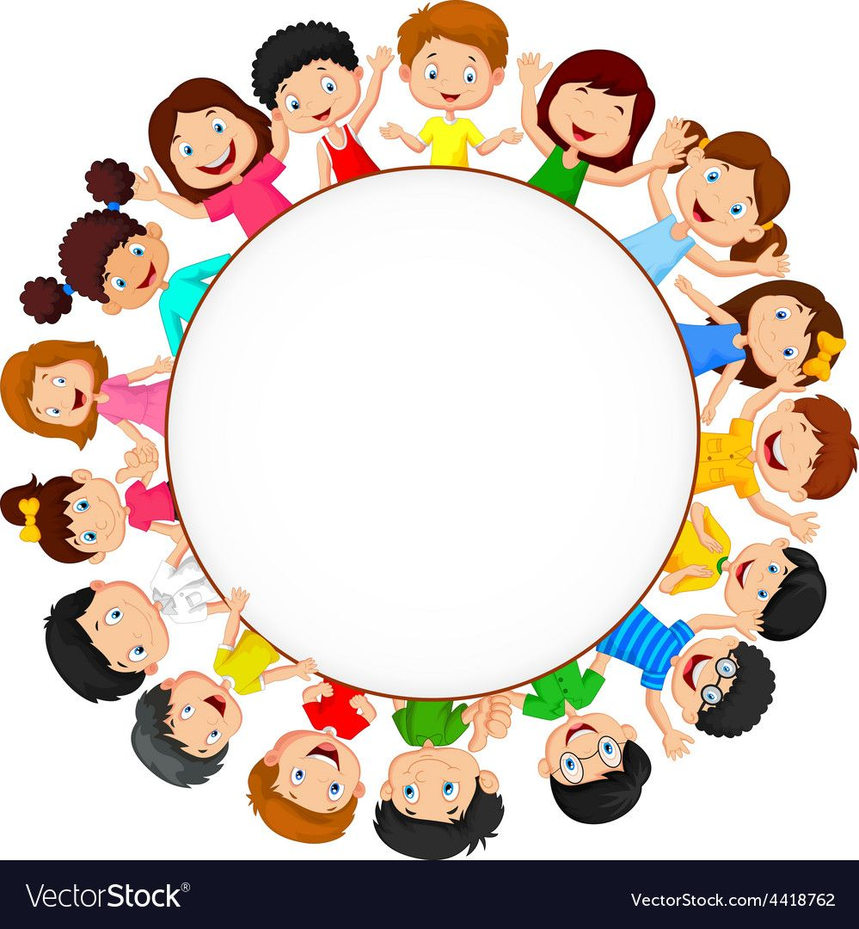
THANKING YOU
ODM EDUCATIONAL GROUP
THANKING YOU
ODM EDUCATIONAL GROUP

