Slide 1


SESSION : 6
CLASS : III
SUBJECT : ENGLISH
CHAPTER NUMBER: 2
CHAPTER NAME : MY LITTLE TED
SUBTOPIC : GRAMMAR JUNCTION

Slide 2
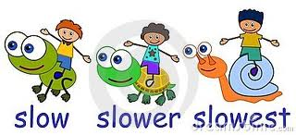
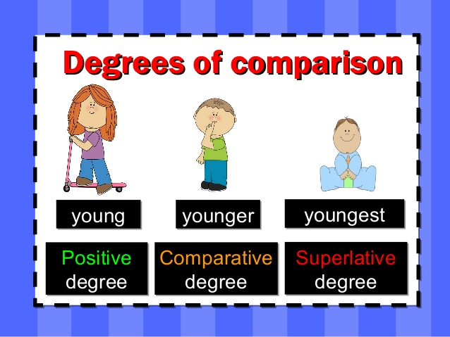
MY LITTLE TED (GRAMMAR JUNCTION)

Slide 3
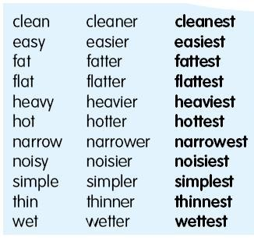
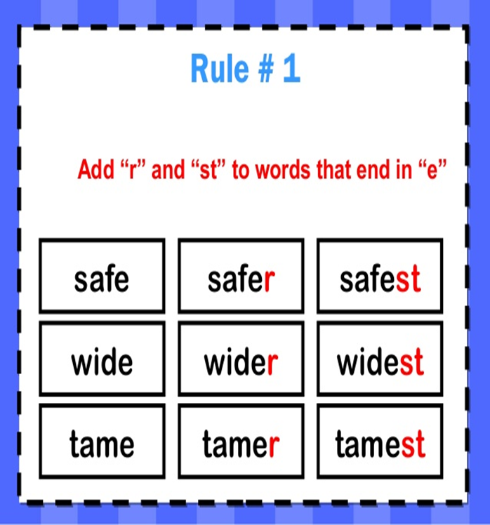

Slide 4
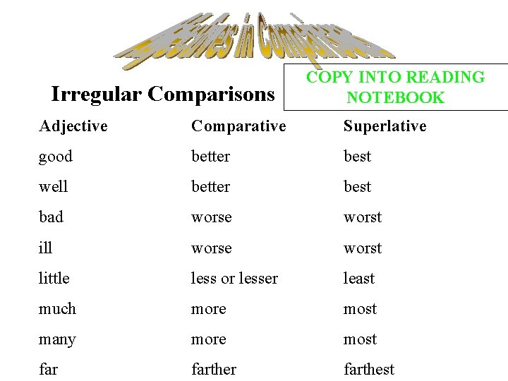

Slide 5
Look at the underlined words in the following sentences and identify the degree of adjective used. Write P for positive, C for comparative and S for superlative degree.
The red dress is cheaper than the black one.
I am the tallest girl in my class.
The teacher asked who is the bravest in the class.
This path is very narrow.
This story is funnier than the one you told me.
ANSWER
Cheaper – C
Tallest – S
Bravest – S
Narrow – P
Funnier – C

Slide 6
MY LITTLE TED
GRAMMAR JUNCTION
2. Fill in the blanks with correct words from brackets.
a) The cheetah is the_________(faster/fastest) animal.
b) Seema is _________ (wiser/wisest) than Sheetal.
c) Sunny is a _________(brave/braver) boy.
d) This is the __________ (beautiful/most beautiful) painting I have ever seen.
e) The lion’s cage is the __________ (clean/cleanest) of all in the zoo.
ANSWER
a) The cheetah is the fastest animal.
b) Seema is wiser than Sheetal.
c) Sunny is a brave boy.
d) This is the most beautiful painting I have ever seen.
e) The lion’s cage is the cleanest of all in the zoo.

Slide 7
MY LITTLE TED
3. Rewrite the sentences using the correct form of the adjectives.
a) Ruhi visited the larger garden in the city with her grandparents.
b) The white boat is most beautiful than the blue boat.
c) The soldiers were tired as they had marched through the hotter desert in the country.
d) Going to an adventure camp is gooder than going on a picnic.
e) Ronith’s house is more far than Nitin’s, but Sangeeth’s house is the most far.
ANSWER
a) Ruhi visited the largest garden in the city with her grandparents.
b) The white boat is more beautiful than the blue boat.
c) The soldiers were tired as they had marched through the hottest desert in the country.
d) Going to an adventure camp is better than going on a picnic.
e) Ronith’s house is more far than Nitin’s, but Sangeeth’s house is the most far.

Slide 8

HOME ASSIGNMENT
Do Book pg – no 21 Q. No -2 Fill in the blanks with correct words from brackets in English notebook.

Slide 9
LEARNING OUTCOME:
Students are able to use the correct form of adjectives in their language.

Slide 10
THANKING YOU
ODM EDUCATIONAL GROUP

