Slide 1


SESSION : 6
CLASS : III
SUBJECT : ENGLISH
CHAPTER NUMBER: 6
CHAPTER NAME : THE ANT EXPLORER
SUBTOPIC : GRAMMAR JUNCTION – PREPOSITION OF MOVEMENT,

Slide 2
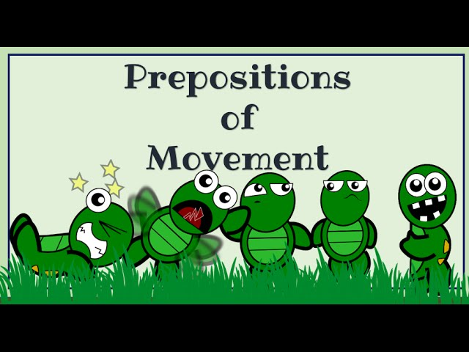

Slide 3
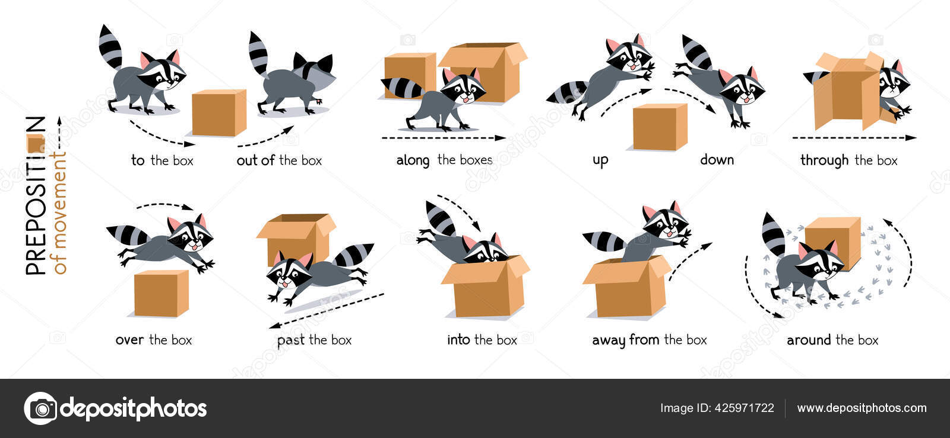

Slide 4



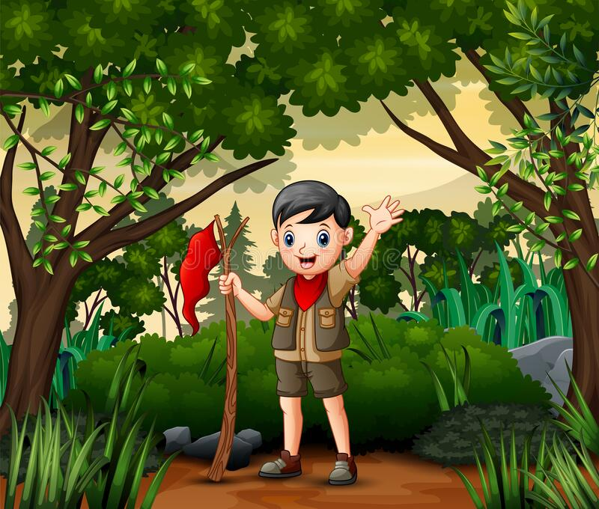
1. Match the pictures in column A to the sentences in column B.
A | B
 | Sridhar is riding a bicycle along the bank of the river.
 | The girl is walking across the street with her dog.
 | Arun is hiking through the forest.
 | The children are dancing around the tree.

Slide 5
GRAMMAR JUNCTION
2.Select the correct preposition from the bracket to complete the sentences.
a)The Ganga flows through Bengal.
b)Shyam ran around the play ground.
c)It’s dangerous to walk across the street when there is no zebra crossing.
d)Karan jumped over the wall to open the gate.
e)She walked along the bridge.

Slide 6
LEARNING OUTCOME:
Students use the preposition of movement correctly in a sentence .

Slide 7
THANKING YOU
ODM EDUCATIONAL GROUP

