Slide 1


SESSION : 7
CLASS : III
SUBJECT : ENGLISH
CHAPTER NUMBER: 5
CHAPTER NAME : GULLIVER’S TRAVELS
SUBTOPIC : GET GOING – FIND THE ANSWERS FROM THE STORY

Slide 2
LEARNING OBJECTIVE :
The students will recapitulate the topic and be able to answer the questions.

Slide 3
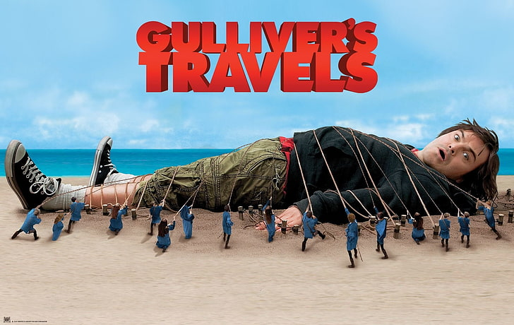
Notes:
Some

Slide 4

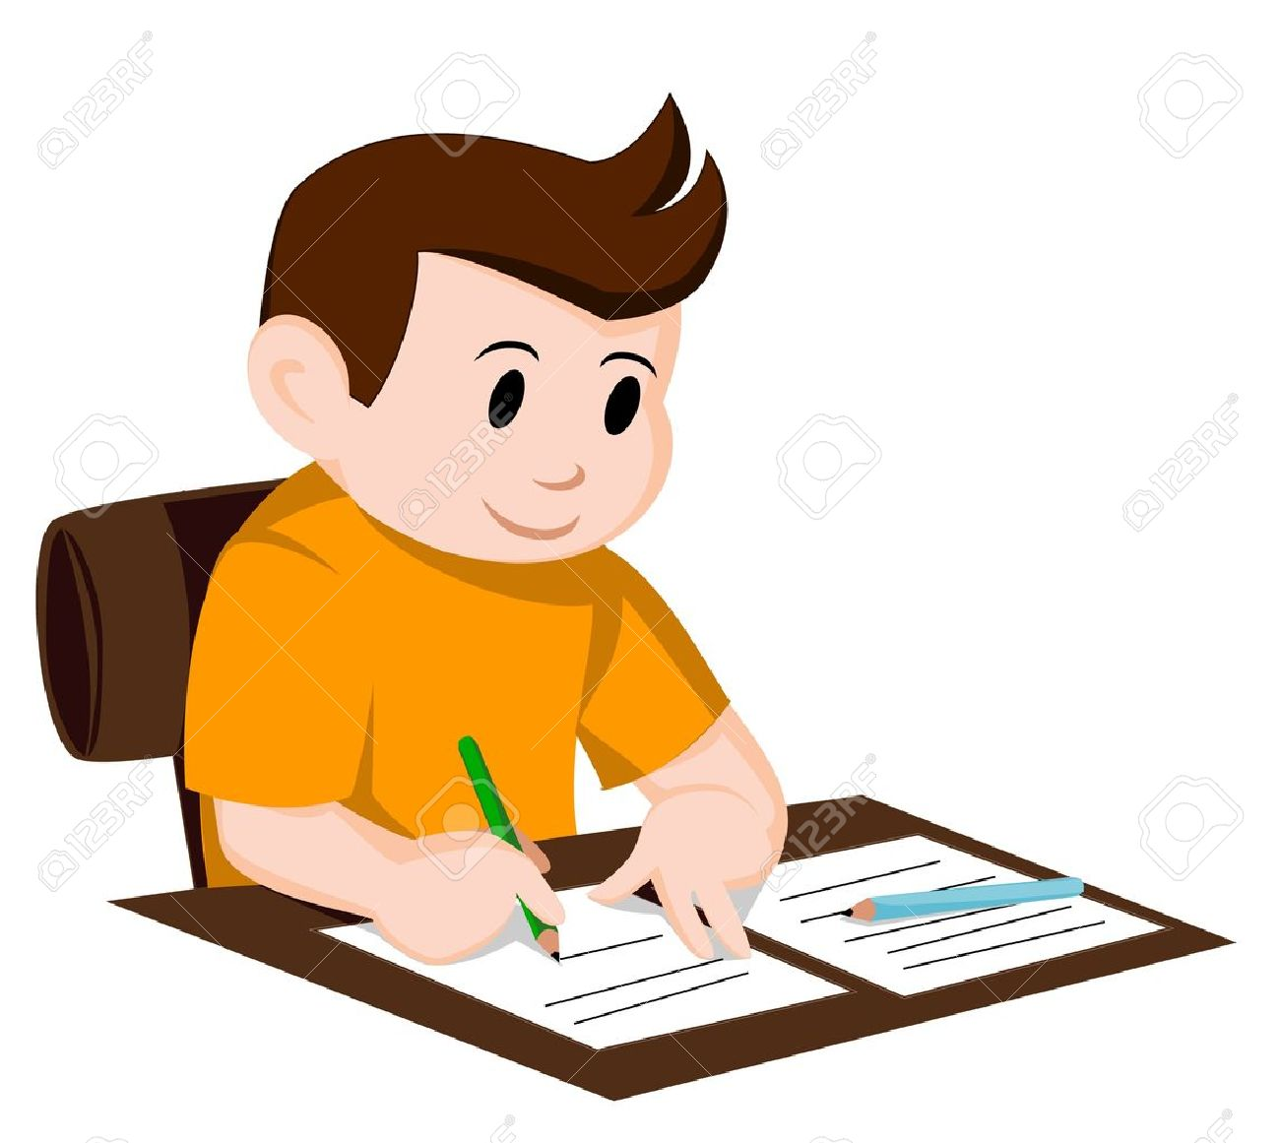
C.W
14/9/21
Answer the following questions
1. Who was Gulliver? What happened to his ship?
2. How did Gulliver reach the island?
3. Why did Gulliver fall asleep?
A- Gulliver was a sailor. A violent storm destroyed his ship.
A- Gulliver reached the island by swimming for a long time in the sea.
A- Gulliver fell asleep because he was so tired.

Slide 5
4. What was strange about the people of the island?
5. Why did Gulliver stay still when the men attacked him?
6. What promise did Gulliver make to the king?
A –The people of the island were no larger than his thumb.
A- Gulliver stayed still because he did not want to hurt them back.
A- Gulliver promised the king that he would not harm any Lilliputians.

Slide 6
7. Why did the king send for Gulliver?
8. How did Gulliver help the king?
A – The king sent for Gulliver to help in the war with its neighbouring island Blefuscu.
A- Gulliver walked into the sea, took a long rope, tied all the hundred ships together
and dragged them across the water for the whole day in the war.

Slide 7
LEARNING OUTCOME :
The students recapitulate and learns to answer the questions .

Slide 8
THANKING YOU
ODM EDUCATIONAL GROUP

