Slide 1


SESSION : 5
CLASS : III
SUBJECT : ENGLISH
CHAPTER NUMBER: 10
CHAPTER NAME : AUXILIARY VERBS
SUBTOPIC : RECAPITULATION AND EXERCISE – 2, 3

Slide 2

AUXILIARY VERBS

Slide 3
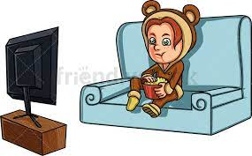
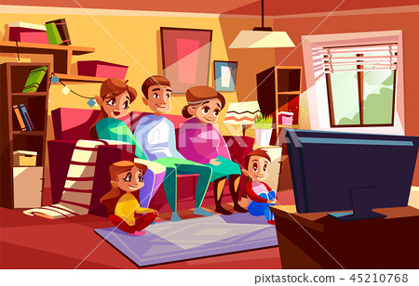
An auxiliary verb is often paired with the main verb to form the
tense.
AUXILIARY VERB | PRESENT TENSE | PAST TENSE
be | Singular – am, is Examples : I am watching a movie. He is watching a movie.
be
Singular – was
Examples :
I was watching a movie.
He was watching a movie.
Plural – are
Examples :
We are watching a movie.
They are watching a movie.
Plural – were
Examples :
We were watching a movie.
They were watching a movie.

Slide 4
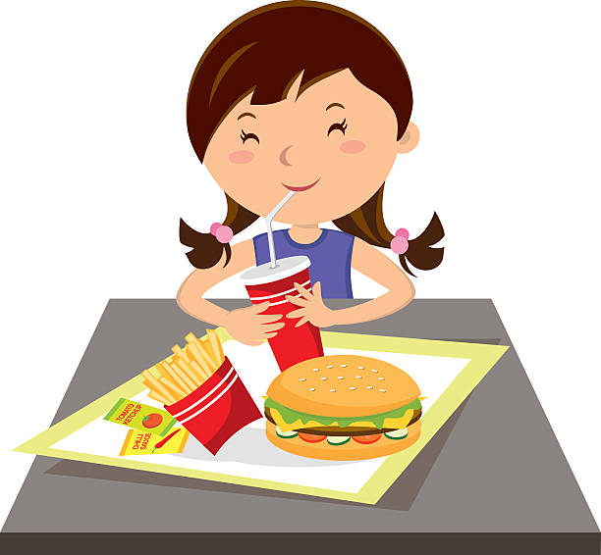
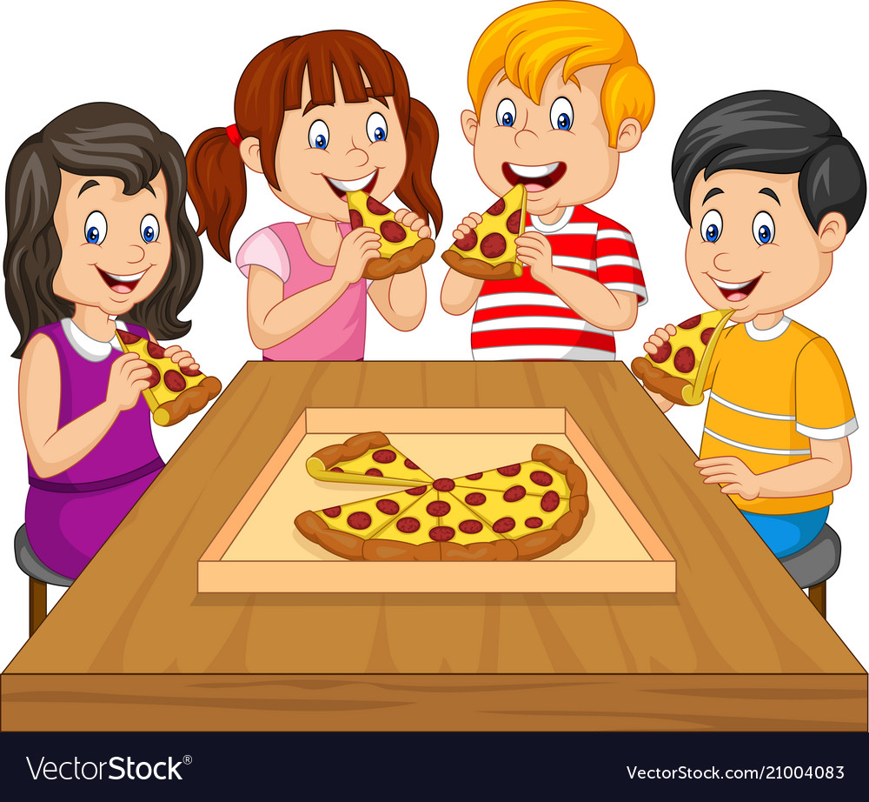

The auxiliary verb do helps to ask question.
AUXILIARY VERB | PRESENT TENSE | PAST TENSE
do
do
Singular – does
Examples :
He does not eat pizza.
She does not eat pizza.
Singular & Plural – did
Examples :
Did you eat pizza?
Did they eat pizza?
Personal & Plural – do
Examples :
I do not eat pizza.
You do not eat pizza.
They do not eat pizza.

Slide 5



The auxiliary verb have is used to indicate that an action is complete.
AUXILIARY VERB | PRESENT TENSE | PAST TENSE
have
have
Singular – has
Examples :
Sriya has completed all the work.
Raj has completed all the work.
Singular & Plural – had
Examples :
She had completed all work.
You had completed all the work.
They had completed all the work.
Personal & Plural – have
Examples :
I have completed all the work.
You have completed all the work.
They have completed all the work.

Slide 6
2. Circle the correct auxiliary verbs in the given sentences.
a) I am / is / are going to the market now.
b) Mercedes cars have / are / is made in Germany.
c) America have / has / was discovered by Christopher Columbus.
d) They have / will / should thought about this for quite some time.
e) Did / Are / Was you open that huge wooden box that your aunt brought for you?

Slide 7
3. The auxiliary verbs in the following sentences are used incorrectly.
Correct them and rewrite the sentences.
They was going to the exhibition.
_____________________________
b) She were a shy girl.
______________________________
c) You does not understand.
_______________________________
d) Sreelal have a lot of toys.
_______________________________
They were going to the exhibition.
She was a shy girl.
You do not understand.
Sreelal has a lot of toys.

Slide 8
e) I does not understand this chapter.
___________________________________
f) I am finished my homework.
____________________________________
g) Neeti do not come to play today.
____________________________________
h) You was not well yesterday.
____________________________________
I did not understand this chapter.
I have finished my homework.
Neeti did not come to play today.
You were not well yesterday.

Slide 9

HOMEWORK
Do pg - 52 Exercise – 4 in grammar book.

Slide 10
LEARNING OUTCOME:
Students were able to know about the auxiliary verb.
They are able to identify and rewrite the sentences correctly.

Slide 11
THANKING YOU
ODM EDUCATIONAL GROUP

