Slide 1


SESSION : 4
CLASS : III
SUBJECT : ENGLISH
CHAPTER NUMBER: 10
CHAPTER NAME : AUXILIARY VERBS
SUBTOPIC : INTRODUCTION AND EXERCISE – 1

Slide 2
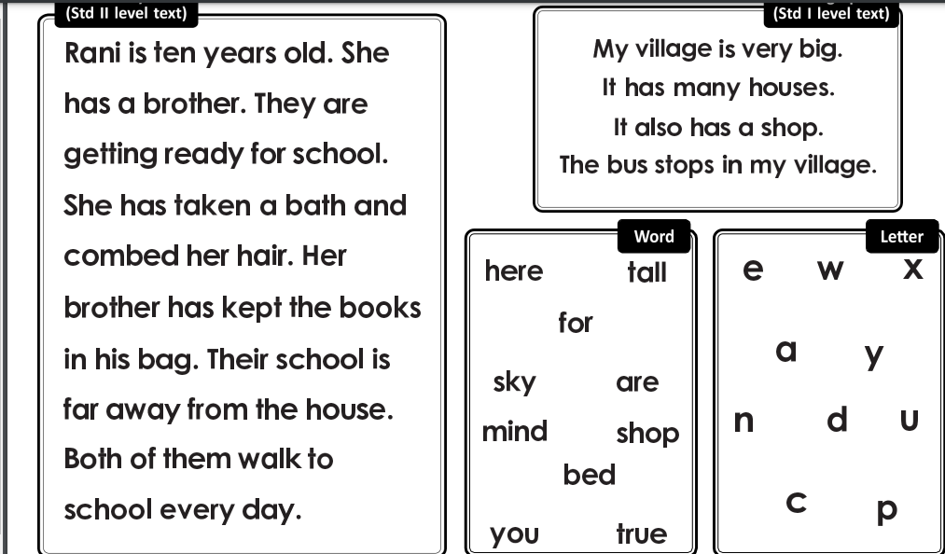
READING ASSESSMENT

Slide 3
READING ASSESSMENT

Slide 4
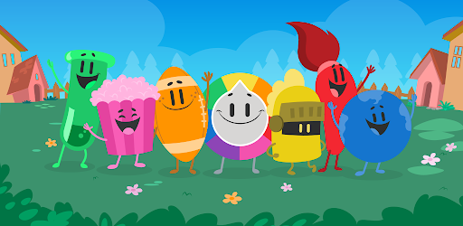
LET’S HAVE FUN WITH AN
ON-LINE GAME

Slide 5

AUXILIARY VERBS

Slide 6

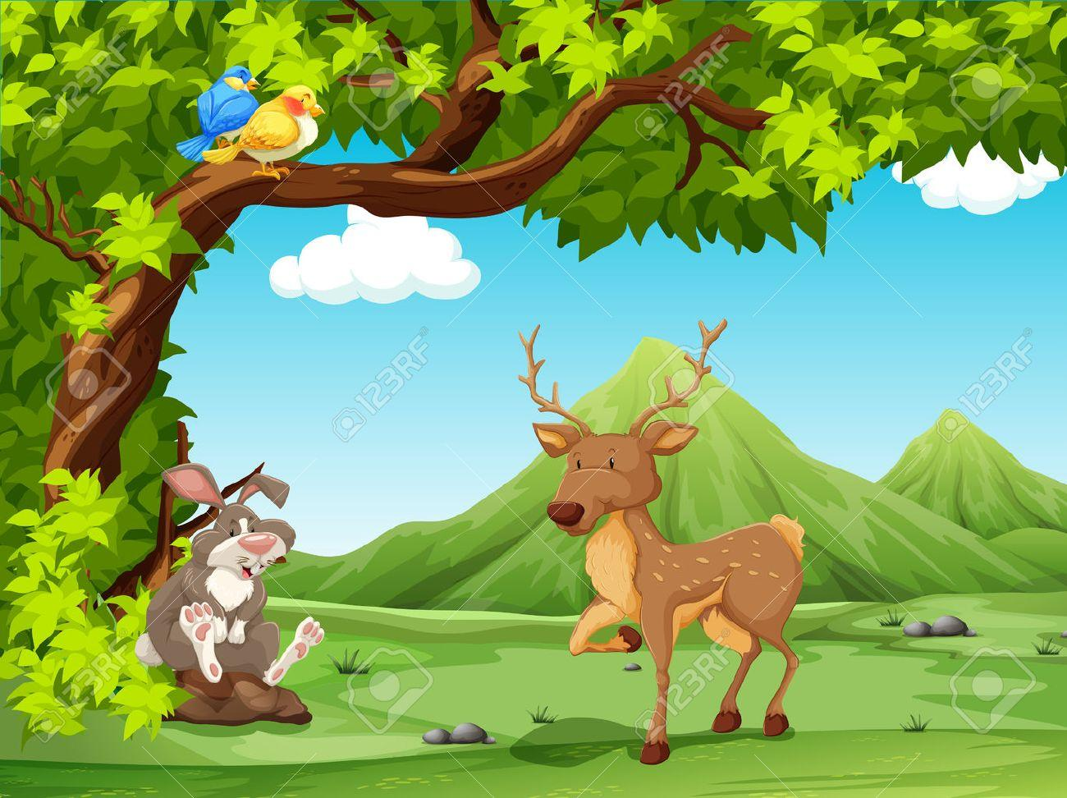
Read these sentences :
The words in red in the sentences - is, are and have – are called auxiliary verbs.
Auxiliary verbs are also called helping verbs.
The sun is shining and the birds are singing.
The other animals are relaxing
in the shade of the trees.
The mother is looking for her baby.
We have read all about the birds and animals.

Slide 7
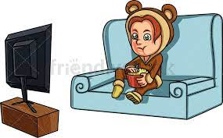
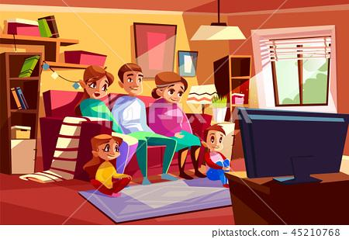
An auxiliary verb is often paired with the main verb to form the
tense.
AUXILIARY VERB | PRESENT TENSE | PAST TENSE
be | Singular – am, is Examples : I am watching a movie. He is watching a movie.
be
Singular – was
Examples :
I was watching a movie.
He was watching a movie.
Plural – are
Examples :
We are watching a movie.
They are watching a movie.
Plural – were
Examples :
We were watching a movie.
They were watching a movie.

Slide 8
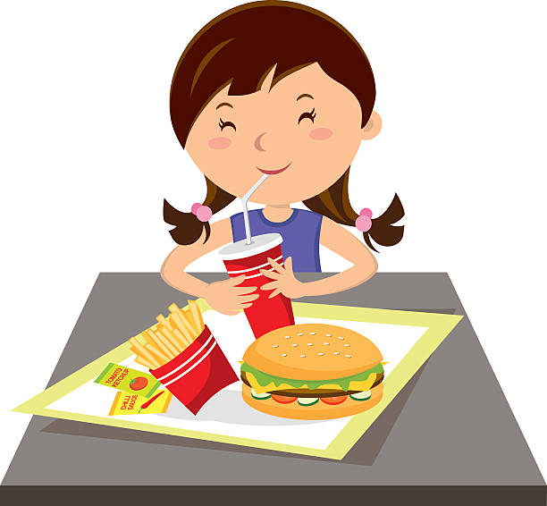
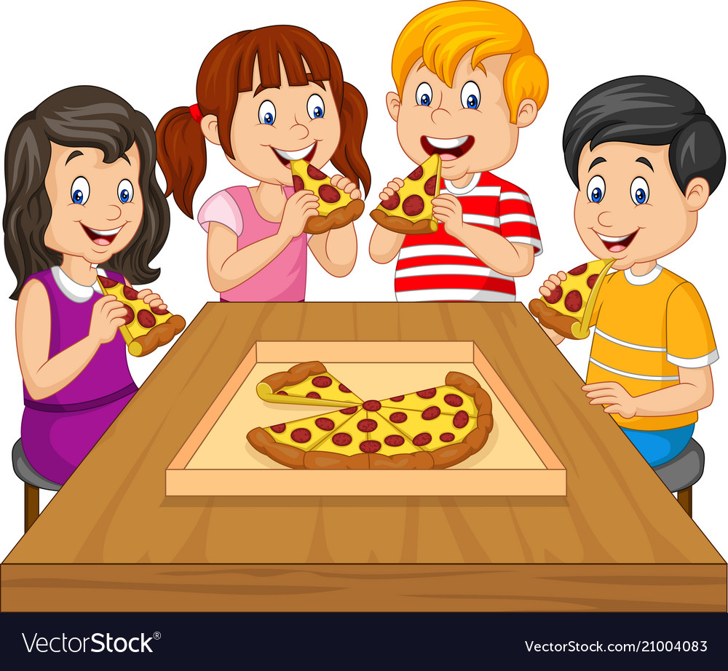
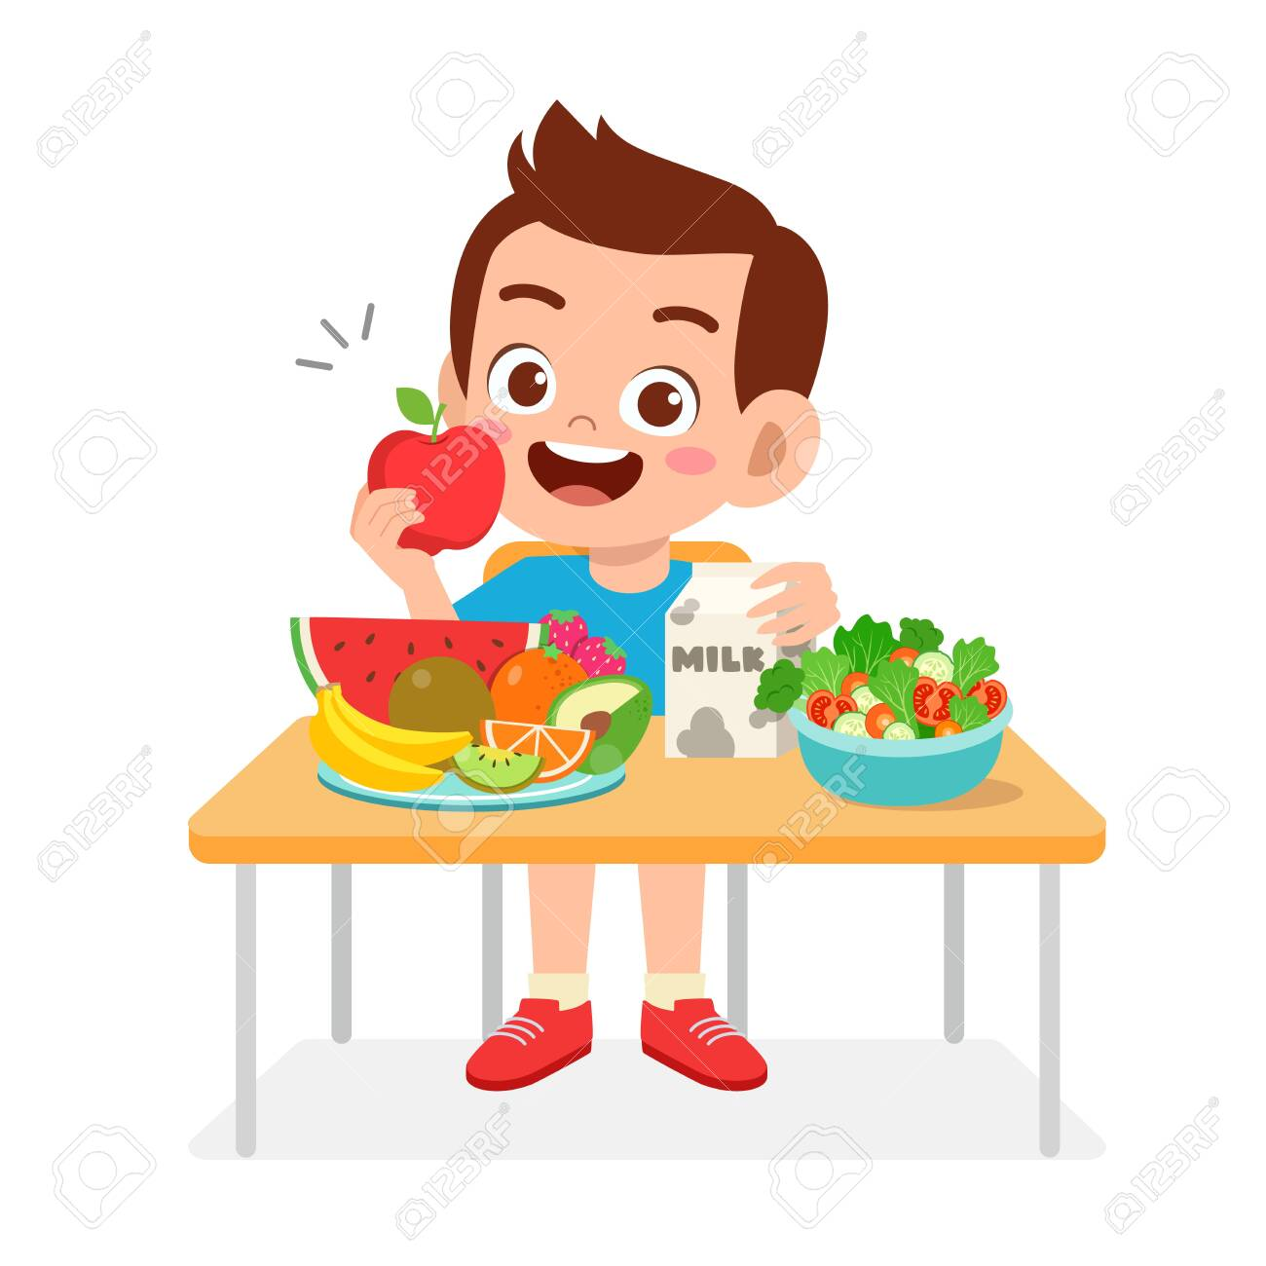
AUXILIARY VERB | PRESENT TENSE | PAST TENSE
do
do
Singular – does
Examples :
He does not eat pizza.
She does not eat pizza.
Singular & Plural – did
Examples :
Did you eat pizza?
Did they eat pizza?
Personal & Plural – do
Examples :
I do not eat pizza.
You do not eat pizza.
They do not eat pizza.

Slide 9
1. In the sentences given below, find out whether the words in red are main
verbs or auxiliary verbs. Tick the correct answer.
a) | I will have the chicken curry. | main verb auxiliary verb
b) | The police are coming to arrest the thief. | main verb auxiliary verb
c) | Hema is feeding the birds. | main verb auxiliary verb
d) | Where does your mother teach? | main verb auxiliary verb
e) | He does his homework before going to bed. | main verb auxiliary verb

Slide 10
LEARNING OUTCOME:
Students were able to know about the auxiliary verb and identify them.

Slide 11
THANKING YOU
ODM EDUCATIONAL GROUP

