Slide 1


SESSION : 1
CLASS : II
SUBJECT : ENGLISH
CHAPTER NUMBER: 6
CHAPTER NAME : DESCRIBING WORDS
SUBTOPIC : EXPLANATION AND EXERCISE - 1

Slide 2
LEARNING OBJECTIVE :
The students will learn about describing words (adjectives) and how they are used to describe nouns.

Slide 3


Slide 4
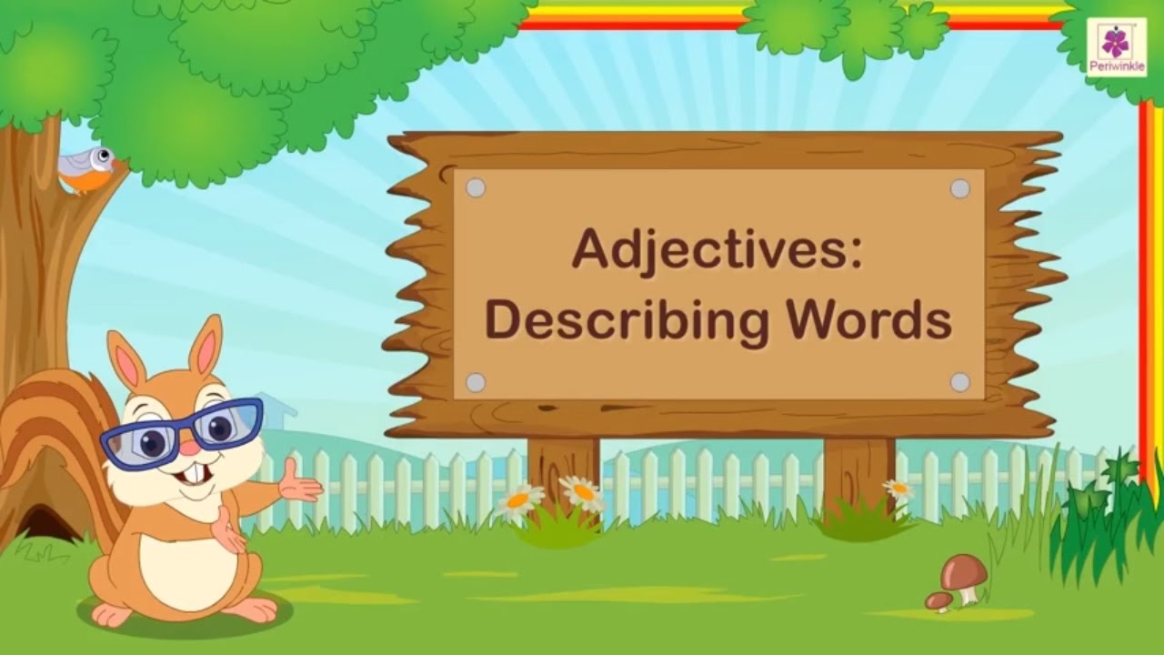
From here you can type content. (Size of Content will be 14-Calibri-Black Colour)

Slide 5
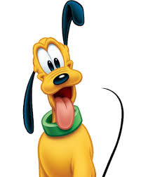

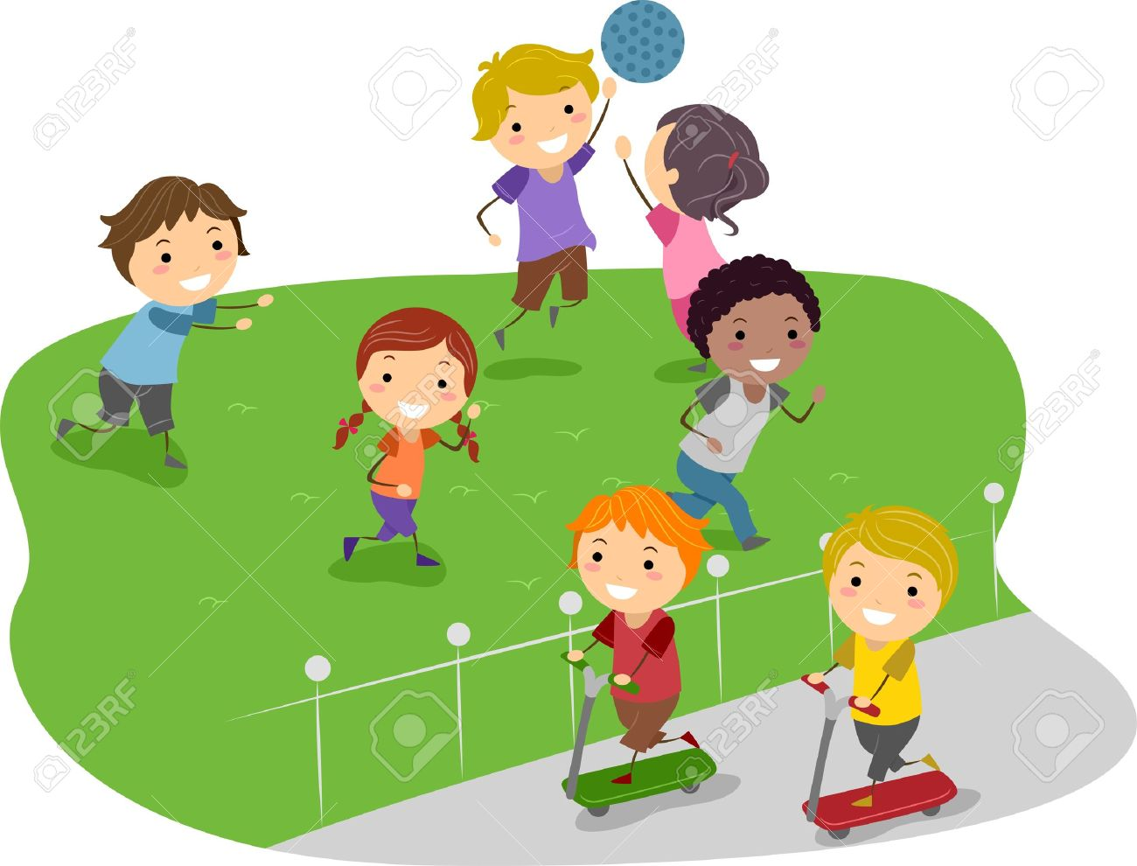

DESCRIBING WORDS
Words that describe the quality of a naming word (person, place, animal or thing) are called describing words or adjectives.
happy girl
big playground
funny dog
beautiful car

Slide 6



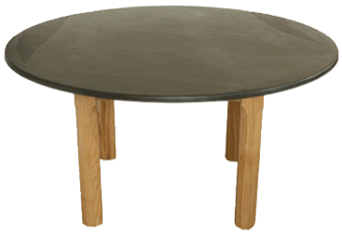
Words for numbers, colours, size and shape are also describing words.
two pens
red shirt
round table
fat boy

Slide 7

An adjective also describes how someone or something looks, tastes, feels, smells or sounds like.
beautiful girl
‘beautiful’ describes the looks of the girl

Slide 8

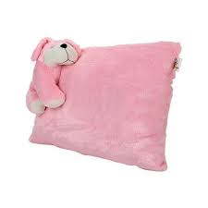
salty chips
‘salty’ describes the taste of the chips
soft pillow
‘soft’ describes the feel of the pillow

Slide 9


fresh fragrance
‘fresh’ describes the fragrance of the
perfume
loud music
‘loud’ describes the sound of the music
https://www.youtube.com/watch?v=5ZkMbLkGims

Slide 10
Read the following sentences
Rohan is a good boy.
Sheena saw a round box of delicious chocolates.
Roma saw a huge pink teddy bear.
The boy gave two roses to his teacher.
The words good, round, delicious, huge, pink and two in the sentences are describing words or adjectives.

Slide 11
1. Circle the describing words in the given sentences.
Pg-29
a. Nikhil has a cute puppy.
b. She had a red apple in her bag.
c. The tiny chick walked around the farm.
d. Mother got me a bunch of green grapes.
e. Sulekha's garden has beautiful flowers.

Slide 12
LEARNING OUTCOME:
Students are able to define an adjective.
They can categorize and find adjectives in a sentence.
They also write sentences with their own adjectives.

Slide 13
THANKING YOU
ODM EDUCATIONAL GROUP

