Slide 1


SESSION : 13
CLASS : II
SUBJECT : ENGLISH
CHAPTER NUMBER: 3
CHAPTER NAME : LEARNING TOGETHER
SUBTOPIC : WORD BASKET AND BOOK EXERCISE

Slide 2
LEARNING OBJECTIVE :
Be able to learn the difficult words and enhance vocabulary skills.
Be able to brainstorm the answers from the text.

Slide 3
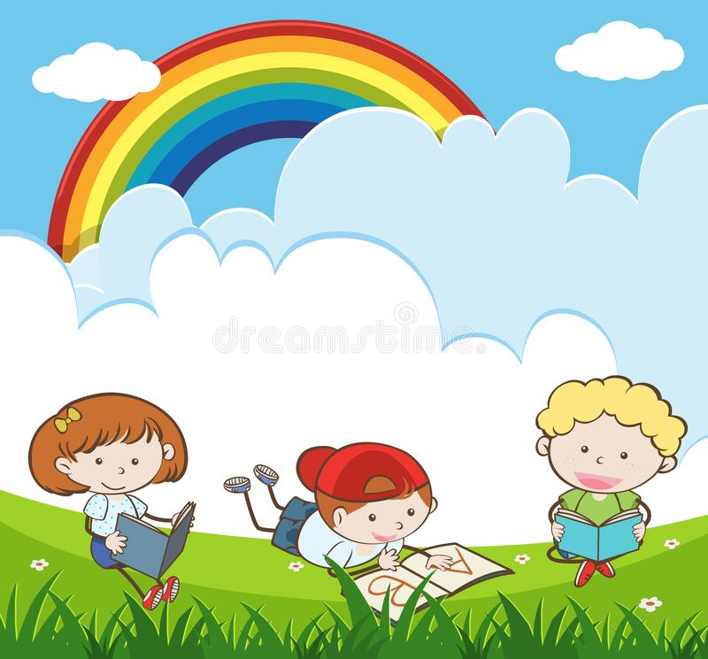
CH-3 LEARNING TOGETHER

Slide 4
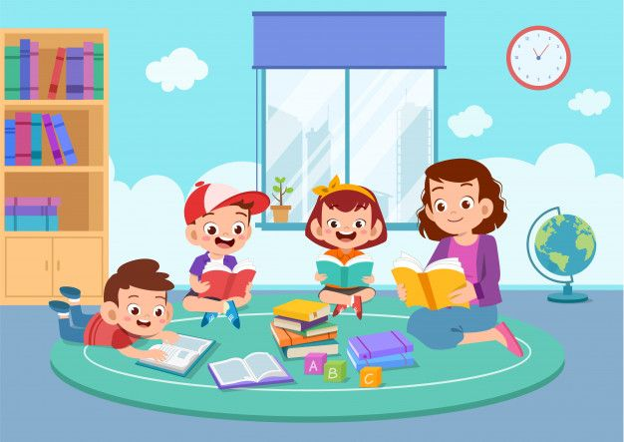
Let’s summarize the chapter
This is a story about a little girl called Rama who learns to read and write.
One day Gia and Hussain went to playground after lunch.
They saw Rama grazing her goats.
Rama said them that she likes to go to school and read books.
Gia and Hussain started helping Rama to read adventure stories and fairy tales.
They also solved math problems and played number games too.
If we learn together it will be more fun.

Slide 5

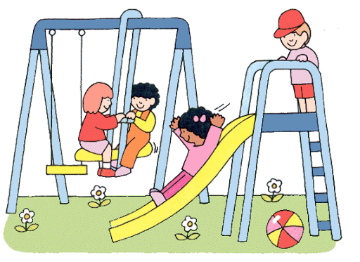
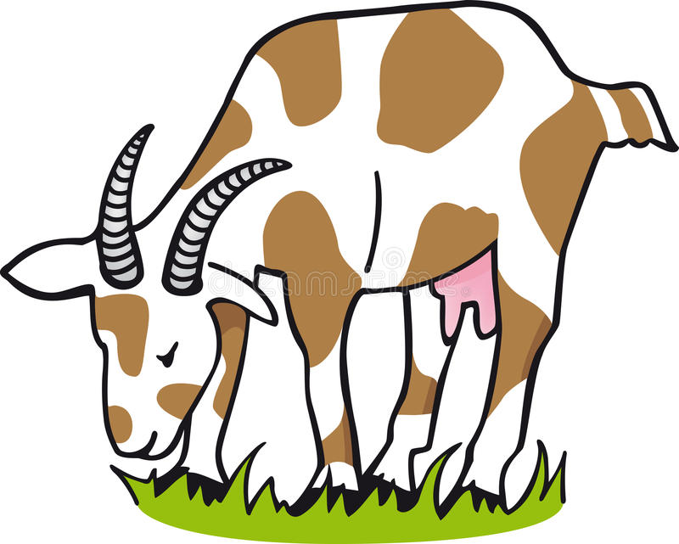



Word Basket:
C.W
CH – 3 LEARNING TOGETHER
DT- 20.07.21
1. recess
2. grazing
3. smiled
4. waved
5. in turn
6. security guard

Slide 6

7. apartment
8. suggested
9. promise
10. ripe
11. adventure
12. indeed

Slide 7
1. Who said this and to whom?
PG- 27
a. “Yes she is Rama. Her father is the security guard of our apartment.”
Ans - Gia said to Hussain.
b. “Didi, I love to come here every day. I want to go to school too.
I want to read books like you.”
Ans- Rama said to Gia.
c. “Do you know her?”
Ans- Hussain asked Gia.

Slide 8
2. Read these sentences. Write T for true and F for false:
Rama and Hussain were playing with a flying disc.
Rama wanted to go to school.
Gia’s father is a security guard.
Gia and Rama met at the park to study.
F
T
F
T

Slide 9

Write the words two times in English notebook.

Slide 10
LEARNING OUTCOME:
The children enhance their vocabulary skills and answer the questions related to the topic.

Slide 11
THANKING YOU
ODM EDUCATIONAL GROUP

