Slide 1


SESSION : 9
CLASS : II
SUBJECT : ENGLISH
CHAPTER NUMBER: 14
CHAPTER NAME : PREPOSITIONS – UNDER, OVER, INSIDE,
OUTSIDE, BELOW, AT, IN, ON
SUBTOPIC : EXPLANATION OF INSIDE, OUTSIDE AND BOOK
EXERCISE - 1 AND 2

Slide 2
LEARNING OBJECTIVE :
The students will learn about the prepositions, which tell us where a thing is.

Slide 3

Prepositions are words that show position and time in a sentence.
In and on are prepositions of place and time.
In is also used to talk about a period of time such as days, years, months and seasons.
On is also used to talk about a day or date on which a particular event happens.
At is used to talk about specific time or place.
Under is used when someone or something is below something else.
Over is used when someone or something is above something else.
Below is used when something is kept/placed at a position lower than something else.

Slide 4

Inside and outside:
inside is used to say about something is within something else.
Outside is used to say about something is out of something else. It is opposite of inside.
Example –
This dog is outside the kennel.
That dog is inside the kennel.
Notes:
The cat is sitting near the Sofa.

Slide 5

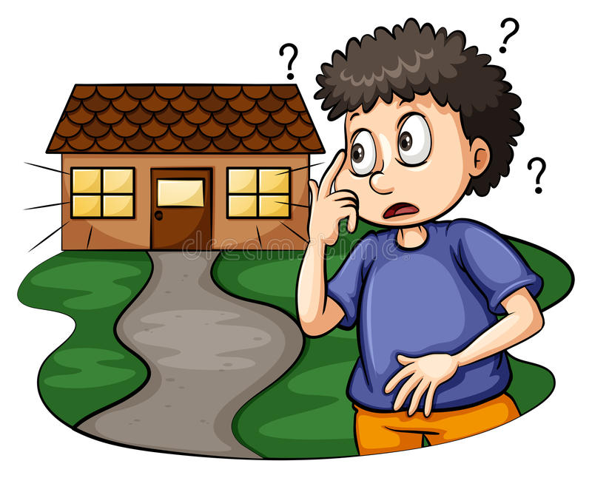
The boy is sitting inside the car.
The boy is standing outside his house.

Slide 6
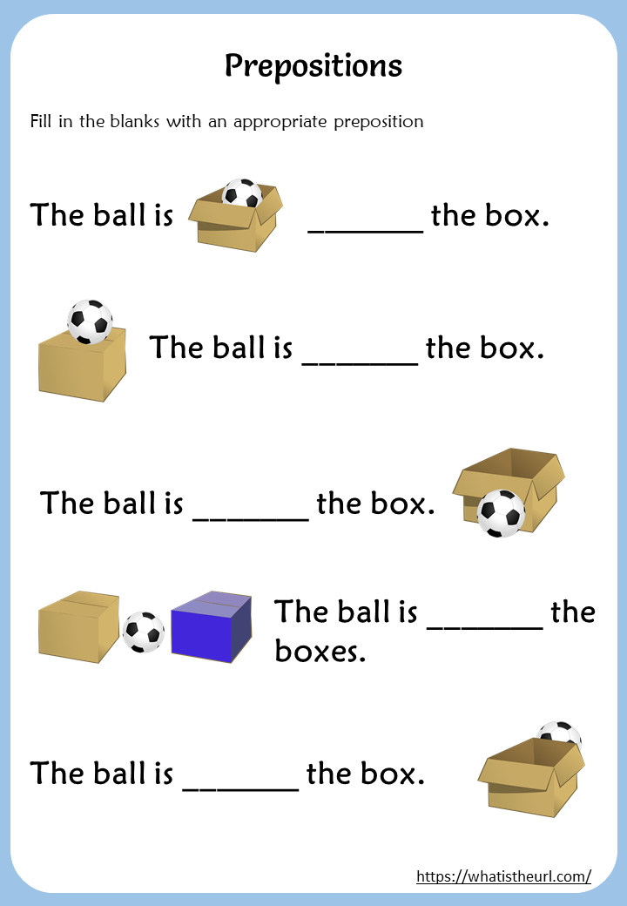
Look at the picture and fill in the blanks:
ORAL
in
on
in front of
between
behind

Slide 7
2. Underline the preposition in the following sentences.
a. The dog jumped over the fence.
b. The puppy was hiding under the table.
c. There was a bird outside the window.
d. Sona will come home at 6 o’clock.
e. I have karate classes on Monday and Wednesday every week.

Slide 8
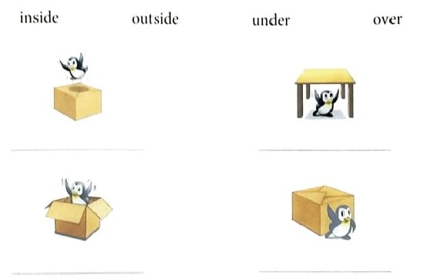
3. Write the correct preposition below each picture to show the position of Fluffy, the penguin. Choose the prepositions from the box below.
over
under
inside
outside

Slide 9

Do page - 61 Exercise 4 in Grammar Book.

Slide 10
LEARNING OUTCOME:
The students understand the topic Preposition and how to use it in a sentence.
Recognize prepositions and their objects.

Slide 11
THANKING YOU
ODM EDUCATIONAL GROUP

