Slide 1


SESSION: 6
CLASS: I
SUBJECT: EVS
CHAPTER NUMBER:3
CHAPTER NAME: MY BODY HELPS ME
SUB TOPIC: ACTIVITY-GUESS WHO AM I?, CLASS TEST.

Slide 2
LEARNING OBJECTIVE :
To enable the learner to answer the questions from the chapter.

Slide 3

MY BODY HELPS ME

Slide 4

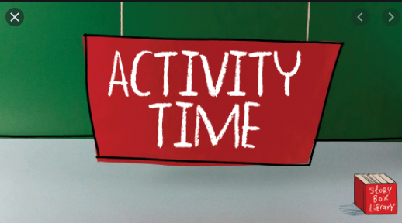


Slide 5
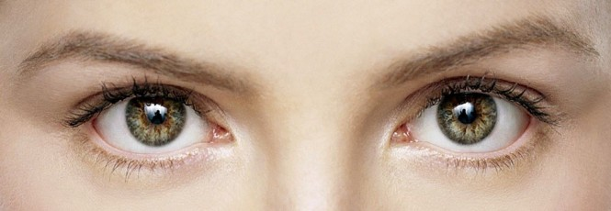
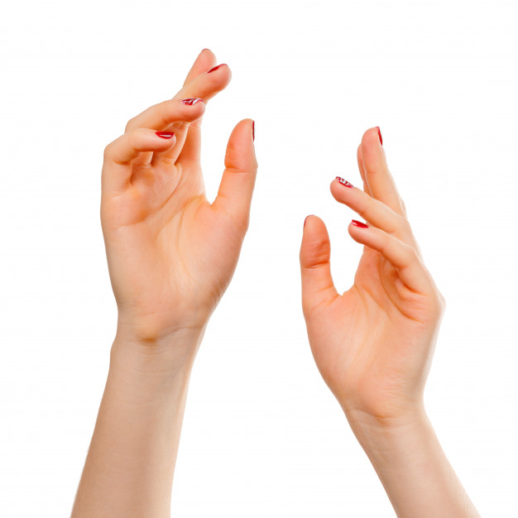

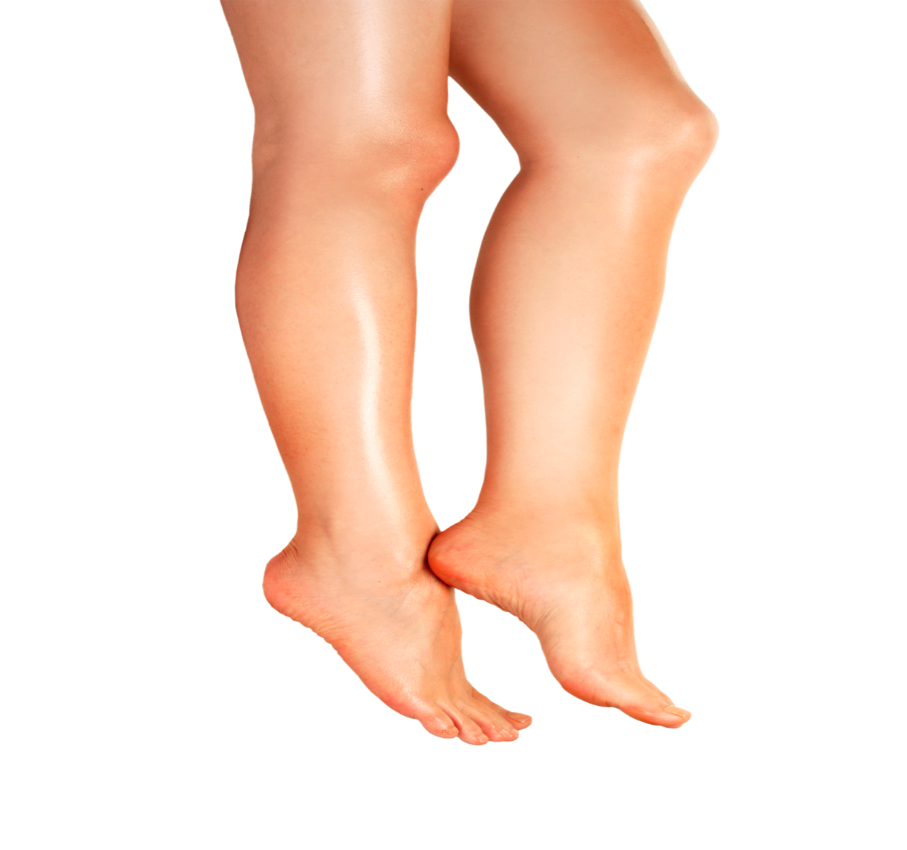
GUESS WHO AM I?
I help you to see
I help you to touch and feel.
I help you to taste the ice cream.
I help you to run in the field.

Slide 6
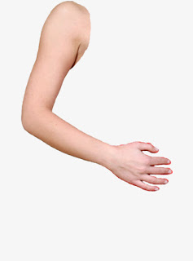
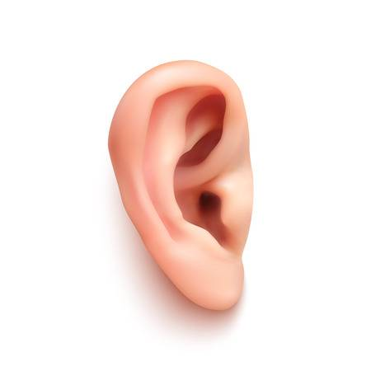

I help you to hold the things.
I help you to hear the music.
I help you to smell.

Slide 7


Class test
Q1.Mark the sentences as true( ) or not true ( )
1.I feel with my nose.
2. My hand helps me to eat.
3. My tongue helps me to taste.
4. I can run with my head.
5. I can hear with my ears.

Slide 8
Answer in one word
1.I see with my ______________.
2. I taste with my _____________.
3. I smell with my _____________.
4. I hear with my ______________.
5. I feel with my _______________.

Slide 9
Class test
Q1.Mark the sentences as true( ) or not true ( )
1.I feel with my nose.
2. My hand helps me to eat.
3. My tongue helps me to taste.
4. I can run with my head.
5. I can hear with my ears.

Slide 10
Answer in one word
1.I see with my ______________.
2. I taste with my _____________.
3. I smell with my _____________.
4. I hear with my ______________.
5. I feel with my _______________.
eyes
tongue
nose
ears
skin

Slide 11
LEARNING OUTCOME:
The learner will be able to give answers to the questions from the chapter.

Slide 12
THANKING YOU
ODM EDUCATIONAL GROUP

