Slide 1


SESSION: 4
CLASS: I
SUBJECT: EVS
CHAPTER NUMBER:3
CHAPTER NAME: MY BODY HELPS ME
SUB TOPIC: EXTRA QUESTIONS- ANSWER IN ONE WORD, IDENTIFY THE PICTURES.

Slide 2
LEARNING OBJECTIVE :
To enable the learner to answer the questions related to the chapter.

Slide 3

MY BODY HELPS ME

Slide 4
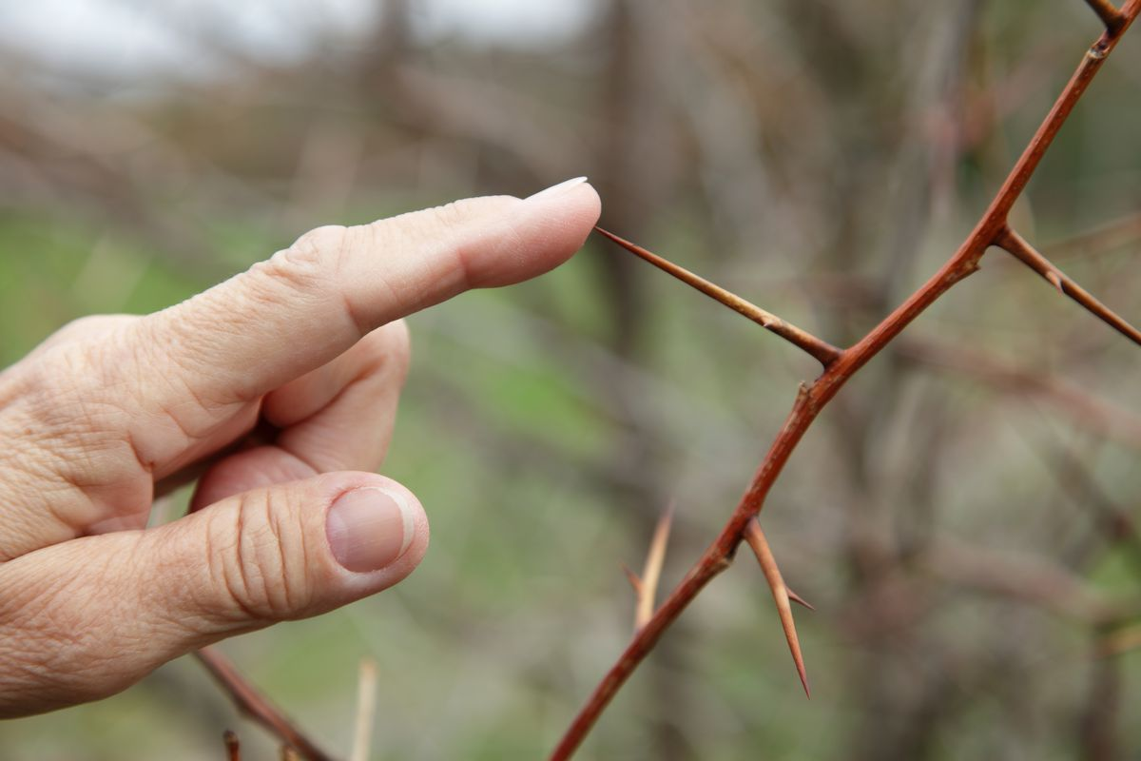


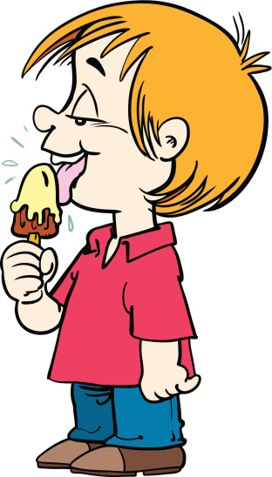
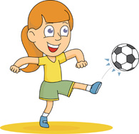

Slide 5

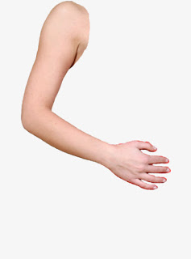
How my body helps me
These are my hands

Slide 6
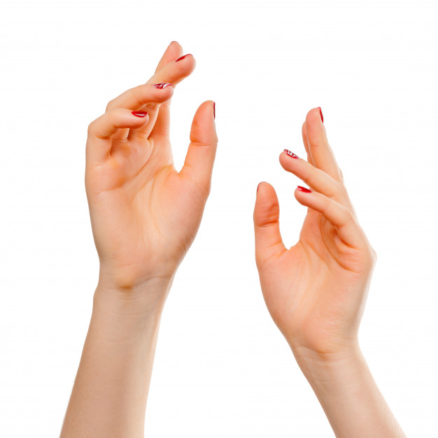
HANDS
I have two hands.
Left hand and Right hand.
I can do so many works with my hands.

Slide 7

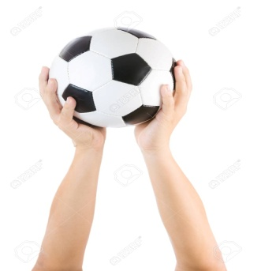
I can hold things with my hands.
I can eat with my hands.

Slide 8
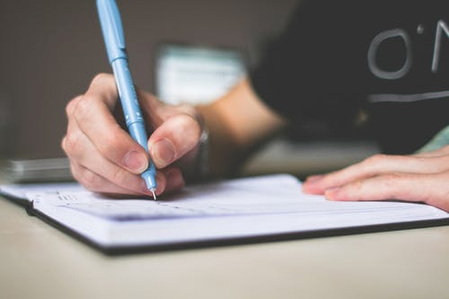
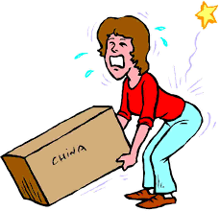
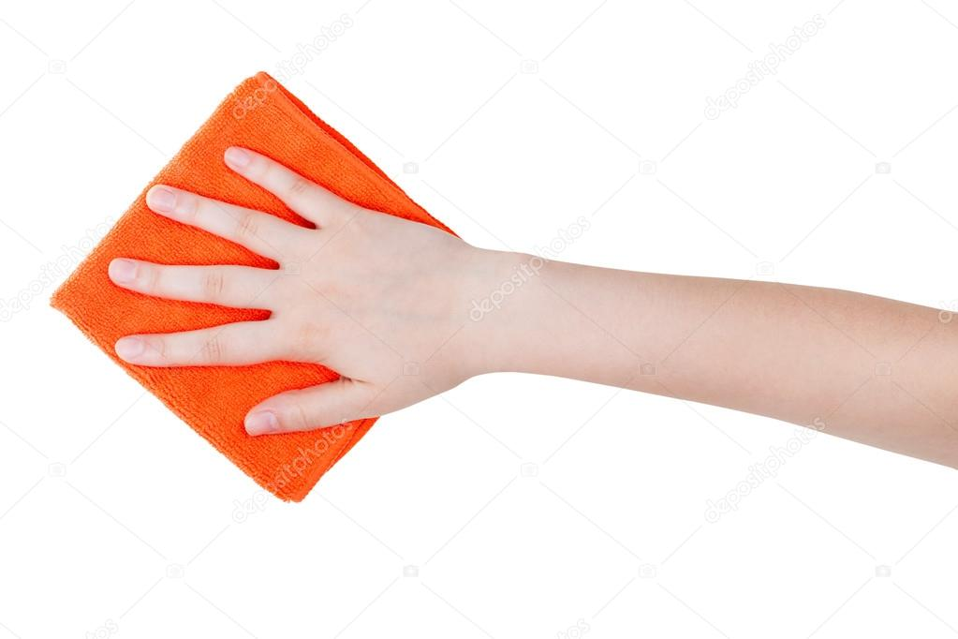
I can write with my hand.
I can lift the things with my hand
I can wipe with my hands

Slide 9

I can draw and paint with my hands.

Slide 10
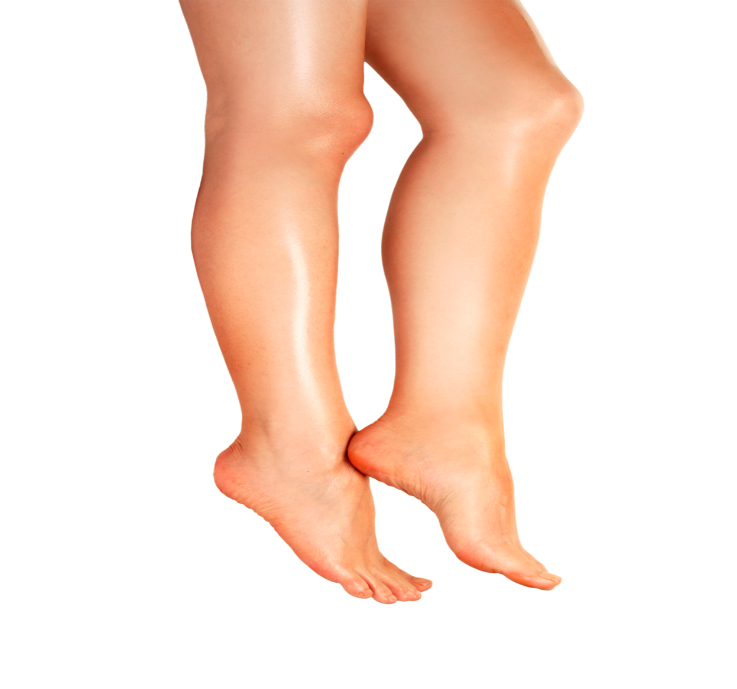
My legs
I have two legs.
Legs help me to move from one place to another place.

Slide 11
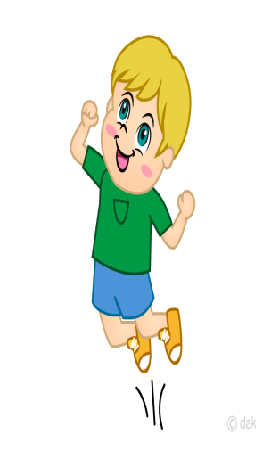
I can jump with my legs
I can kick the ball with our leg.

Slide 12
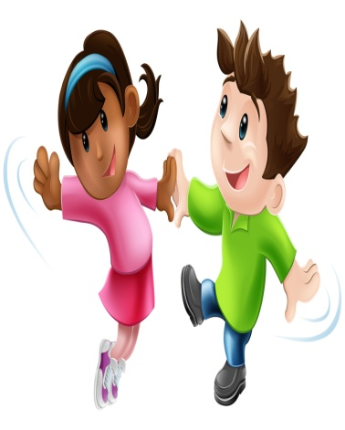
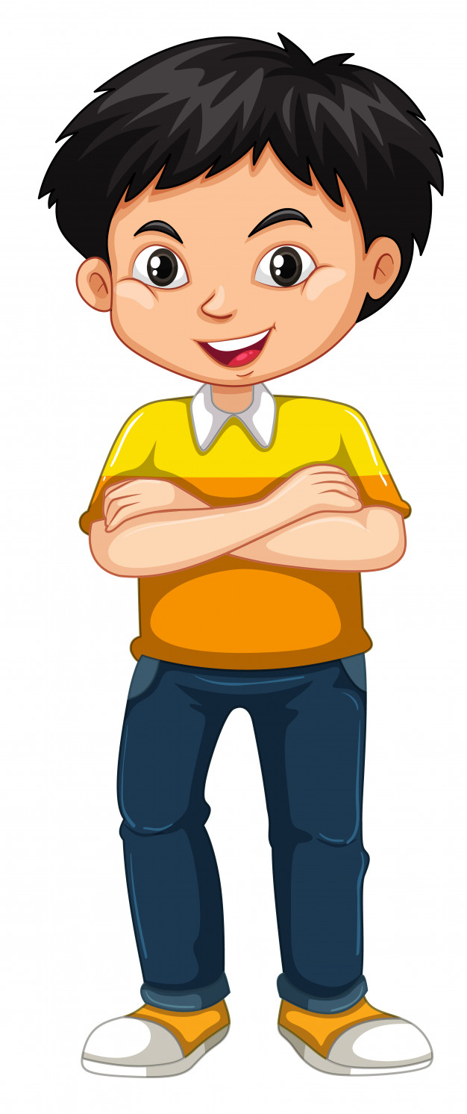
I can dance with my legs.
I can stand with my leg.

Slide 13
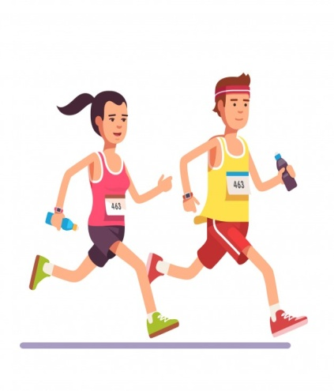
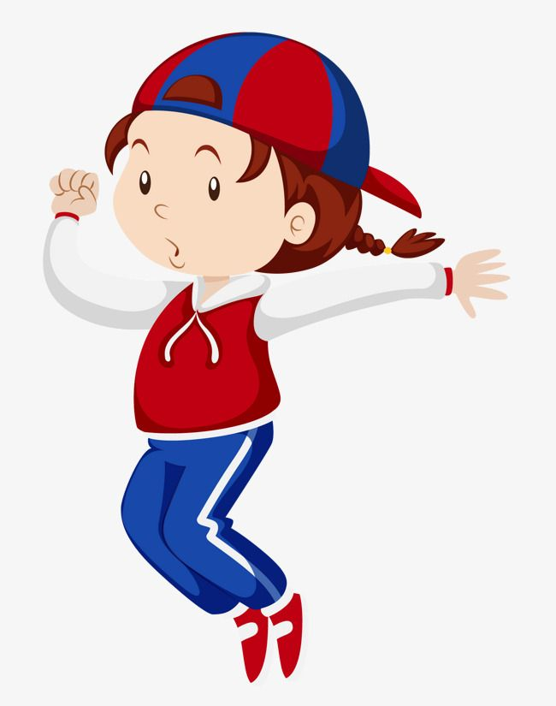
I can run with my legs.
I can hop with my legs.

Slide 14

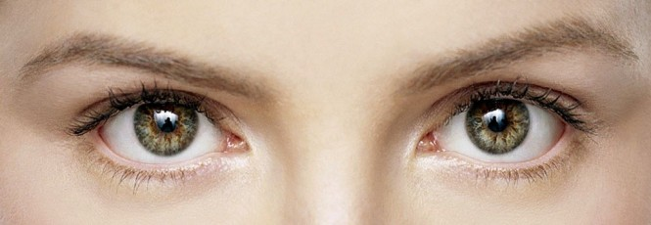

Eyes
I can see colourful rainbow with my eyes

Slide 15


I can smell with my nose
Nose

Slide 16
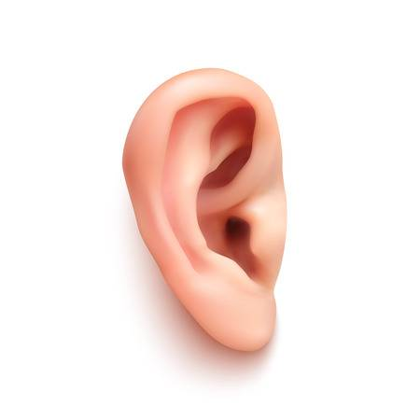
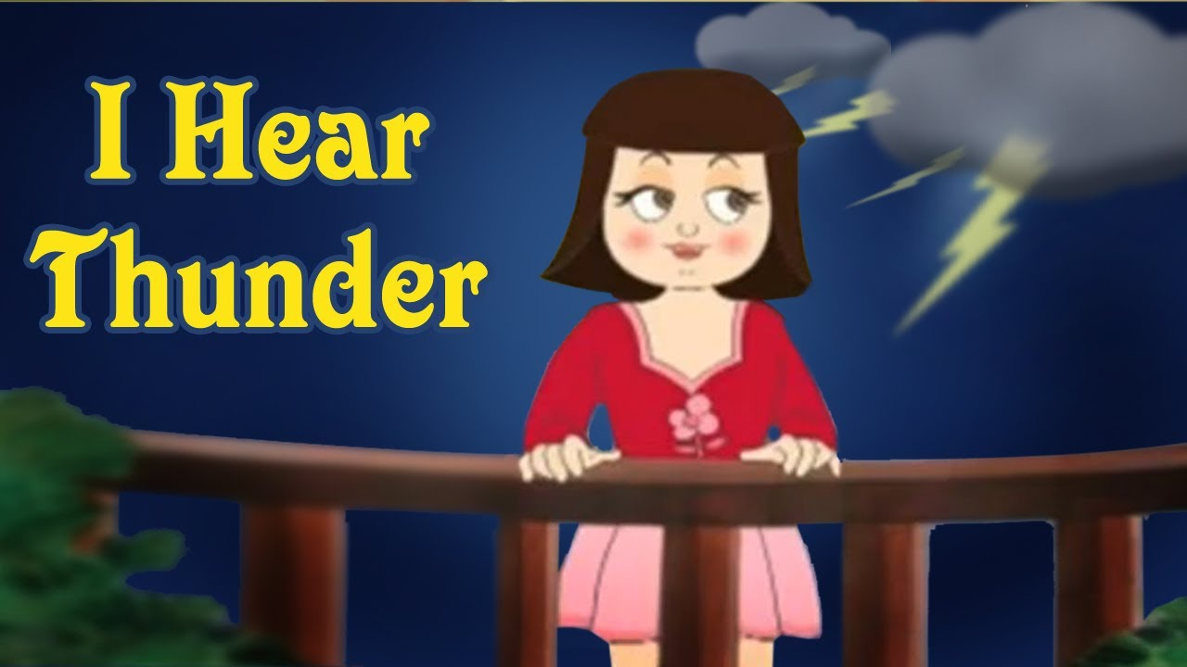
Ears
I can hear with my ears

Slide 17
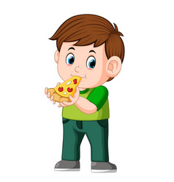

Tongue
I can taste Ice-cream and pizza with my tongue

Slide 18
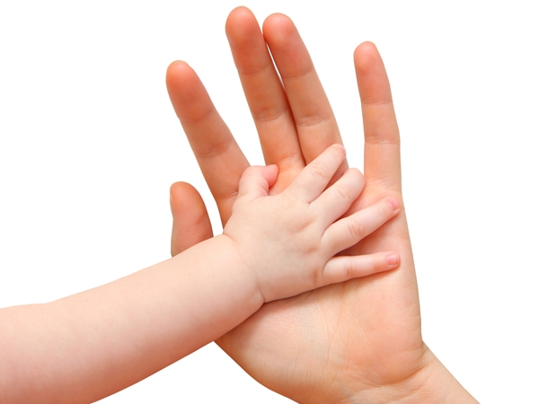
Skin
We feel with our skin

Slide 19
Identify the pictures (Oral)
Eyes
nose
legs
hand
ears

Slide 20
Answer in one word
Q1. My eyes help me to ______
Q2. My legs help me to ______
Q3. My hand helps me to_____
Q4. My skin helps me to _____
Q5. My nose helps me to _____
see
stand
write
feel
smell

Slide 21
Write the missing letters.
C.W
1.J __ M P
2. S M __ L L
3. H A __ D
4. F E __ L
5. H E __ R
U
E
N
E
A

Slide 22
LEARNING OUTCOME:
The learner will be able to answer the questions related to the chapter.

Slide 23
THANKING YOU
ODM EDUCATIONAL GROUP

