Slide 1


SESSION : 3
CLASS: I
SUBJECT: EVS
CHAPTER NUMBER:3
CHAPTER NAME: MY BODY HELPS ME
SUB TOPIC: TEXTUAL QUESTIONS- TICK THE CORRECT WORD, FILL IN THE BLANKS, AND MARK THE SENTENCES AS TRUE OR NOT TRUE.

Slide 2
LEARNING OBJECTIVE :
To enable the learner to solve the questions from the chapter.

Slide 3

MY BODY HELPS ME

Slide 4

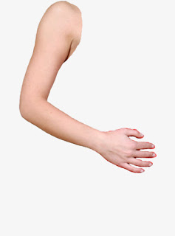
How my body helps me
These are my hands

Slide 5
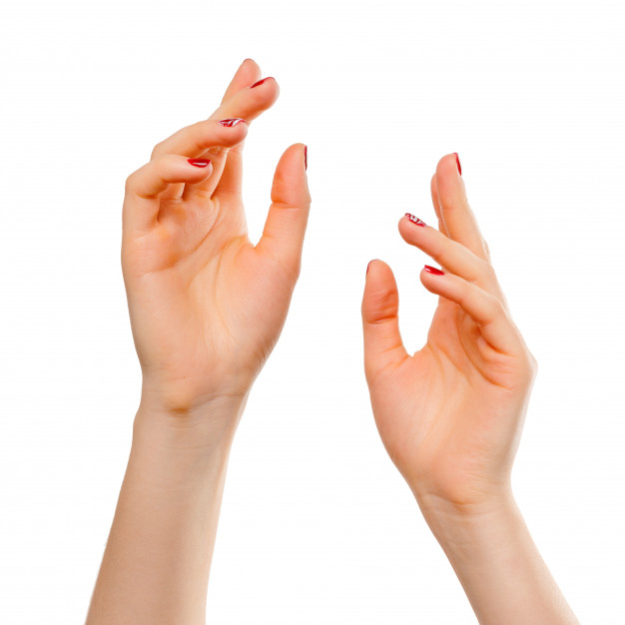
HANDS
I have two hands.
Left hand and Right hand.
I can do so many works with my hands.

Slide 6

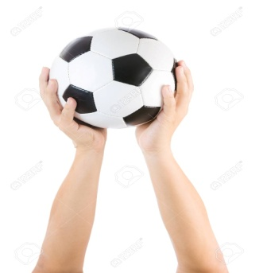
I can hold things with my hands.
I can eat with my hands.

Slide 7

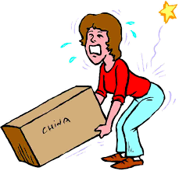
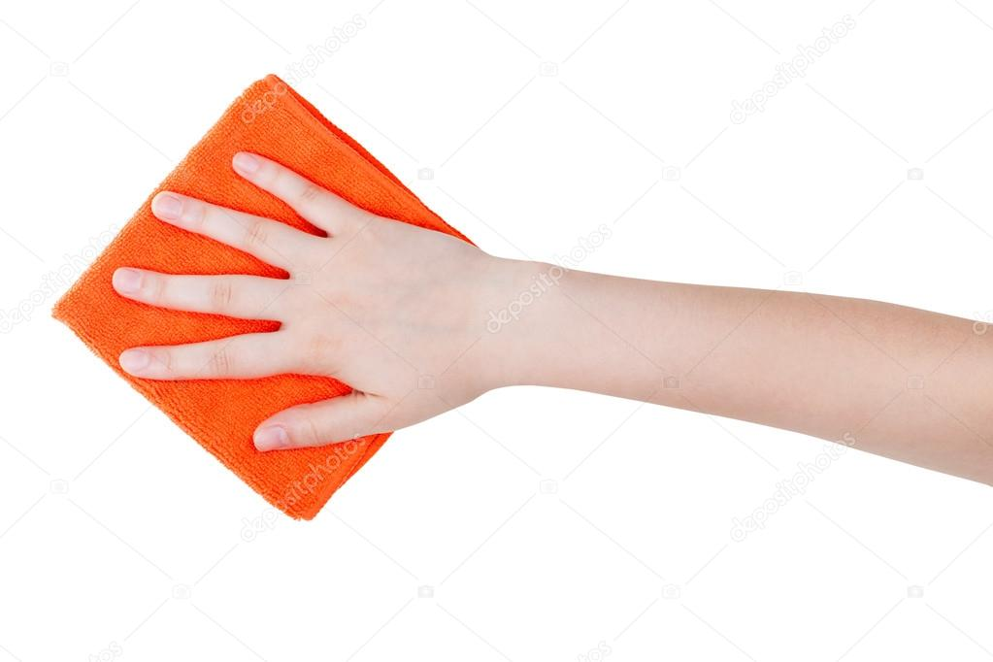
I can write with my hand.
I can lift the things with my hand
I can wipe with my hands

Slide 8


I can draw and paint with my hands.

Slide 9
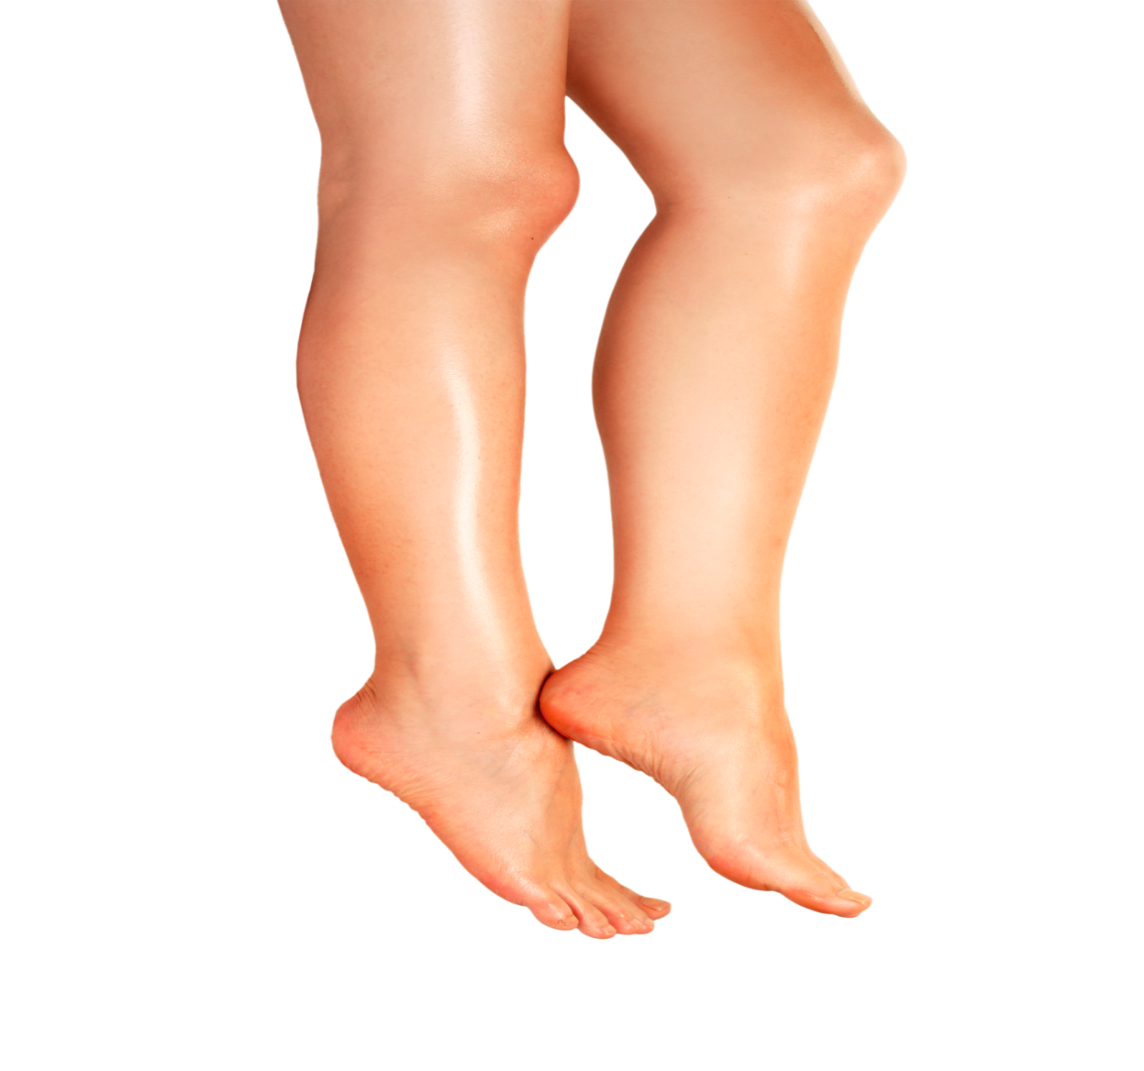
My legs
I have two legs.
Legs help me to move from one place to another place.

Slide 10
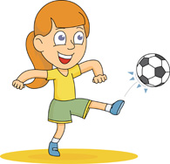
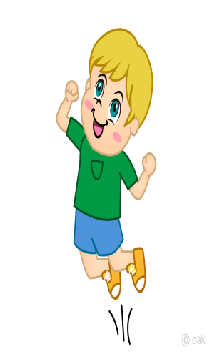
I can jump with my legs
I can kick the ball with our leg.

Slide 11

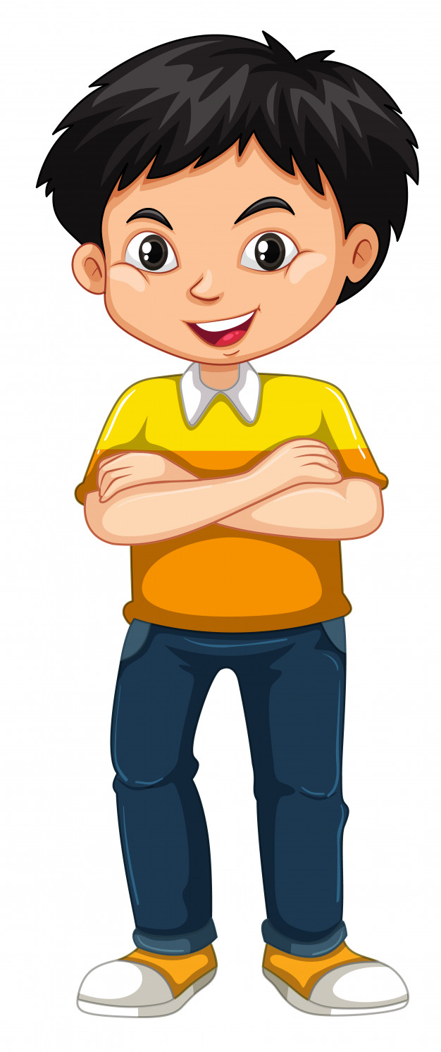
I can dance with my legs.
I can stand with my leg.

Slide 12
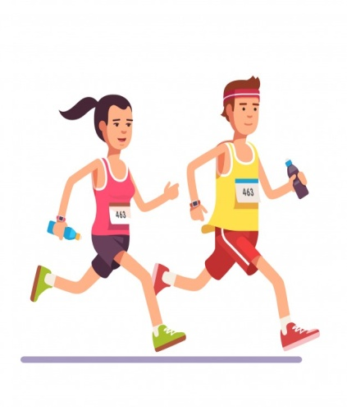
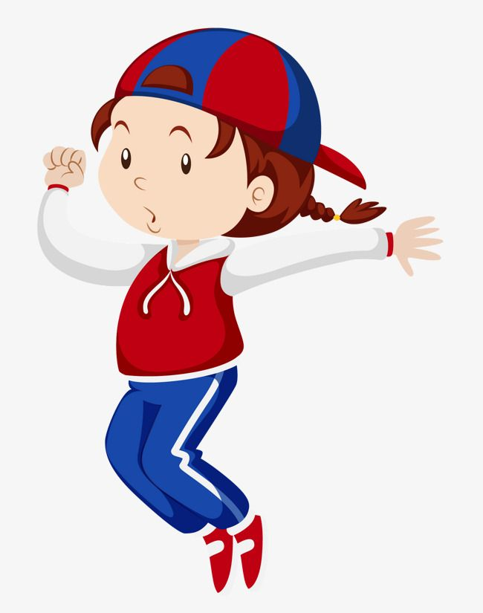
I can run with my legs.
I can hop with my legs.

Slide 13

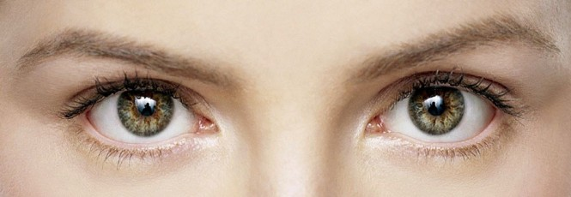
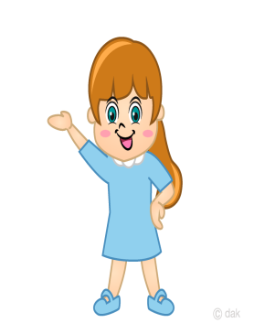
Eyes
I can see colourful rainbow with my eyes

Slide 14


I can see the beautiful flowers and butterflies

Slide 15


I can smell with my nose
Nose

Slide 16
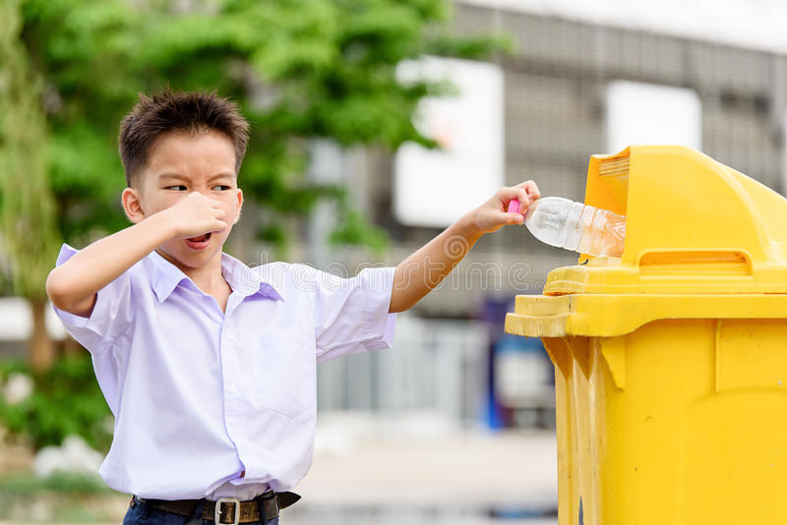
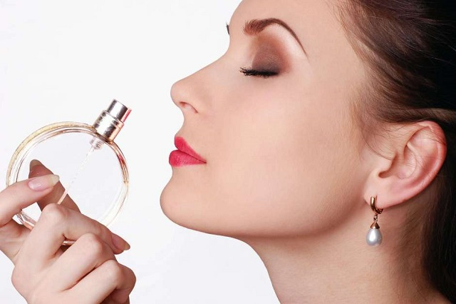
I can smell the perfume
I can smell the garbage….it’s really bad

Slide 17
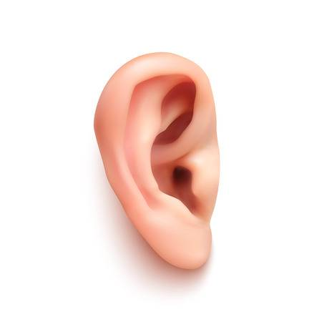
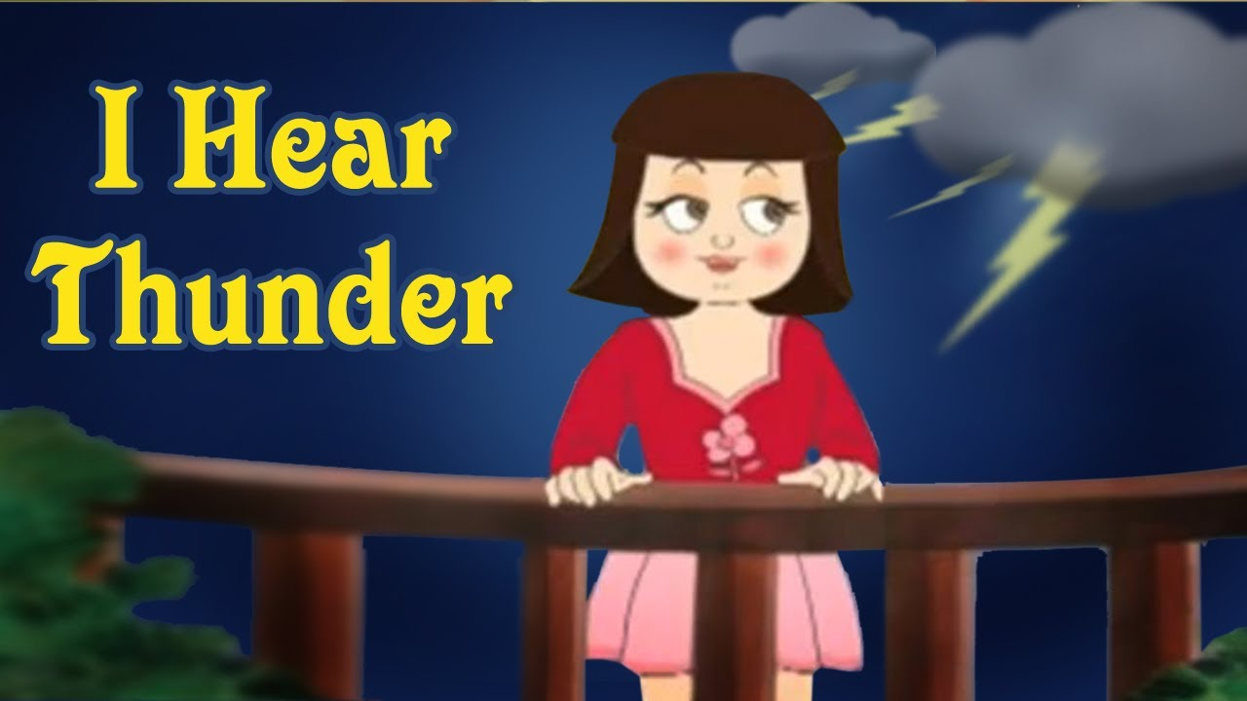

Ears
I can hear with my ears

Slide 18
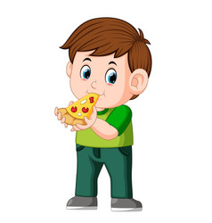

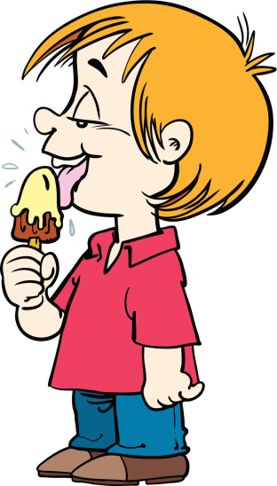
Tongue
I can taste Ice-cream and pizza with my tongue

Slide 19
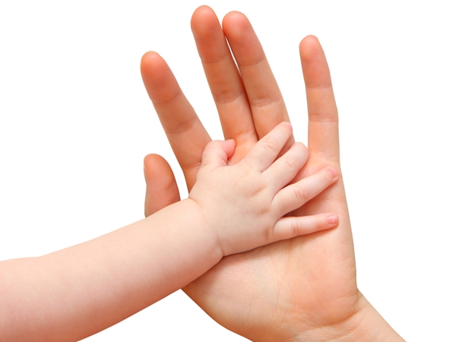
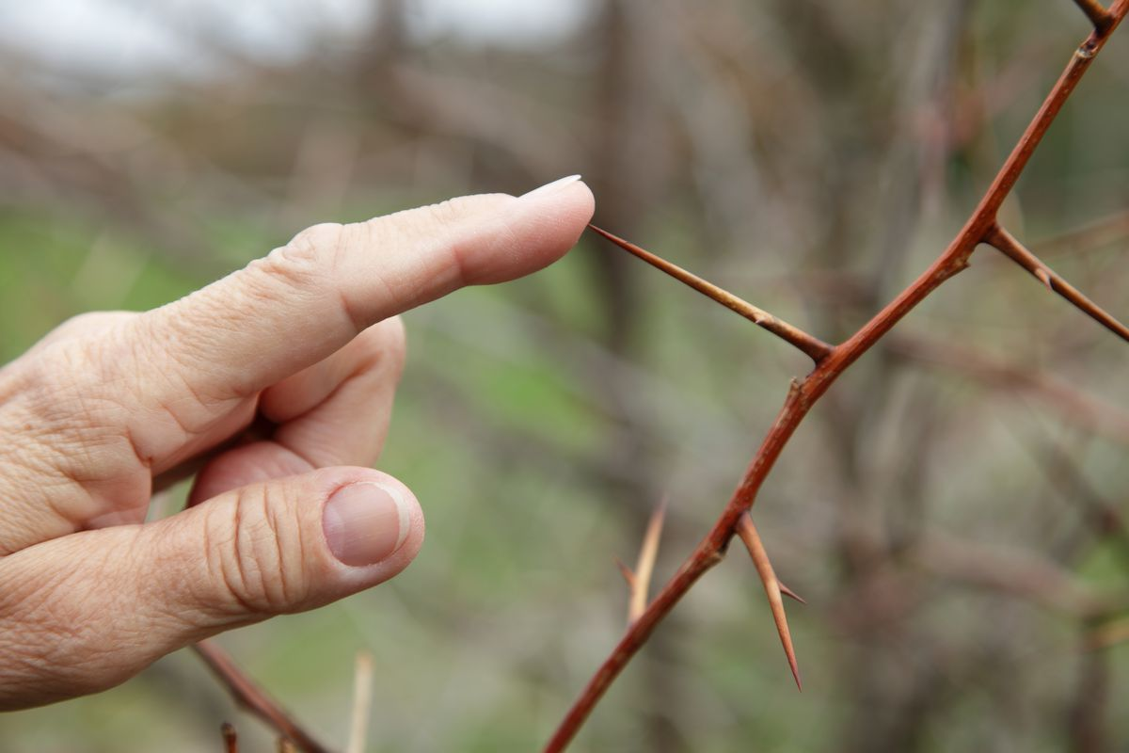
Skin
We feel with our skin

Slide 20

Tick the correct word
1.I write with my (leg/hand/head).
2. I read with my (feet/eyes/nose).
3. I use my (hands/ears/legs) to walk to school.
4. I use my (stomach/chest/hands) to throw a ball.
5. I use my (eyes/nose/legs) to smell.

Slide 21
Fill in the blanks with words from the help box.
Ears nose eyes skin tongue
1.My ______________ tells me that the mango is sweet.
2. My _____________ tells me that it is a cold day.
3. My _____________ tells me that the cake smells good.
4. My _____________ tells me that the grass is green.
5. My _____________ tells me that the bell is ringing.
tongue
skin
nose
eyes
ears

Slide 22

Mark the sentences as true ( )or not true ( ).
1. I eat with my legs. ( )
2. I kick with my nose. ( )
3. I write with my hand. ( )
4. I hear with my ears. ( )
5. I feel with my nose. ( )

Slide 23
Answer the questions.(Orally)
1. Do you eat with your legs?
2. Do you smell with your nose?
3. Do you jump with your chest?
4. Do you have 6 sense organs?
5. Name the sense organs?

Slide 24
LEARNING OUTCOME:
The learner will be able to solve the questions from the chapter.

Slide 25
THANKING YOU
ODM EDUCATIONAL GROUP

