Slide 1


SESSION: 1
CLASS: I
SUBJECT: EVS
CHAPTER NUMBER: 13
CHAPTER NAME: THE EARTH AND THE SKY
SUBTOPIC: INTRODUCTION OF THE CHAPTER, THE EARTH, THE LAND

Slide 2

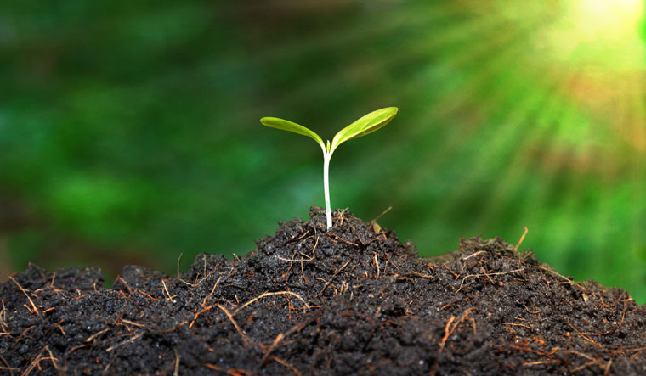


Activity
“The Earth”
Our Earth is special, there is just one.
It gives us water, soil and Sun.
People and animals share the land,
Let’s all lend a helping hand!
You can save water, and plant a tree,
Make a better home for you and me.
I love the Earth where we all stay,
Let’s make special every day.

Slide 3
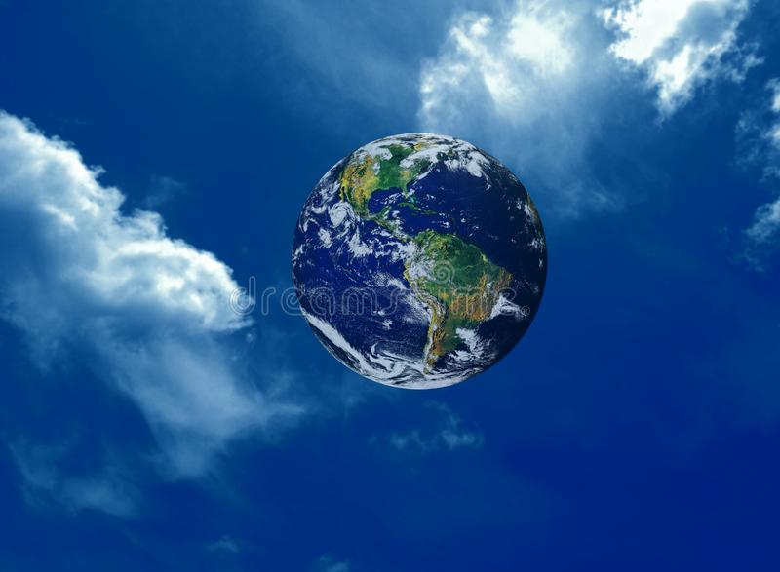
THE EARTH AND THE SKY

Slide 4
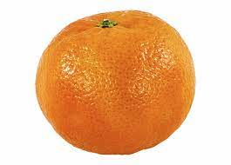
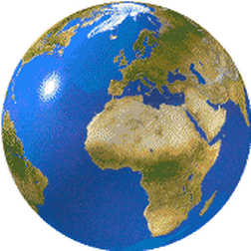
C.W
Dt.
The Earth
Orange
The shape of the earth is round like an orange.

Slide 5
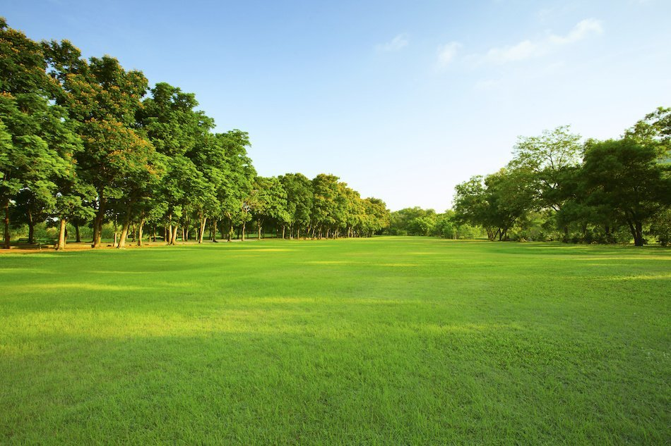
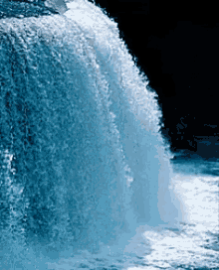
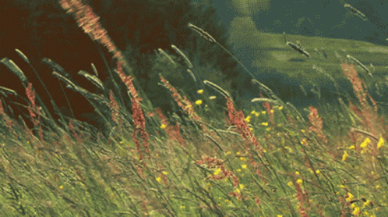

The Earth
LAND
WATER
AIR
The Earth is made up of land, water and air.

Slide 6
LAND
Flatlands are called plains.

Slide 7
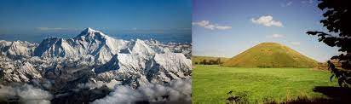
MOUNTAINS AND HILLS
The higher areas that rise above the plains
are called mountains and hills.

Slide 8
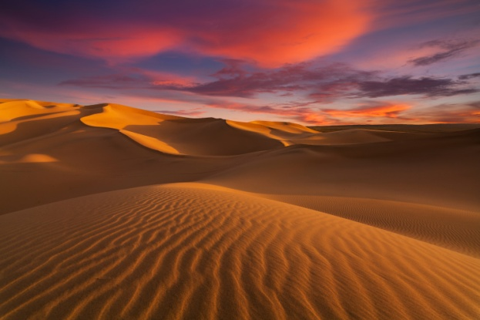
DESERT
Deserts are hot and dry parts of land.
They are covered with sand.

Slide 9
SUMMARY
C.W
Dt.
The shape of the Earth is round like an orange.
The Earth is made up of land, water and air.
Flatlands are called plain.
The higher areas that rise above the plains
are called mountains and hills.
Deserts are hot and dry parts of land.
They are covered with sand.

Slide 10
Say “Yes” or “No”
1. The shape of the earth is round like a ball.
No
2. Flatlands are called plains.
Yes
3. Higher areas are called mountains.
Yes
4. Deserts are very cold areas.
No

Slide 11
LEARNING OUTCOME:
Students are able to learn about the earth and its shape. They got the knowledge about different forms of land.

Slide 12
THANKING YOU
ODM EDUCATIONAL GROUP

