Slide 1


SOUND STD-VII
SUBJECT-PHYSICS
CHAPTER NO- 06

Slide 2


LEARNING OBJECTIVE
Students will be able to
Define Reflection of sound
Define Range of Hearing

Slide 3
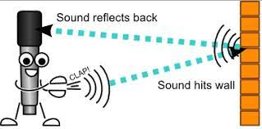
Reflection of sound
When sound waves strike a surface, they return back into the same medium. This phenomenon is called reflection.
Laws of reflection of sound
There are two basic laws of reflection of sound:
(i) Angle of incidence is equal the angle of reflection.
(ii) The incident wave, the reflected wave and the normal all lie in the same plane.

Slide 4
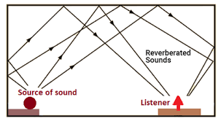
THE ECHO:
Sound heard after reflection from a surface is called echo. Just like heat or light, when sound falls on a surface, it is partly reflected and partly absorbed.
Soft surfaces are better absorbers of sound whereas hard surfaces are better reflectors of sound.

Slide 5
ABSORPTION OF SOUND
When sound falls on sofa, fluffs and light substances such as clothes, papers, thermocol, coating of plaster of Paris, carpets, curtains, furniture, wood etc., it is absorbed to a good extent. These substances are called good absorbers of sound.

Slide 6

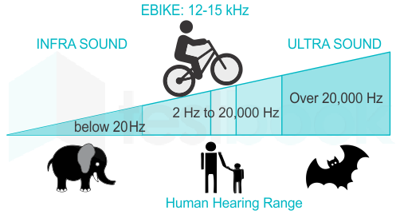
Range of Hearing
Audible sounds are those that can be heard while inaudible sounds are those that cannot be heard.
Human can hear sounds with frequency between 20Hz and 20,000Hz.
Low frequency sounds which cannot be hear are called infrasonics.
Objects that vibrate at frequencies of above 20,000Hz produce sound which also cannot be heard by us. Such sounds are called ultrasonics.
Ultrasound is produced by dolphins, bats and porpoises

Slide 7

HOME ASSIGNMENT
Why do we hear more clearly in a room with curtains than in a room without curtains? Explain in brief?
What is echo ?
Explain giving reason the purpose of using curved ceilings in cinema halls?

Slide 8
THANKING YOU
ODM EDUCATIONAL GROUP

