Slide 1


SOUND STD-VII
SUBJECT-PHYSICS
CHAPTER NO- 06

Slide 2

Wave
Wave is a phenomenon or disturbance in which energy is transferred from one point to another without any direct contact between them.
For example: Heat, light and sound is considered as a wave.

Slide 3

LEARNING OBJECTIVE
Students will be able to
Define wave
Define Longitudinal waves & Transverse waves

Slide 4
Types of Waves On the basis of direction of propagation, waves are categorized into two parts:
Longitudinal waves: These are the waves in which the particles of the medium vibrate along the direction of propagation of the wave. For example: sound wave.
Transverse waves: In this type of wave the particles of the medium vibrate in a direction perpendicular to the direction of propagation of the wave. For example: waves produced in a stretched string. *Another type of waves which do not require any medium for propagation are called electromagnetic waves. These waves can travel through vacuum also. For example, light waves, X-rays.

Slide 5
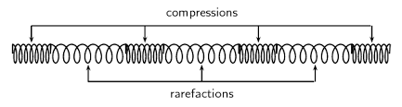
Compressions and Rarefactions:
Compression is the part of wave in which particles of the medium are closer to one another forming the region of high pressure and density.

Slide 6
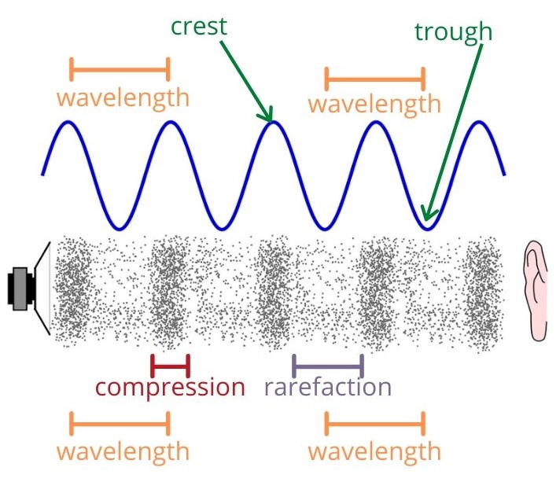
Compressions are represented by the upper portion of the curve called crest.
Rarefaction is a part of the wave where particles spread out to form a region of low pressure and density.
Rarefactions are represented by the lower portion of the curve called trough.

Slide 7
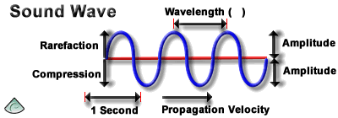
Characteristics of a sound wave
Sound waves have following characteristics: (1) Amplitude (2) wavelength (3) Frequency (4) Time period
(5)Velocity

Slide 8

HOME ASSIGNMENT
Define wave
Define Longitudinal waves & Transverse waves

Slide 9

THANKING YOU
ODM EDUCATIONAL GROUP

