Slide 1


SOUND
STD-VII
SUBJECT-PHYSICS
CHAPTER NO- 06

Slide 2


LEARNING OBJECTIVE
Students will be able to
Define sound
Define mechanical wave

Slide 3
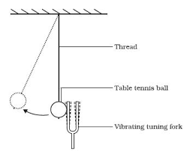
Sound
Sound is a form of energy which produces a sensation of hearing in our ears.

Slide 4
PRODUCTION OF SOUND
Sound is produced due to the vibration of objects.
Vibration is a periodic back-and-forth motion of the particles of an elastic body or medium about a central position. It is also named as oscillation.
For example:
Stretched strings of a guitar vibrate to produce sound.
When membrane of a table is struck, it vibrates to produce sound.

Slide 5
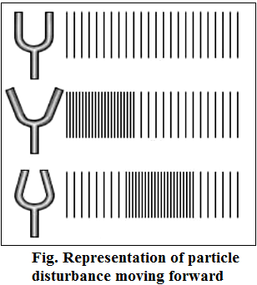
PROPAGATION OF SOUND
The travelling of sound is called propagation of sound.
Sound is propagated by the to and fro motion of particles of the medium.

Slide 6
When an object vibrates, the particles around the medium vibrate. The particle in contact with the vibrating object is first displaced from its equilibrium position.
Each particle disturbs the other particle in contact. Thus, the disturbance is carried from the source to the listener.
Only the disturbance produced by the vibrating body travels through the medium but the particles do not move forward themselves.

Slide 7

MEDIUM
The matter or substance through which sound is transmitted is called a medium.
A medium is necessary for the propagation of sound waves.
The medium can be solid, liquid or gas.
Sound cannot travel in vacuum.
Wave that requires medium to propagate is called Mechanical wave.

Slide 8

HOME ASSIGNMENT
Explain how sound is produced by your school bell.
Why are sound waves called mechanical waves?
Suppose you and your friend are on the moon. Will you be able to hear any sound produced by your friend?

Slide 9
THANKING YOU
ODM EDUCATIONAL GROUP

