Slide 1

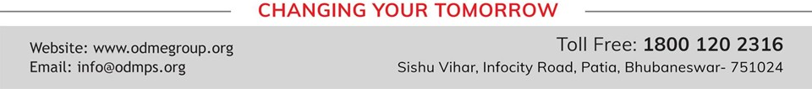
SIMPLE MACHINES
SUBJECT-PHYSICS CHAPTER NUMBER-4

Slide 2

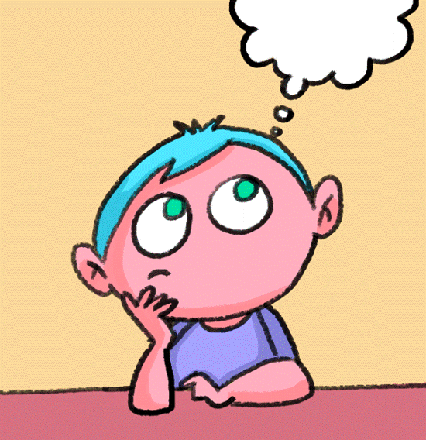
LEARNING OBJECTIVE
Students will be able to :
Define work
Define energy
State the SI unit of work and energy

Slide 3

Recapitulation
https://youtu.be/LSfNYpCprw4

Slide 4

SIMPLE MACHINES
WORK:
Work is said to be done if the force applied on the body moves it.
SI unit: joule
Energy:
The capacity or ability to do work is known as energy.
SI unit: joule

Slide 5
SIMPLE MACHINES
Machines:
A machine is a device which helps us to do work more easily by applying less force and spending less energy.
Examples:

Slide 6
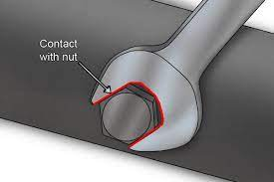
Use of spanner to open a tight nut.

Slide 7
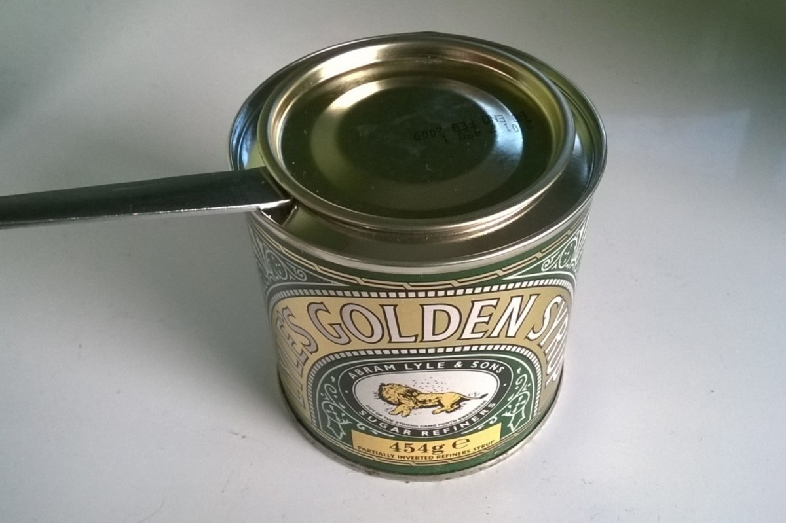
Use of a spoon to open the lid of a container

Slide 8
Examples of simple machines
A needle is used for sewing.
A pair of scissors is used for cutting cloth.
A pulley is used to pull a bucket of water from a well.
A crane is used to lift heavy equipments.

Slide 9
Principle of a machine
To do work on machine, a force is applied. The applied force is called effort (E).
As a result of force, the machine lifts or moves an object called the load (L).
The work output of a machine is equal to the work input.

Slide 10
Q.1. When is work said to be done by a force?
A- Work is said to be done if the force applied on the body moves it.
Q.2. What is energy?
A- The ability or capacity of a body to do work is known as energy.
Q.3. What do you understand by a machine?
A- A machine is a device which helps us to do work more easily by applying less force and spending less energy
Q.4. What is the principle on which a machine works?
A- The work output of a machine is equal to the work input.

Slide 11
THANKING YOU
ODM EDUCATIONAL GROUP

