Slide 1

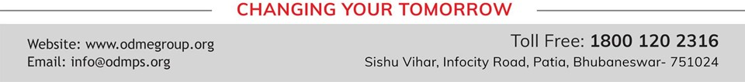
SIMPLE MACHINES
SUBJECT-PHYSICS CHAPTER NUMBER-4

Slide 2


LEARNING OBJECTIVE
Students will be able to :
Define work
Define energy
State the SI unit of work and energy

Slide 3

Recapitulation
https://youtu.be/LSfNYpCprw4

Slide 4

SIMPLE MACHINES
WORK:
Work is said to be done if the force applied on the body moves it.
SI unit: joule
Energy:
The capacity or ability to do work is known as energy.
SI unit: joule

Slide 5
SIMPLE MACHINES
Machines:
A machine is a device which helps us to do work more easily by applying less force and spending less energy.
Examples:

Slide 6
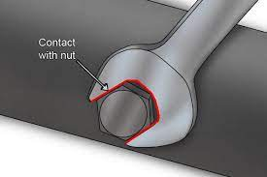
Use of spanner to open a tight nut.

Slide 7
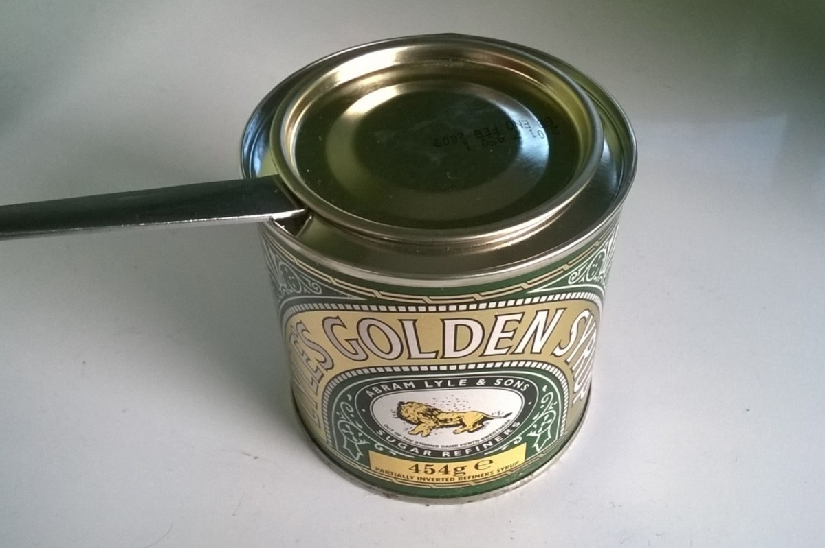
Use of a spoon to open the lid of a container

Slide 8
Examples of simple machines
A needle is used for sewing.
A pair of scissors is used for cutting cloth.
A pulley is used to pull a bucket of water from a well.
A crane is used to lift heavy equipments.

Slide 9
Principle of a machine
To do work on machine, a force is applied. The applied force is called effort (E).
As a result of force, the machine lifts or moves an object called the load (L).
The work output of a machine is equal to the work input.

Slide 10
Q.1. When is work said to be done by a force?
A- Work is said to be done if the force applied on the body moves it.
Q.2. What is energy?
A- The ability or capacity of a body to do work is known as energy.
Q.3. What do you understand by a machine?
A- A machine is a device which helps us to do work more easily by applying less force and spending less energy
Q.4. What is the principle on which a machine works?
A- The work output of a machine is equal to the work input.

Slide 11
FUNCTIONS OF A SIMPLE MACHINE
1. It decreases the magnitude of the force required i e the effort is less than the load. Ex- A bar is used to push a heavy stone.
2. It increases the distance moved by the load.Ex- In a pair of scissors, its arms move longer on cloth than its handle
3. It changes the direction of the effort in a convenient direction.
Ex- To lift a bucket of water, we use our weight as effort to pull up the bucket of water.
4 It changes the point of application of effort to a convenient point.
Ex- In a bicycle, the rear wheel is joined with the help of a chain to a toothed wheel attached to pedal.
The rear wheel is rotated by applying the effort on pedal.

Slide 12
TYPES
1. The lever: A pair of scissors
2. The pulley: water well, crane.
3. The wheel and axle: steering wheel
4. The inclined plane: staircase, ramp
5. The wedge: needle, axe
The screw: bolt, drill.

Slide 13
MECHANICAL ADVANTAGE
The factor by which a machine multiplies the force applied i.e effort is called the mechanical adventage of that machine.
Mechanical advantage= Load/ Effort.
Its value can be less than 1, equal to 1 or greater than 1.
If it is greaer than 1, then the machine is called a force multiplier.

Slide 14
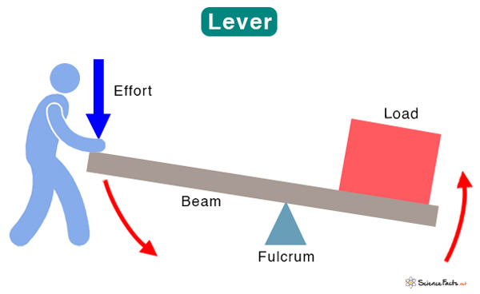
LEVERS
A lever is a simple machine, a rod which can turn about a fixed point.

Slide 15
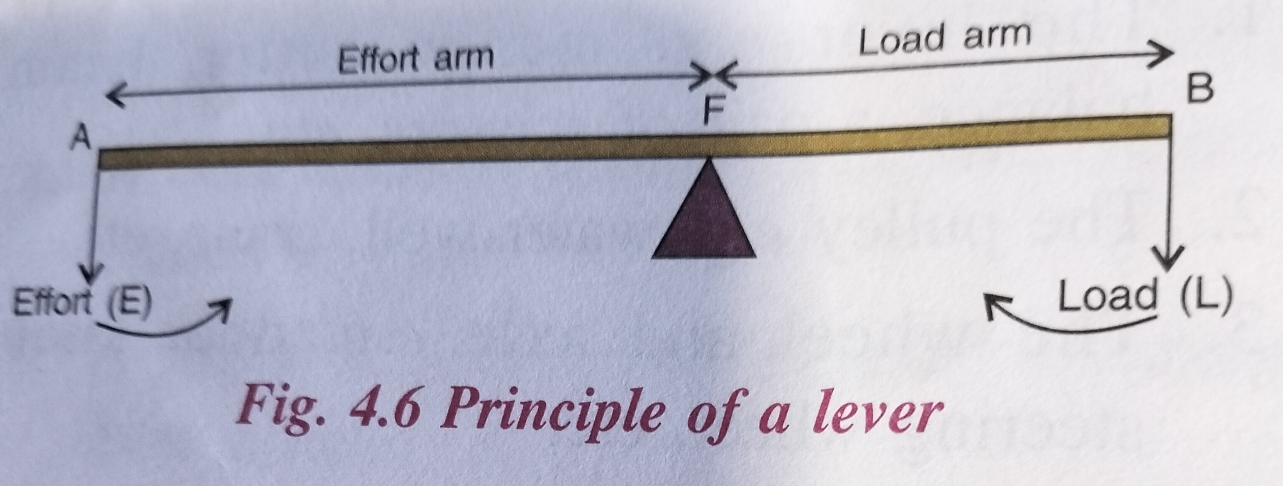
PRINCIPLE OF A LEVER
Mechanical advantage of lever = Load/Effort
= Effor arm FA/Load arm FB.
075568

Slide 16
If load arm is greater than the effort arm, mechanical advantage is less than 1.
If load arm = effort arm, the mechanical advantage= 1
If load arm is smaller than the effort arm, the mechanical advantage= greater than 1.

Slide 17
CLASSES OR ORDERS OF LEVERS
LEVERS are divided into 3 classes or orders, depending on the position of fulcrum, effort, load.
Class I
Class II
Class III

Slide 18
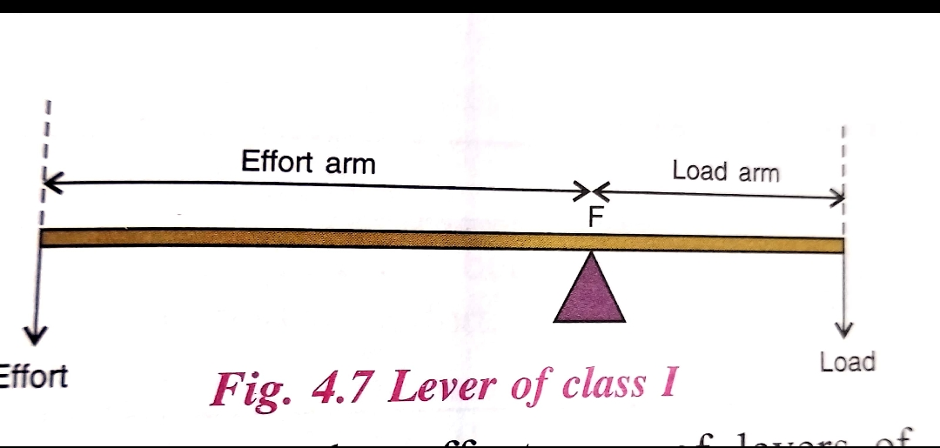
LEVERS of class I
The levers in which the fulcrum is between the load and the effort are called levers of class I.

Slide 19
LEVERS of class I
Effort arm of class I is longer than the load arm.
So, mechanical advantage of class I levers is greater than 1.
If effort arm is equal to load arm, then the mechanical advantage is equal to 1.
If effort arm is Shorter than the load arm, then mechanical advantage is less than 1.
So, the mechanical advantage of levers of class I can be greater than 1, equal to 1 or smaller than 1.

Slide 20
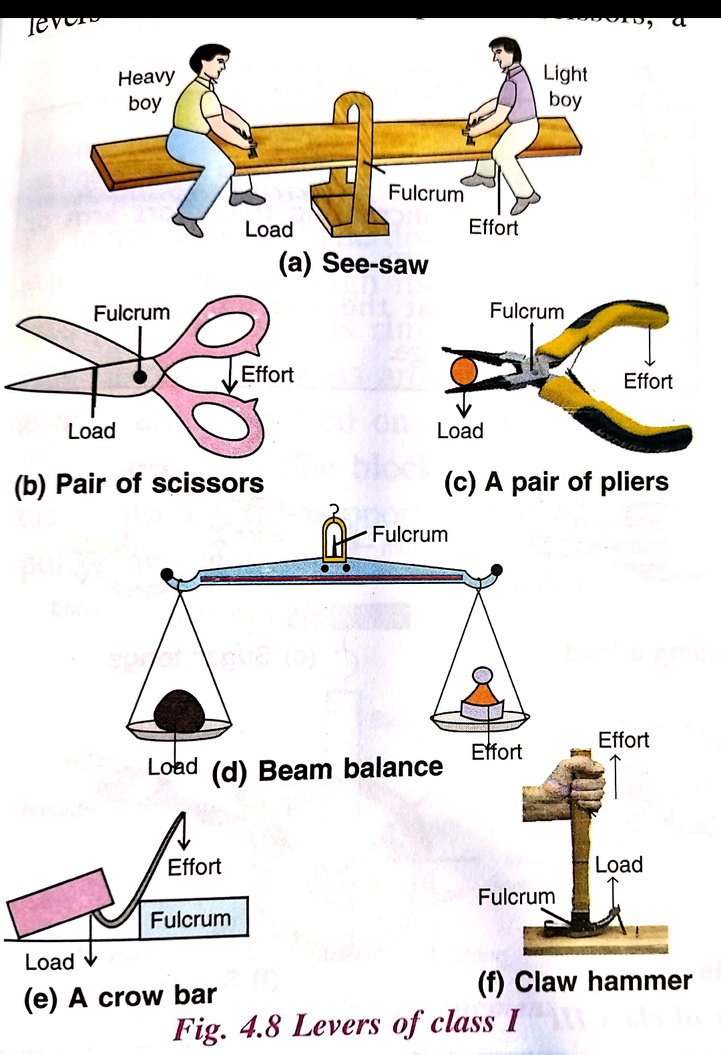
Examples of levers of class I

Slide 21
THANKING YOU
ODM EDUCATIONAL GROUP

Slide 22
THANKING YOU
ODM EDUCATIONAL GROUP

