Slide 1

WELCOME TO THE ONLINE CLASS
SUBJECT-MATHS
TOPIC-SHAPES

Slide 2

TRIANGLE

Slide 3
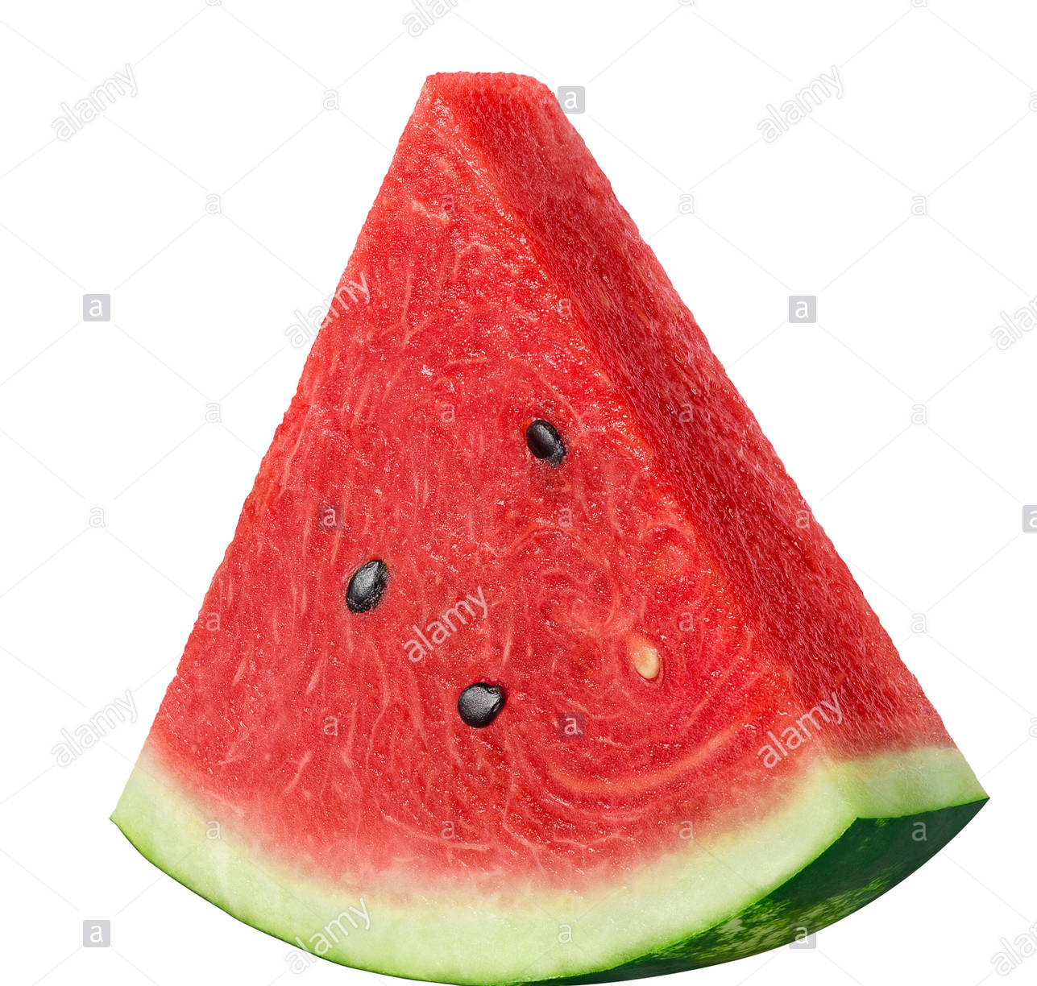

OBJECTS RELATED TO TRIANGLE

Slide 4
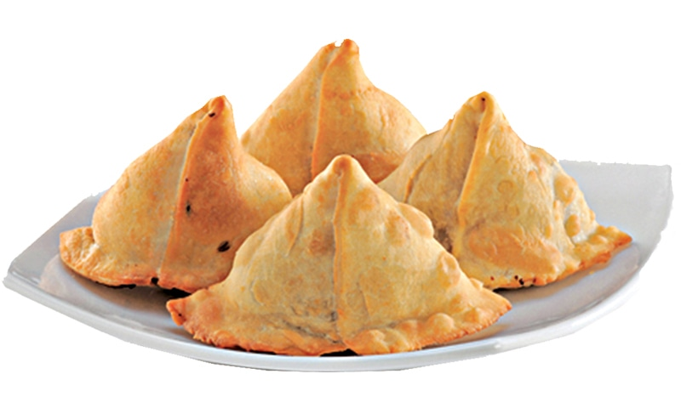
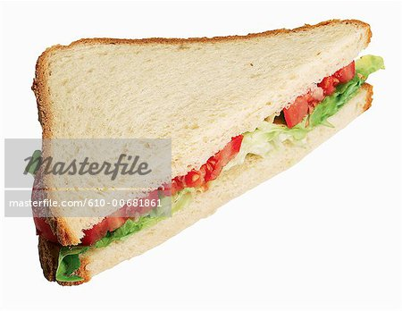

Slide 5
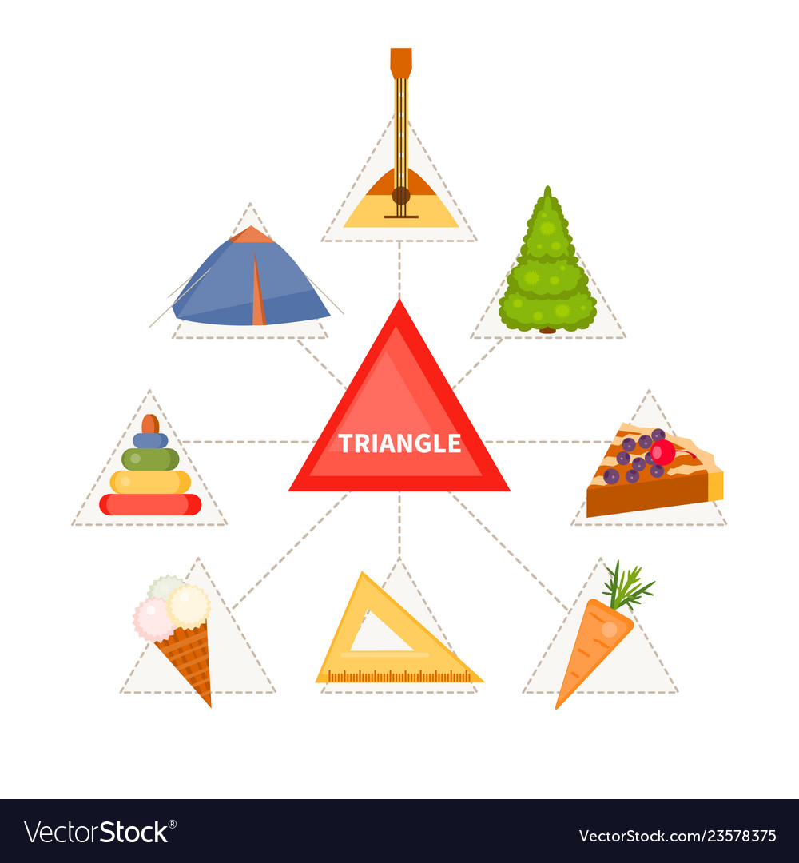

Slide 6


THANKING YOU
ODM EDUCATIONAL GROUP

