Slide 1

WELCOME TO THE ONLINE CLASS
SUBJECT-MATHS
TOPIC-SHAPES

Slide 2
SQUARE

Slide 3

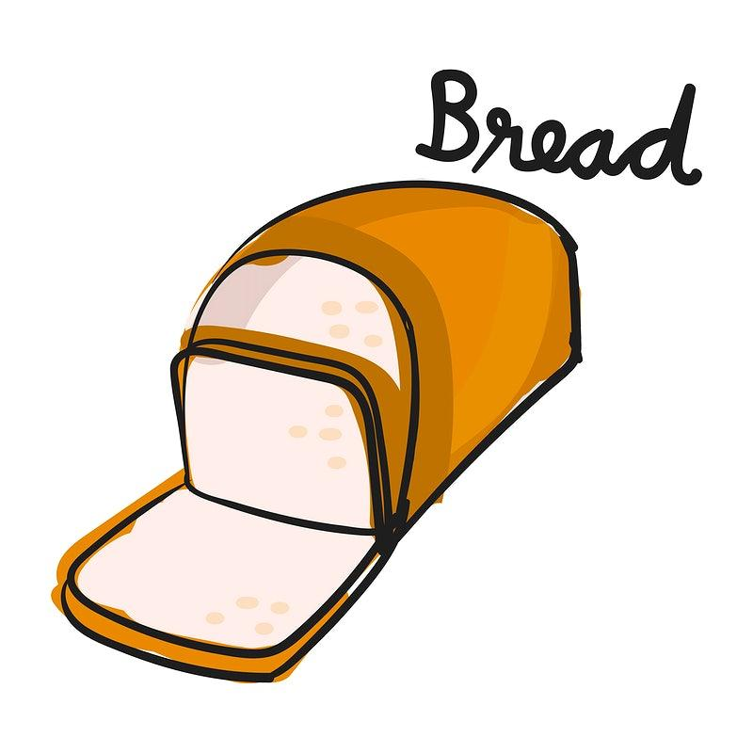
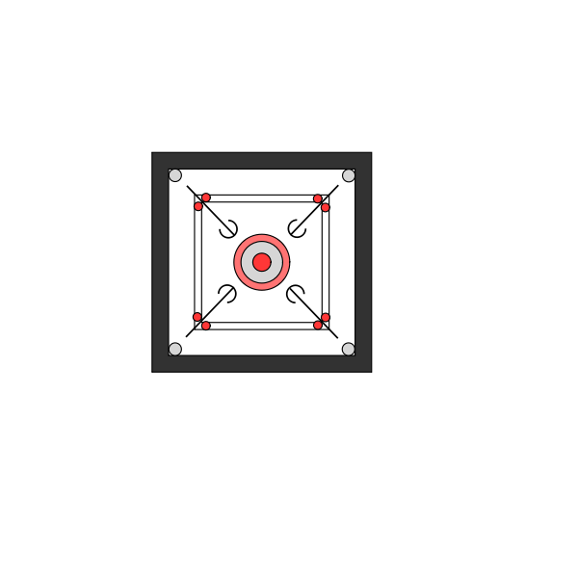
OBJECTS RELATED TO SQUARE
CARROM
CLOCK

Slide 4
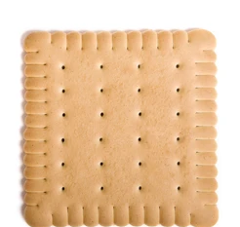
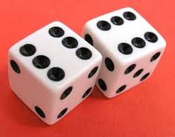
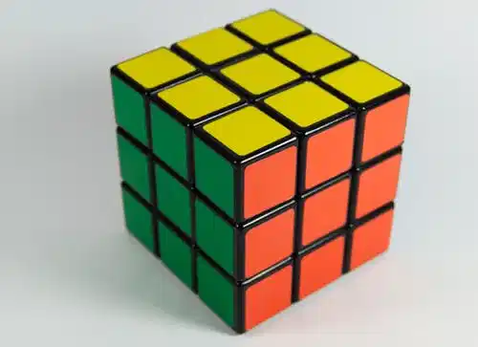


Slide 5


THANKING YOU
ODM EDUCATIONAL GROUP

