Slide 1

WELCOME TO THE ONLINE CLASS
SUBJECT-MATHS
TOPIC-SHAPES

Slide 2
CIRCLE

Slide 3


OBJECTS RELATED TO CIRCLE

Slide 4
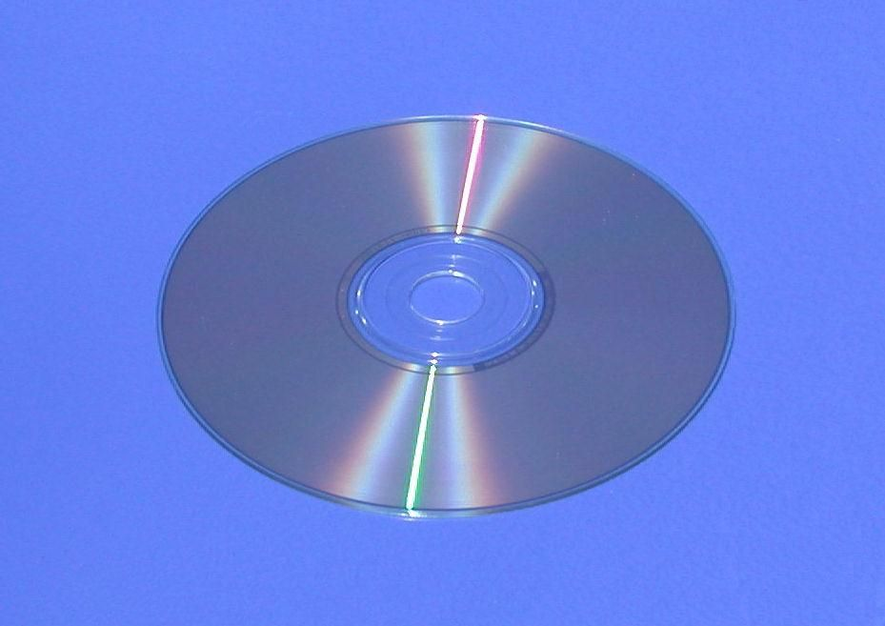
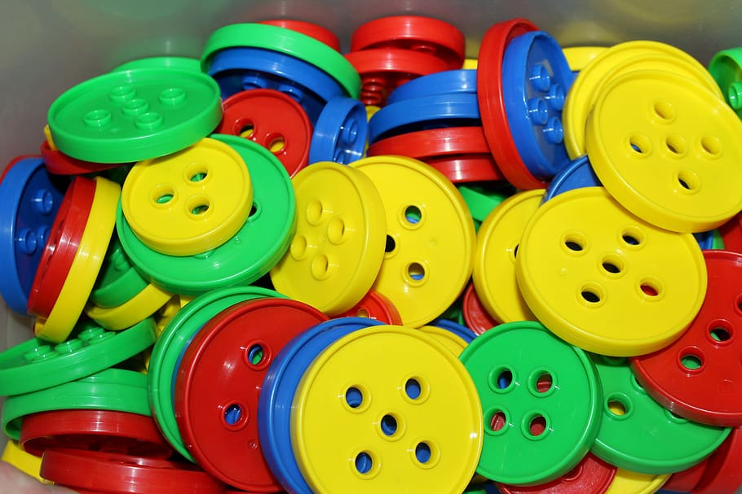
DISC
BUTTONS

Slide 5
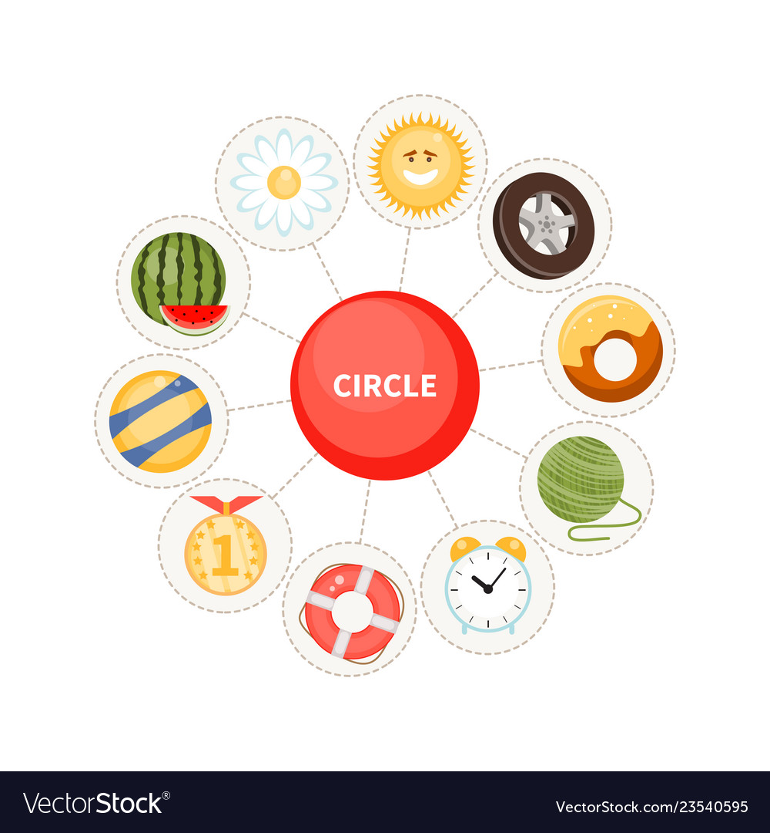

Slide 6


THANKING YOU
ODM EDUCATIONAL GROUP

