Slide 1


MONTH : SEPTEMBER
SESSION : 5
CLASS : V
SUBJECT : MATHEMATICS
CHAPTER NUMBER: 9
CHAPTER NAME : FRACTION
SUB-TOPIC : DIVISION OF FRACTIONS
EXERCISE 9 D

Slide 2
LEARNING OBJECTIVE :
Enable the students
To divide a fraction by another fraction.
To reduce to their lowest term

Slide 3


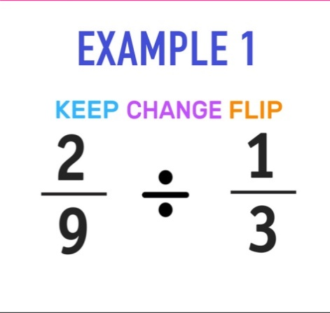

Division of Fractions
2
3
2
×
=
9
1
3
3

Slide 4

Division of Fractions
Example: 1
1
÷
2
3
1
1 × 1
1
1
×
=
=
3 × 2
6
3
2
keep
change
Flip

Slide 5
Division of Fractions
Example: 2
11
2
÷
15
3
11 × 3
11
1
=
=
=
1
15 × 2
10
10
5
Example: 3
19
16
5
71
213
2
÷
=
÷
26
13
26
13
71 × 13
1
=
=
6
26 × 213
2
3

Slide 6

Division of Fractions
Example: 4
Write the quotient in its simplest form
6
18
35
7
Reciprocal of =
35
18
18
35
5
6
×
35
=
7
18
3
5
2
=
1
=
3
3

Slide 7

EXERCISE : 9 D
1. Divide:
a.
35
70
÷
44
35 × 1
1
=
=
44 × 70
88
2
b.
12
15
÷
13
4
12 × 1
4
=
=
13 × 15
65
5

Slide 8
EXERCISE : 9 D
1. Divide:
c.
8
2
÷
13
13
4
8 × 13
=
=
4
13 × 2
5
10
d.
÷
12
21
7
5 × 21
=
7
=
12 × 10
4
8
2

Slide 9
EXERCISE : 9 D
1. Divide:
j.
3
1
6
÷
÷
4
2
7
3
2
7
7
=
×
×
3
=
=
1
4
1
×
6
4
×
4
2
2
1
3
3
9
13
3
k.
2
÷
1
÷
=
÷
÷
4
10
13
4
10
13
3
5
9
10
13
15
=
×
×
1
=
=
7
4
13
×
3
2
×
2
2

Slide 10
EXERCISE : 9 D
2. Find the quotient in its simplest form
a.
3
5
10
7
Reciprocal of =
7
10
7
10
2
3
10
6
=
×
=
5
7
7
b.
5
16
9
14
7
5
14
35
=
×
=
16
9
72
8

Slide 11
EXERCISE : 9 D
2. Find the quotient in its simplest form
8
c
15
35
36
12
8
36
96
=
×
=
15
35
175
5
12
d
17
5
12
1
12
=
×
=
17
5
85

Slide 12
EXERCISE : 9 D
2. Find the quotient in its simplest form
j
10
10
5
=
÷
2
1
3
1
3
2
10
×
3
=
=
6
1
5
k
24
24
10
=
÷
3
1
1
3
3
12
24
3
36
=
1
=
×
=
7
1
10
5
5
5

Slide 13

Complete exercise 9 D Q.No.1 and 2 in the notebook.

Slide 14

Students are able to divide a fraction by another fraction and reduce the same to its lowest term.

Slide 15
THANKING YOU
ODM EDUCATIONAL GROUP

