Slide 1

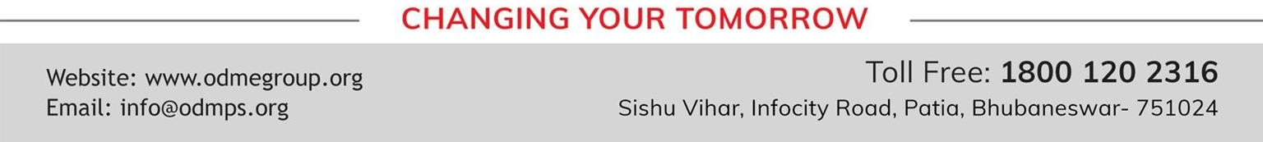
CAPITAL MARKET
SUBJECT : (ENTREPRENEURSHIP) CHAPTER NUMBER: 6
CHAPTER NAME : RESOURCE MOBILIZATION

Slide 2
NEED OF FINANCE
‘Finance’ refers to funds or monetary resources needed. Finance is one of the most important pre- requisite to start an enterprise. Whether running a home based business or a mid sized venture, the first thing required is money. Right from the very beginning i.e. conceiving an idea; finance is required to:
Promote or establish the business
Acquire fixed assets
Make market investigations
Develop product
Keep men and machines at work
Encourage management to make progress and create value.
Expand, diversify, improve and grow.
Be enough to meet unexpected/unplanned business expenses.

Slide 3
SOURCES OF FINANCE
An enterprise can raise finance through various sources. These sources can be broadly classified as:
Internal sources: it includes to those sources which are generated from within the business.
External sources: it includes those sources of financing, which are raised from outside the business.

Slide 4
INTERNAL SOURCES
Equity shares
Preference shares
Retained earnings
Global depository receipts
American depository receipts
Indian depository receipts

Slide 5
EXTERNAL SOURCES
Debenture and bonds
Loans from financial institution
Loans from commercial banks
Public deposits
Trade credit
Inter- corporate deposits

Slide 6
CAPITAL MARKET
A capital market may be defined as an organized mechanism meant for effective and smooth transfer of money capital or financial resources from the investors to the entrepreneurs. Here, productive capital is raised and made available for industrial purposes. Capital markets are the most important source of raising finance for the entrepreneurs as this market can:
Mobilize the financial resources on a nation-wide scale.
Secure the required foreign capital and know-how to promote economic growth at a faster rate.
Ensure the most effective allocation of the mobilized financial resources by directing the same either to such
projects which are capable of the highest yield or to the underdeveloped priority areas where there is an urgent need to promote balanced and diversified industrialization.

Slide 7
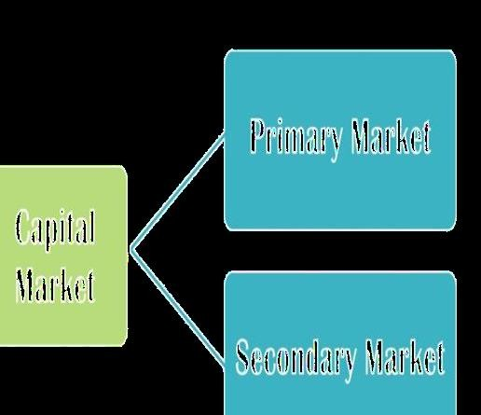

Slide 8
THANKING YOU ODM EDUCATIONAL GROUP

Slide 9
PRIMARY MARKET
Primary market is basically to facilitate transfer of resources from the savers to the entrepreneurs seeking
funds for:
Setting new enterprises
Expanding
Diversifying
The 'new issues' may be issued by:
New companies – also called initial issues.
Old companies – also called further issues.

Slide 10
PUBLIC ISSUE
Public issue is the most popular method of raising capital these days by the entrepreneurs. This involves raising of funds directly from the public through the issue of prospectus. An enterprise organizing itself as a public limited company can raise the required funds commonly by preparing a prospectus.
ADVANTAGES
Access to capital
Mergers and acquisitions
Higher valuations
Benchmark trading price
Capital formation
Incentives
Reduced business requirements

Slide 11
Less dilution
Liquidity
Prestige
DRAWBACKS
Increasing accountability to public shareholders
Need to maintain dividend and profit growth trends
Becoming more vulnerable to an unwelcome takeover
Need to observe and adhere strictly to the rules and regulations by governing bodies
Increasing costs in complying with higher level of reporting requirements
Relinquishing some control of the company following the public offering
Suffering a loss of privacy as a result of media interest.

Slide 12
THANKING YOU
ODM EDUCATIONAL GROUP

Slide 13
RIGHTS ISSUE
Rights issue is a method of raising additional finance from existing shareholders by offering securities to them on pro-rata basis i.e. giving them a right to a certain number of shares in proportion to the shares they are holding.
Normally, through a circular, rights issues are proposed to the existing shareholders and in case they are not
willing to subscribe, they can renounce the same in favor of another person. This method of issuing securities is considered to be inexpensive as it does not require any brokers, agents, underwriters, prospectus or enlistment, etc.

Slide 14
PRIVATE PLACEMENT
Private placement means the direct sale by a company of its securities to a limited number of sophisticated
investors. Entrepreneurs, herein, raise funds by selling the issues mainly to the institutional investors like:
Unit Trust of India
Life Insurance Corporation of India
General Insurance Corporation of India
Army Group Insurance
V) State Level Financial Corporations, etc.
This is an effective source of raising capital if the company do not wish to disclose information in the open market.

Slide 15
THANKING YOU
ODM EDUCATIONAL GROUP

Slide 16
OFFER TO EMPLOYEES
Stock options or offering shares to the employees has gained much popularity in many countries of the world. This method enables employees to become shareholders and share the profits of the company leading to:
Higher efficiency
Low labor turnover
Better industrial locations
Low floatation cost
Wider/higher generation of funds.

Slide 17
SECONDARY MARKET
Any transaction in shares or debentures subsequent to its primary offering is called "Secondary Transaction". Thus, the secondary capital market, which is also known as old securities market or stock exchange deals with buying and selling of old securities i.e. the market securities issued earlier are sold by existing investors in this market
It operates through the medium of stock exchanges which regulate the trading activities in this market and ensures a measure of safety and fair dealings to the investors.

Slide 18
THANKING YOU
ODM EDUCATIONAL GROUP

Slide 19
STOCK EXCHANGE
A stock exchange means anybody of individuals, whether incorporated or not, constituted for the purpose of
assisting, regulating or controlling the business of buying and selling or dealing in securities.
Features
Association of persons
Recognition from central government
Market for securities
Deals in second hand securities
Regulates trade in securities
Allow dealings only in listed securities
Transactions effected only through members

Slide 20
Working as per rules
Specific location
Financial barometers
FUNCTIONS OF STOCK EXCHANGE
Continuous and ready market for securities
Facilitates evaluation of securities
Checks on brokers
Provides safety and security in dealings
Regulates company management
Intensifying capital formation

Slide 21
Facilitates raising of new capital
Facilitates public borrowing
Facilitates healthy speculation
Serves as economic barometer
Facilitates bank lending

Slide 22
THANKING YOU
ODM EDUCATIONAL GROUP

Slide 23
IMPORTANCE OF STOCK EXCHANGE
From the viewpoint of investors
Dissemination of useful information: Stock exchange publishes useful information regarding price lists, quotations, etc., of securities through newspapers and journals. The interested persons buy and sell their securities on the basis of information provided by the stock exchanges.
Ready market: Persons desirous of converting their shares into cash may easily do so through a member of stock exchange.
Investors' interests protected: Stock exchanges formulate rules and regulations so that members may not exploit the investors.
Genuine guidance about the securities listed: The investors can safely depend upon the information provided by the stock exchanges.

Slide 24
Barriers of distance removed: Stock exchange removes the barriers of distance with regard to securities listed
there.
Knowledge of profit or loss on investments: The investors can estimate the profit or loss on the total amount
of investments in securities, by comparing the original amount invested and the price of securities on a
particular day.
From the viewpoint of entrepreneurs /companies
Recognition: The market values of companies' shares are published in important dailies. This enhances the reputation of good companies.
Wide market: The securities of some companies are listed in some stock exchanges. The market for the securities of such companies is considerably widened. Thus, larger amounts of capital may be raised from different types of investors.

Slide 25
(c) Higher share values: People have a tendency to buy shares that have some premium value. Demand of such
shares increases. This leads to further increase in the price of such shares.
From the viewpoint of society
Rapid capital formation: People get tempted to invest in securities when they study the trend of necessary
prices of shares of good companies. This habit leads to investment of savings in corporate and government securities. The income from these securities may further be invested in buying more securities.
Economic development: Through easy funds mobilizing, the boosted production fetches more capital, enhancing economic development.
National projects: As stock exchange promotes, the capital formation rate the projects which brings National Prosperity can be easily undertaken.

Slide 26
POWERS OF THE GOVERNING BODY
Elect the office bearers and set up committees.
Admit and expel members
Manage the properties and finance of the exchange
Interpret rules, regulations and by-laws
Adjudicate disputes
Conduct the affairs of the exchange.

Slide 27
THANKING YOU
ODM EDUCATIONAL GROUP

Slide 28
SECURITIES EXCHANGE BOARD OF INDIA
SEBI was established as a supervising and regulatory body to curb certain malpractices and to promote the
securities markets in India. SEBI is managed by its members, which consists of following:
Chairman who is nominated by Union Government of India.
Two members, i.e. Officers from Union Finance Ministry.
One member from The Reserve Bank of India.
The remaining 5 members are nominated by Union Government of India, out of them at least 3 shall be whole- time members.

Slide 29
POWERS OF SEBI
To approve by-laws of stock exchanges, SEBI
To enquire the stock exchange to amend their by-laws.
Inspect the books of accounts and call for periodical returns from recognized stock exchanges.
Inspect the books of accounts of financial intermediaries.
Compel certain companies to list their shares in one or more stocks exchanges.
Levy fees and other charges on the intermediaries for performing its functions.
Grant license to any person for the purpose of dealing in certain areas.
Delegate powers exercisable by it.
Prosecute and judge directly the violation of certain provisions of the Companies Act.
Power to impose monetary penalties.

Slide 30
FUNCTIONS OF SEBI
Quasi – legislative
Quasi – executive
Quasi- judicial

Slide 31
THANKING YOU
ODM EDUCATIONAL GROUP

