Slide 1


EMPLOYEE, VENDOR AND QUALITY MANAGEMENT
SUBJECT : (ENTREPRENEURSHIP) CHAPTER NUMBER: 3
CHAPTER NAME :ENTERPRISE MARKETING

Slide 2
EMPLOYEE RELATIONSHIP MANAGEMENT
Employee relationship management is a process that companies use to effectively manage all interactions
with employees, ultimately to achieve the goals of the organisation.
The human resources department can play a critical role in this process, both in terms of training and
coaching managers and executives on how to effectively establish and nurture relationships with employees and in measuring and monitoring those relationships to determine whether objectives are being met.

Slide 3
FACTORS WHICH LEAD TO EFFECTIVE EMPLOYEE RELATIONSHIP
Identifying objectives: The first step towards effective employee management is identifying the objectives of employee relationship management plan. For most companies, relationship management centers around items like attracting and retaining employees. Common measures of the effectiveness of these relationships include time to hire, turnover and employee satisfaction.
Determining employee needs: An organization should not only focus on identifying and achieving its objectives but should also be sensitive towards employee’s needs. This can be done on one-on-one conversations that take place informally throughout the year, during formal employee evaluation meetings and through surveys and polls that can provide a quantitative indication of employee needs.

Slide 4
Balancing work and life needs: Effective employee relationship management requires consideration of the whole employee. That means taking steps to ensure that the employee's work-life needs are well balanced. This can occur through creative staffing that might involve part-time, flex–time or even off-site work assignments.
Open and honest communication: Communication is critical to establishing strong employee relationships. Managers must be committed to communicating regularly and honestly with employees about the issues that impact their work. The more open organizations can be, the more likely they are to establish strong relationships that lead to increased loyalty and productivity among employees and decreased turnover and dissatisfaction.

Slide 5
Measuring and monitoring results: Effective employee relationship management requires ongoing attention. That means that managers and their HR departments should be alert at all times for signs of discontent, which can be subjective, as well as carefully monitoring the results of more formal assessments. These results should also be shared with employees.
Relationships are interpersonal: Employee relationship management requires the same skills and processes required to manage any relationship; a clear understanding of employees' needs and a desire to meet those needs is foundational. Then steps must be taken to interact effectively with employees through a variety of communication channels, both interpersonal and formal. Finally, measurement of the effectiveness of these efforts should be frequent and ongoing.

Slide 6
THANKING YOU
ODM EDUCATIONAL GROUP

Slide 7
VENDOR MANAGEMENT
Vendors are individuals or businesses that supply goods or services to other individuals or businesses.
Vendor management is a term used to describe the process of finding, qualifying and doing business with vendors. Common activities include:
researching vendors
negotiating contracts
obtaining quotes
evaluating performance
creating and updating vendor files
ensuring that payments are made properly.

Slide 8
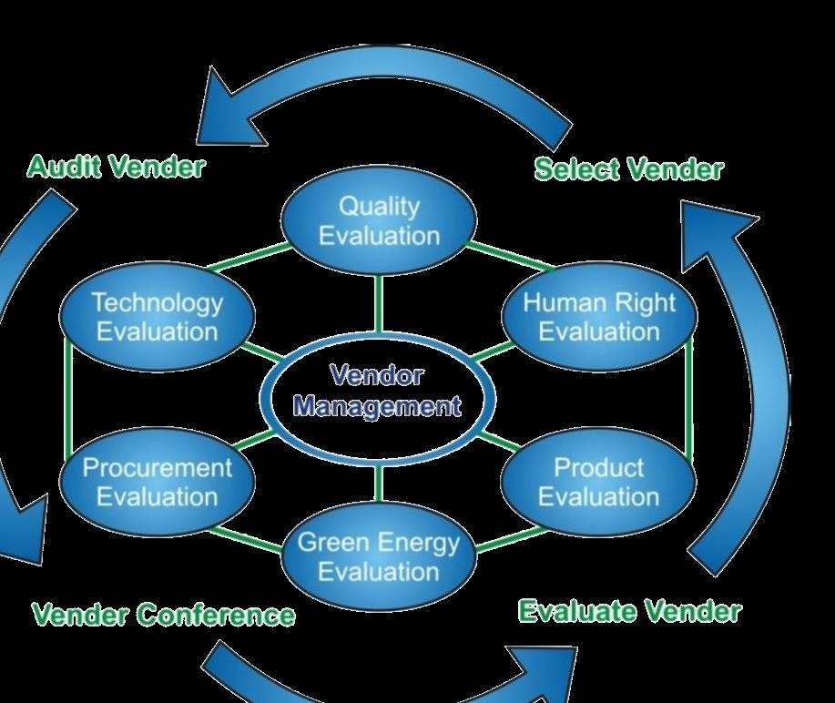

Slide 9
STEPS INVOLVED IN THE PROCESS OF VENDOR MANAGEMENT
Vendor selection
Managing vendors
Proper management records

Slide 10
THANKING YOU
ODM EDUCATIONAL GROUP

Slide 11
QUALITY
Quality is the totality of features and characteristics of a product or service that bear on its ability to satisfy
stated or implied needs. A company that satisfies most of its customer needs most of the time is called a
quality company.
Quality is clearly the key to value creation and customer satisfaction.

Slide 12
IMPACT OF QUALITY
Product and service quality, customer satisfaction and company profitability are intimately connected.
Higher level of quality results in higher level of customer satisfaction, which supports higher prices and
(often) lower costs. Companies that have lowered costs to cut corners have paid the price when the quality
of the customer experience suffers.

Slide 13
THANKING YOU
ODM EDUCATIONAL GROUP

