Slide 1

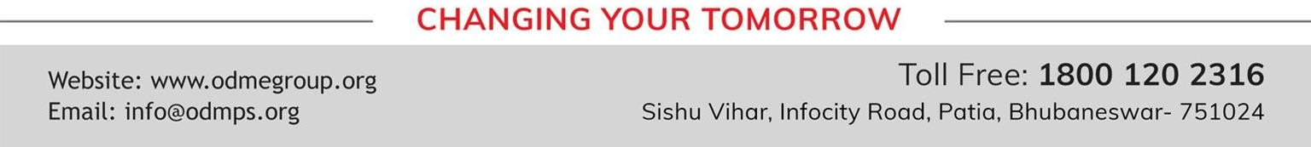
SALES AND PROMOTION STRATEGY
SUBJECT : (ENTREPRENEURSHIP) CHAPTER NUMBER: 3
CHAPTER NAME : ENTERPRISE MARKETING

Slide 2
SALES STRATEGY
A sales strategy consists of a plan that positions a company’s brand or product to gain a competitive
advantage. Successful strategies help the sales force focus on target market customers and communicate
with them in relevant and meaningful ways. Sales representatives need to know how their products or
services can solve customer's problems.
A successful sales strategy conveys this so that the sales force spends time targeting the correct customers at the right time.

Slide 3
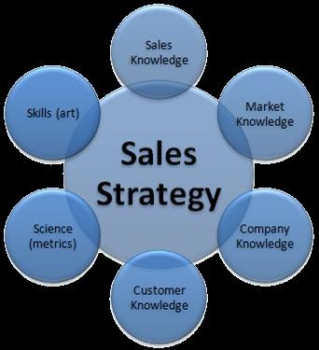

Slide 4
CRITERIA FOR SOUND SALES STRATEGY
Sales strategy should be well defined and presented in unambiguous statements.
They should have a specific product market focus.
They must act towards gaining competitive advantage for the firm.

Slide 5
SIGNIFICANCE OF SALES STRATEGY
Creating awareness about business environment: Planning, an effective sales strategy requires looking at
long term sales goals and analyzing the business sales cycle, as well as meeting sales people and familiarizing
with career goals. This will help owners and managers to gain more precise knowledge of sales intervals,
seasonal changes and motivating factors about the sales team.
Helps in measuring short term performance of sales: After creating long term goals, sales managers create
monthly and weekly strategies. This allows for short term performance evaluation of sales team and allows to take remedial action if targets are not achieved.

Slide 6
TYPES OF SALES STRATEGY
Direct sales strategy: Organizations opting for direct sales strategy hire representatives to sell their product/
services directly to the customers or sell through internet.
Indirect sales strategy: Companies operating an indirect sales strategy, to market their products through
intermediaries such as wholesalers, distributors or retailers who may sell products of competitors also.

Slide 7
THANKING YOU
ODM EDUCATIONAL GROUP

Slide 8
COMPONENTS OF SALES STRATEGY
Product placement
Promotion
Testimonials
Core selling strategies

Slide 9
FUNCTIONS OF SALES STRATEGY
New customer acquisition
Customer retention

Slide 10
CONSIDERATIONS WHILE FORMULATING SALES STRATEGY
Creating an effective sales strategy requires market knowledge, awareness of competitor activities,
awareness of current trends and detailed business analysis. Small business owners wishing to create and
implement a sales strategy for the first time may want to hire a professional business consultant to help
guide the process.

Slide 11
THANKING YOU
ODM EDUCATIONAL GROUP

Slide 12
PROMOTION STRATEGY
Promotion is the method to spread the word about the product or service to customers, stakeholders and
the broader public.
Promotion strategy is a comprehensive plan that aims at finding an appropriate market for a product or
service, utilizing all aspects of promotion such as advertising and discounts used to promote the product or a service in a particular market or we can also that it chooses a market and then formulates the most appropriate promotion mix to influence it.

Slide 13
VARIOUS APPROACHES OF PROMOTION
Above-the-line: This type of promotion focuses on advertising to a large audience. It uses mass media
methods of promotion such as:
Advertising in press
Online banner advertisement
Place advertisements on bill boards.
Website development
Television and cinema advertising
Through-the-line: "Through the line" refers to an advertising strategy involving both above-and below-the line communications in which one form of advertising points the target to another form of advertising thereby crossing the "line".

Slide 14
Below-the-line: Below-the-line methods are very specific, memorable activities focused on targeted groups of consumers. They are under the control of the organisation. The purpose of these activities has been to develop the brand by creating awareness and building a brand profile, which include:
sponsorship
sales promotions
public relations
personal selling
direct marketing

Slide 15
PROMOTION MIX
Promotion mix refers to the combination of promotional tools used by an organization to reach the targeted
market.
These tools are also referred to as elements of promotion mix. These elements can be used in different
combinations, depending on the nature of the market, budget, objectives of promotion, etc.

Slide 16
THANKING YOU
ODM EDUCATIONAL GROUP

Slide 17
ADVERTISING
Advertising is a paid form of communication designed to persuade potential customers to choose the product or service over that of a competitor. Successful advertising involves making the products or services positively known by that section of the public most likely to purchase them. It should be a planned, consistent activity that keeps the name of the business and the benefits of products or services uppermost in the mind of the consumer.
Objectives:
Make business and product name familiar to the public
Create goodwill and build a favourable image
Educate and inform the public
Offer specific products or services
Attract customers to find out more about your product or service

Slide 18
Rules of advertising
Aim - What is the primary purpose of the advertisement? Is it to inform, sell, produce listings or improve the
image of the business?
Target - Who is the target? From which sector of the public are we trying to achieve a response? For
example, is it male, female, adult, teenager, child, mother, father etc.
Media – Bearing the aim and target in mind, which are of the media available is the most suitable – i.e. TV, radio, press or Internet?
Competitors – What are the competitors doing? Which media channel do they use? Are they successful? Can you improve on their approach and beat them in competition?

Slide 19
THANKING YOU
ODM EDUCATIONAL GROUP

Slide 20
Developing effective advertising (AIDA)
Attention – It catches the eye or ear and stands out amid the clutter of competing advertisements.
Interest – It arouses interest and delivers sufficient impact in the message or offering.
Desire – It creates a desire to learn more or crave ownership.
Action – It spurs an action which leads to achievement of the ad’s original objective – i.e. it prompts potential customers to purchase or use your product or service.

Slide 21
Commonly used media
Stationary
Window display or office front
Press advertising
Radio
Television
Direct mail
Outdoor
Ambient
Cinema
Point of sale
Online
Directory listings

Slide 22
PERSONAL SELLING
It means selling products personally. It involves oral presentation of message in the form of conversation
with one or more prospective customers for the purpose of making sales. Companies appoint salesperson to
contact prospective buyers and create awareness about the company’s product. Thus a salesperson plays
three different roles:
Be persuasive
A service provider
Be informative

Slide 23
SALES PROMOTION
Sales promotion relates to short–term incentives or activities that encourage the purchase or sale of a
product or service. Sales promotions initiatives are often referred to as ―below the line activities.
Sales promotion activities can be targeted towards final buyers (consumer promotions), business customers
(business promotions), retailers and wholesalers (trade promotions) and members of the sales force (sales
force promotions). Here are some typical sales promotion activities:
Consumer promotions
Business promotions
Trade promotions
Sales force promotions

Slide 24
THANKING YOU
ODM EDUCATIONAL GROUP

Slide 25
PUBLIC RELATIONS
It is the deliberate, planned and sustained effort to establish and maintain mutual understanding between
an organisation (or individual) and its (or their) public.
Put more simply, public relations is about building good relations with the stakeholders (public) of the
business by obtaining favourable publicity, building a good corporate image and handling or heading off unfavourable rumours, stories and events.
By building good relationships with the stakeholders, particularly customers, we can generate positive word of mouth and referrals from satisfied customers.

Slide 26
Tools of public relations
News creation and distribution (media releases).
Special events such as news conferences, grand openings and product launches.
Speeches and presentations.
Educational programs.
Annual reports, brochures, newsletters, magazines and Audio–visual presentations.
Community activities and sponsorships.

Slide 27
THANKING YOU
ODM EDUCATIONAL GROUP

