Slide 1


Dasam twam asi
SUBJECT- SANSKRIT
STD: VI
CHAPTER NAME: Dasam twam asi

Slide 2



Slide 3


Slide 4
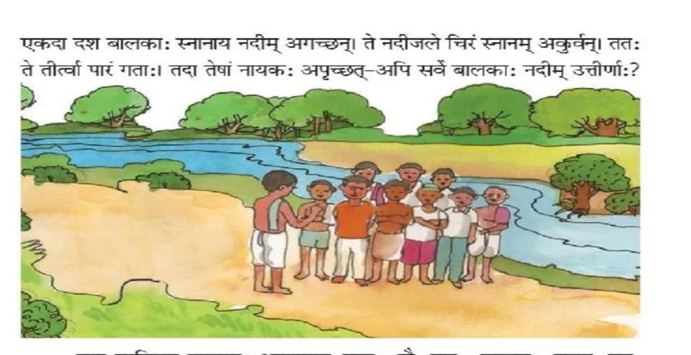

Slide 5
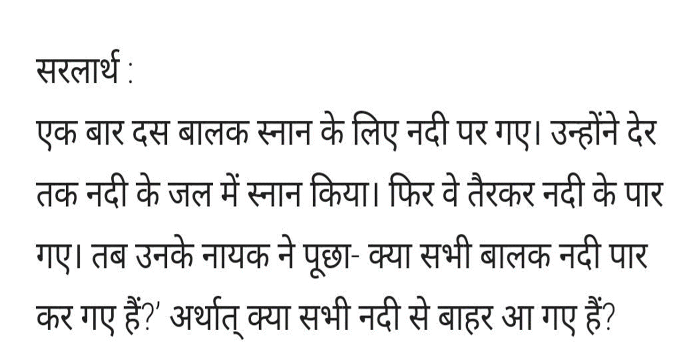

Slide 6
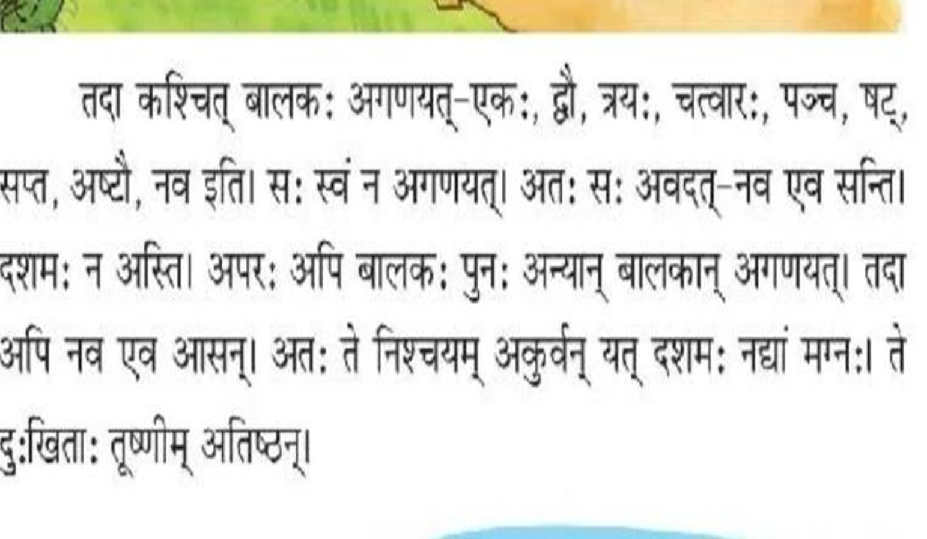

Slide 7
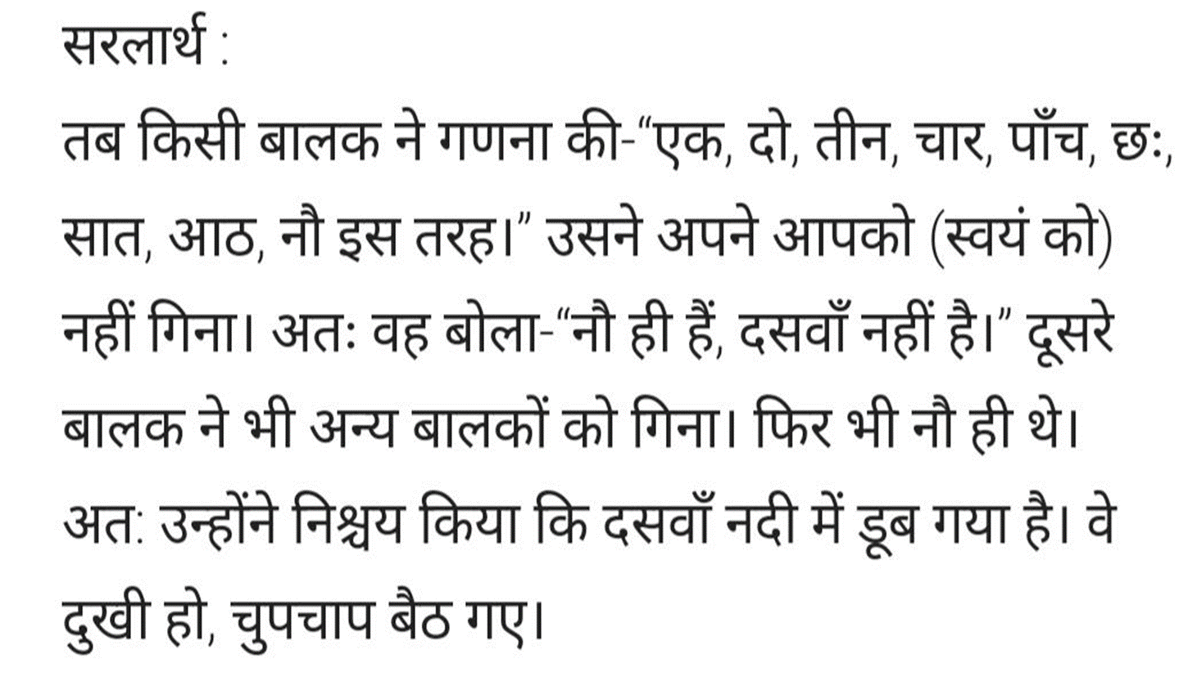

Slide 8
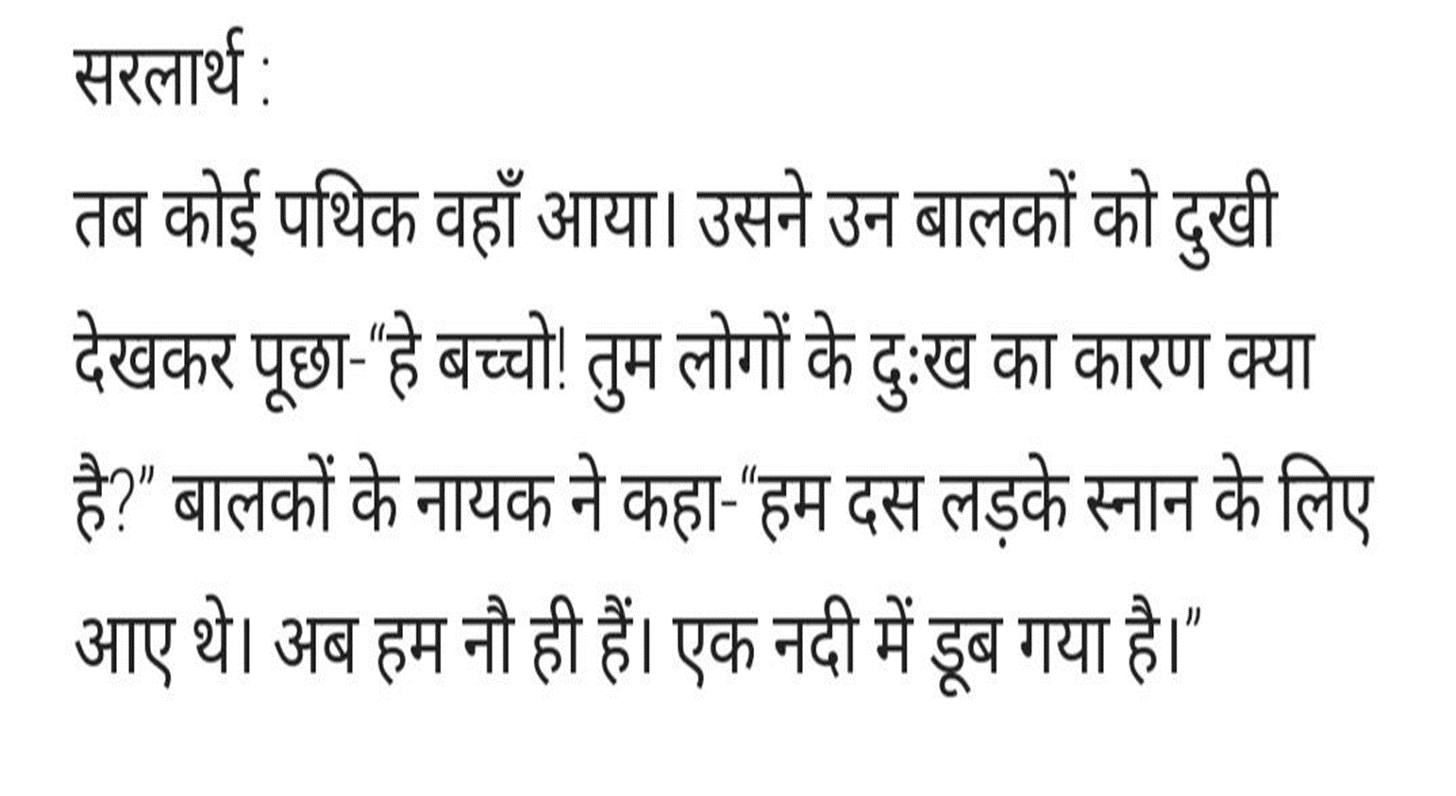

Slide 9
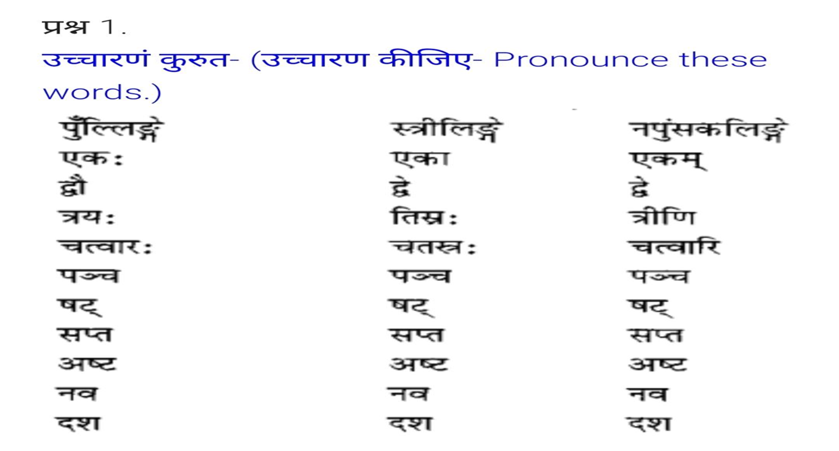

Slide 10
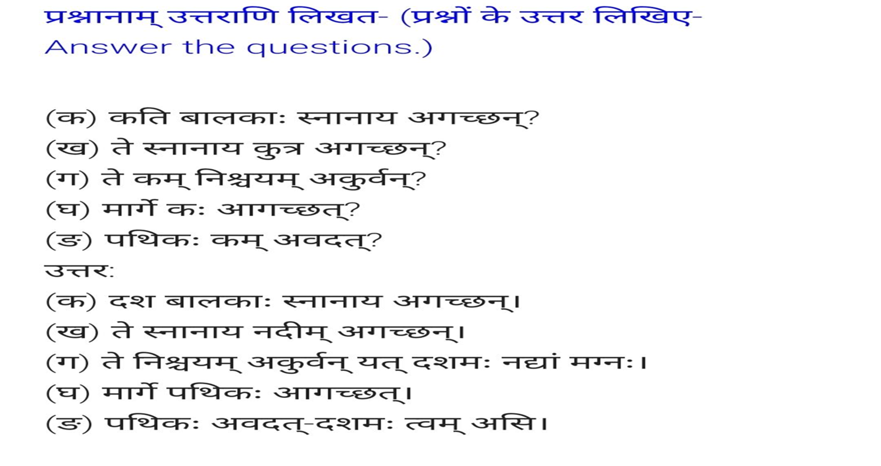

Slide 11
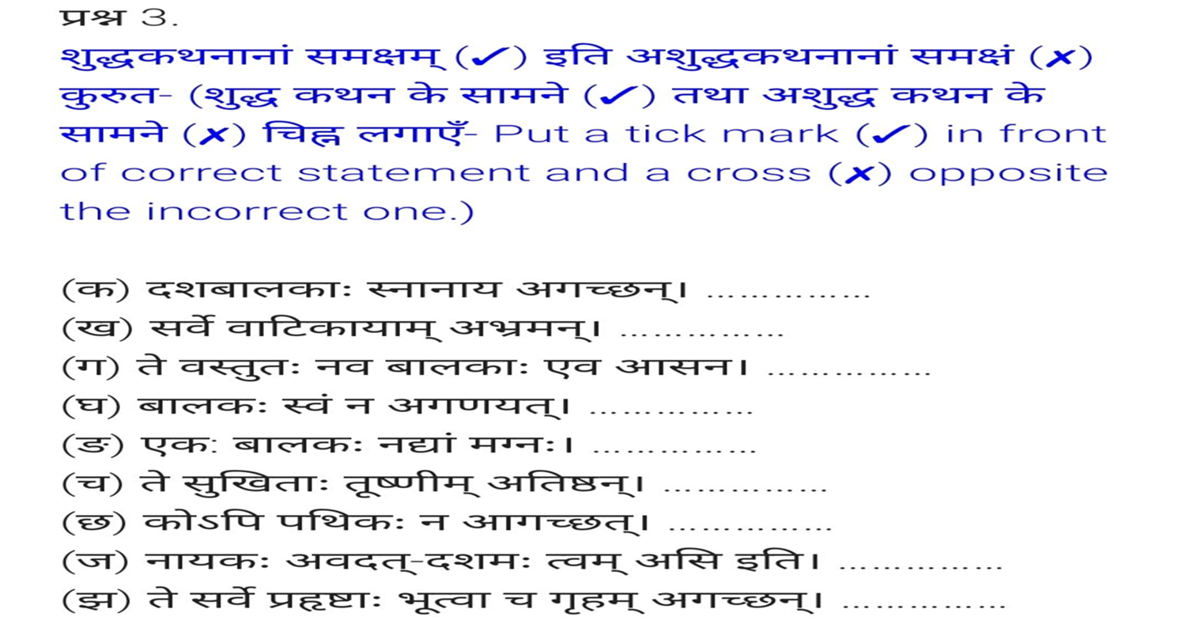

Slide 12
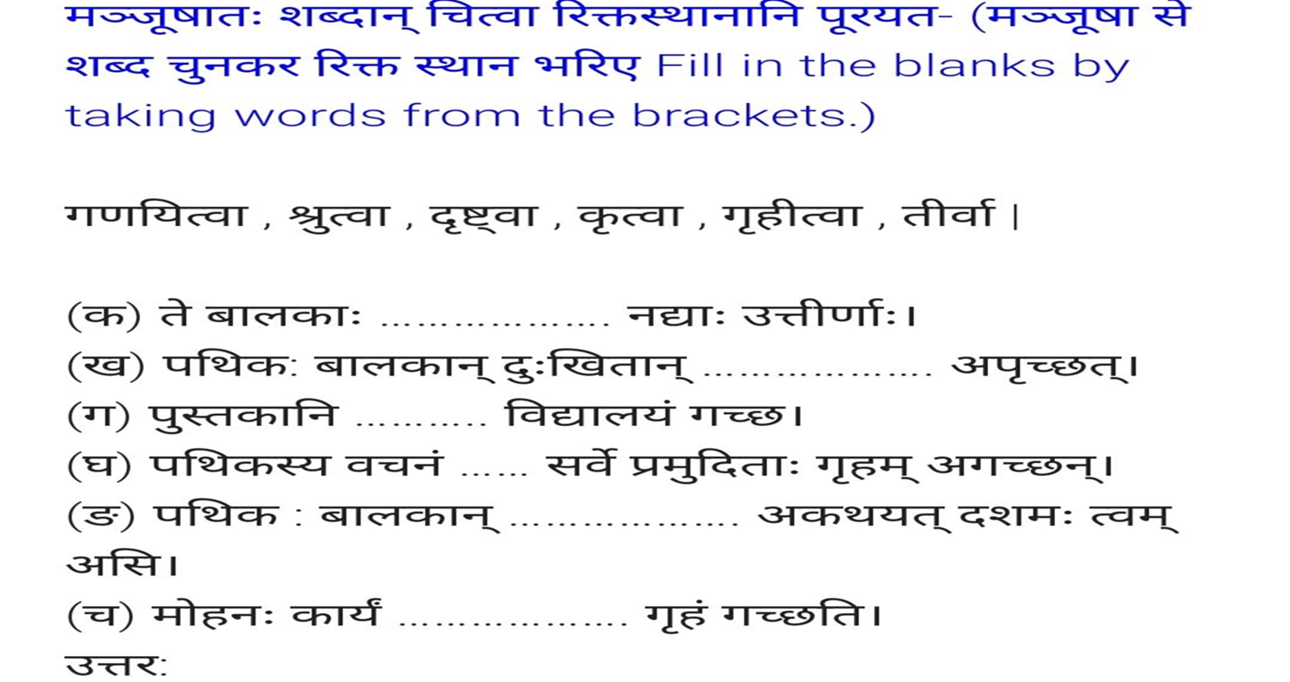

Slide 13
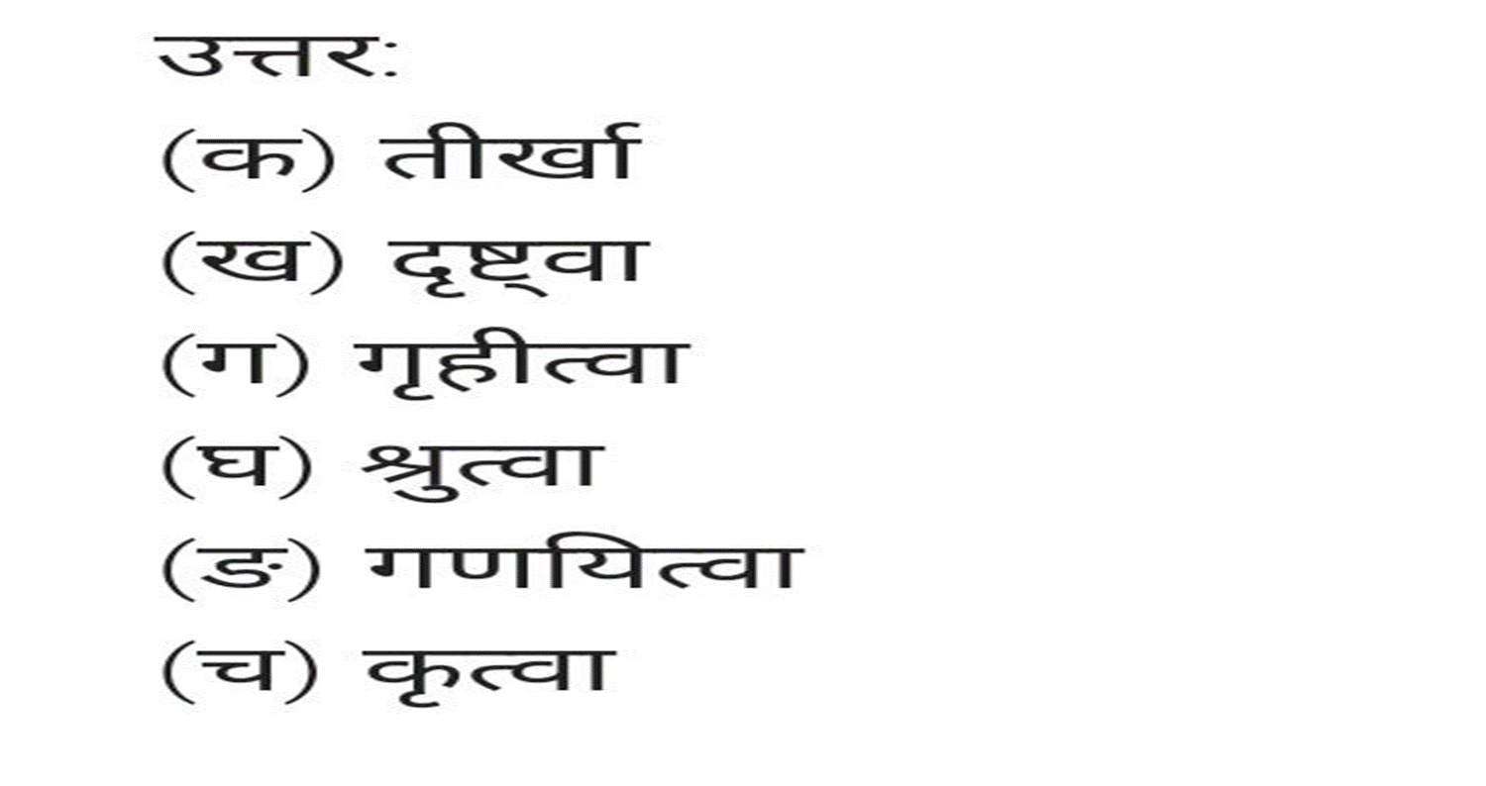

Slide 15
ODM EDUCATIONAL GROUP

