Slide 1


DURBUDHI HI BINASYATI
SUBJECT : SANSKRIT
CHAPTER NO 2
CHAPTER NAME:DURBUDHI HI BINASYATI
PPT 4

Slide 2
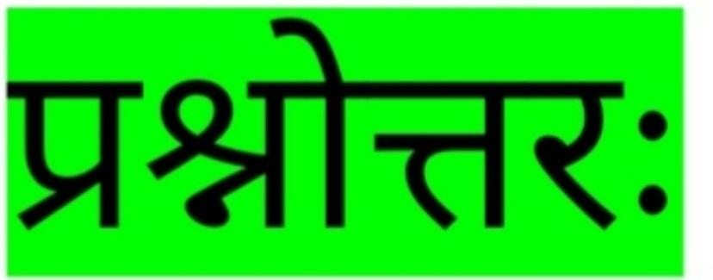

Slide 3
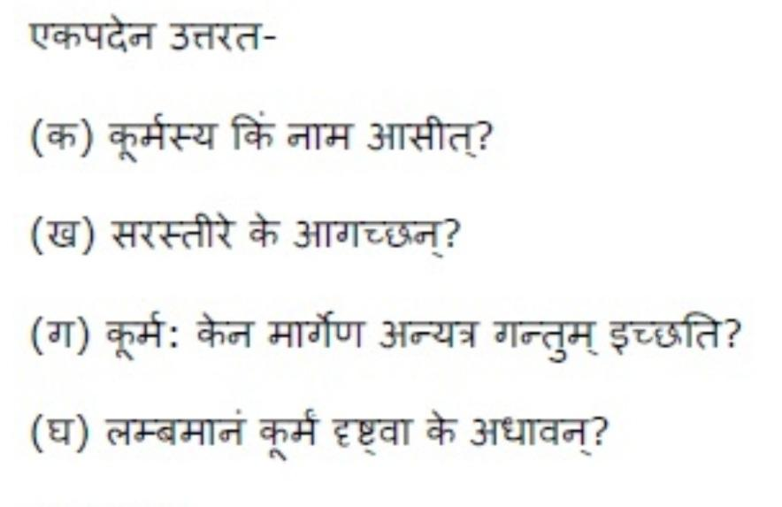

Slide 4
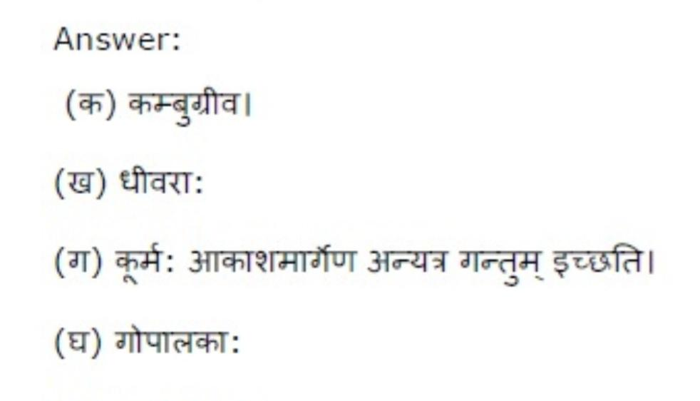

Slide 5
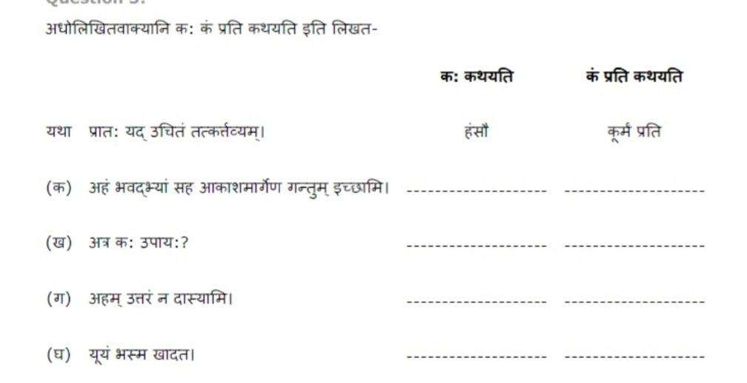

Slide 6
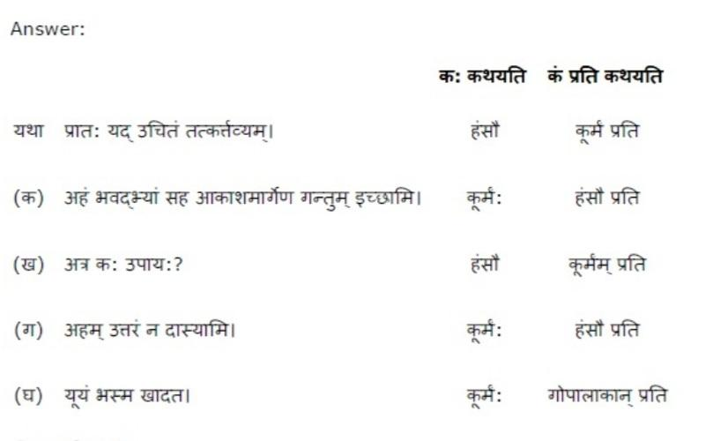

Slide 7
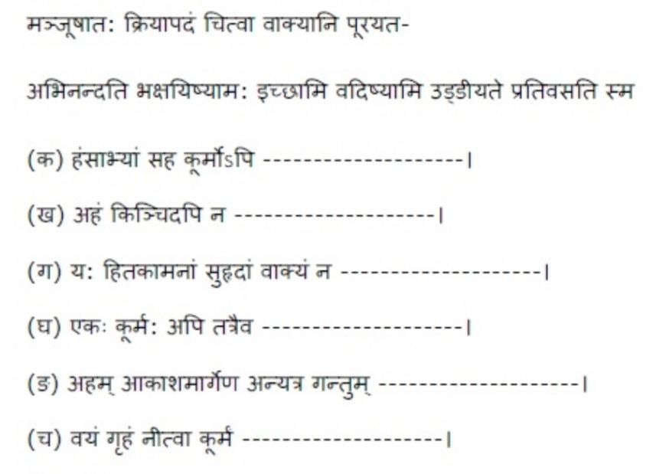

Slide 8
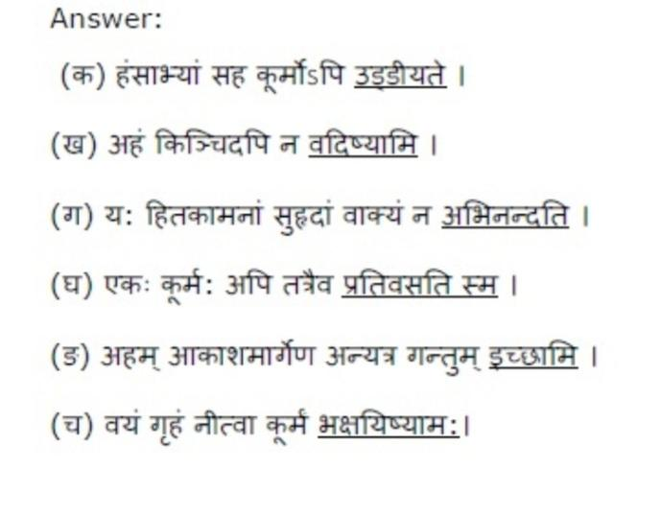

Slide 9
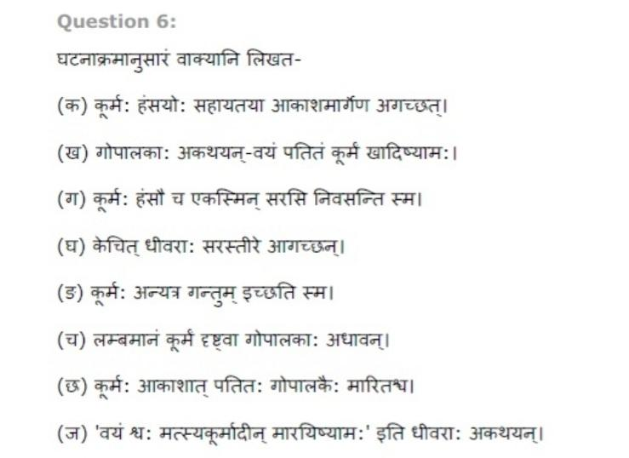

Slide 10
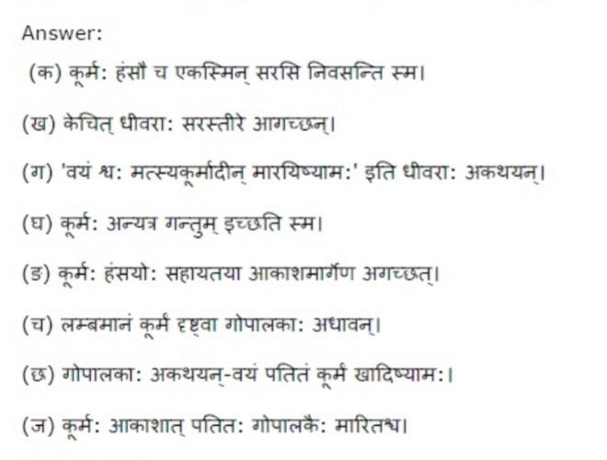

Slide 11
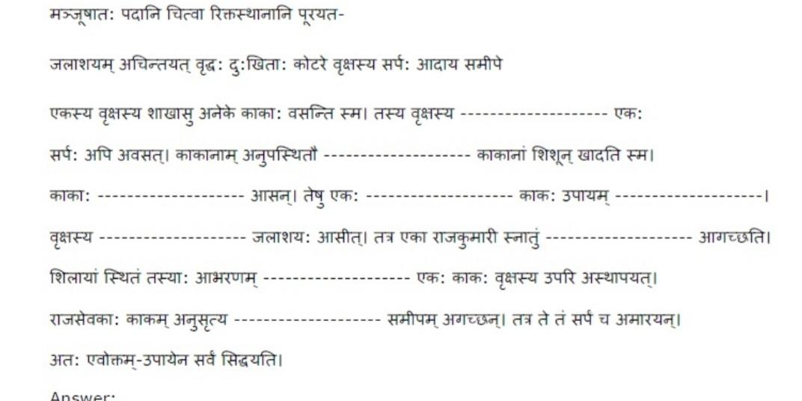

Slide 12
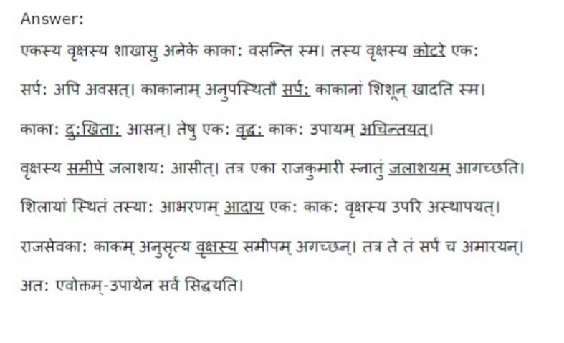

Slide 13
THANKING YOU
ODM EDUCATIONAL GROUP

