Slide 1

WELCOME TO ONLINE CLASS
CLASS - UKG
SUBJECT – MATHS
(REVISION- SAME AND DIFFERENT)

Slide 2
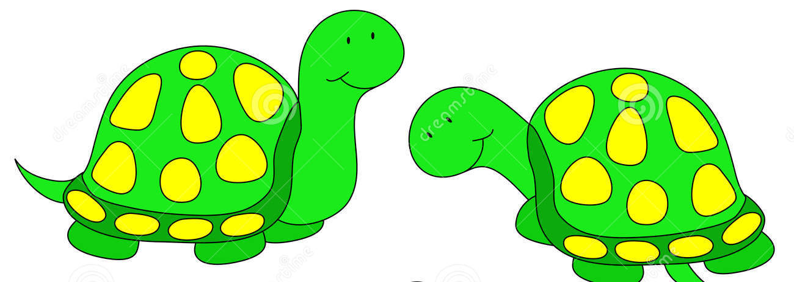

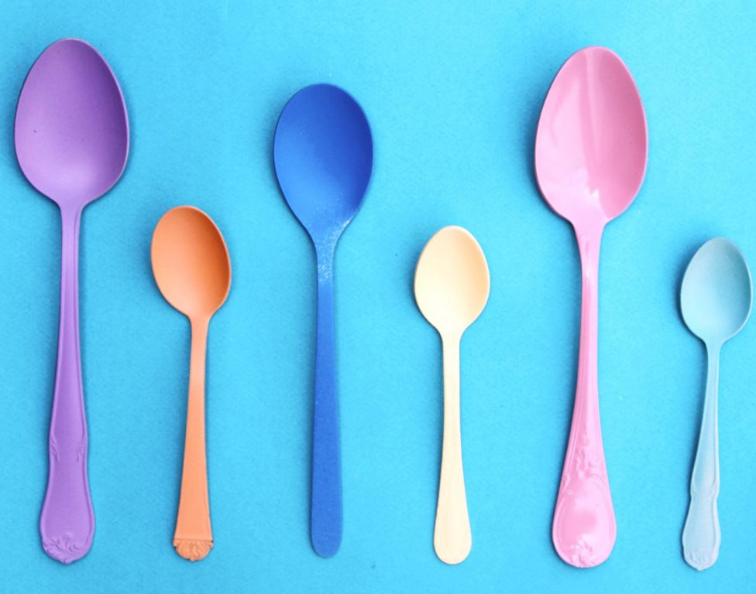





RECAP:
SAME
SAME
DIFFERENT
DIFFERENT
SAME
DIFFERENT

Slide 3



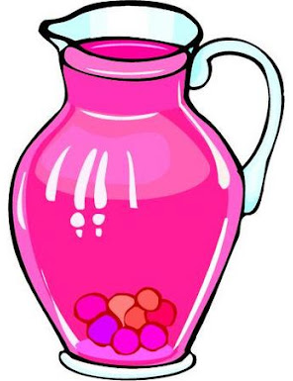





Circle the objects which are same:

Slide 4






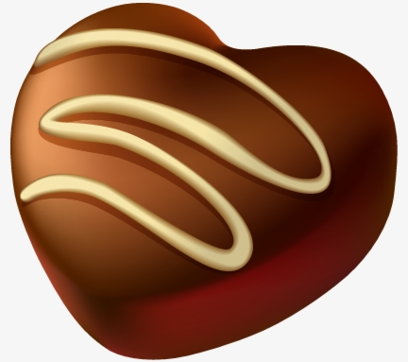

Slide 5






Tick the object from the given set which is different:

Slide 6


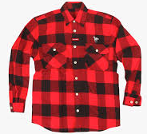
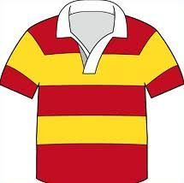
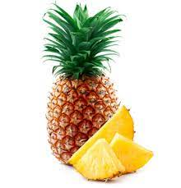
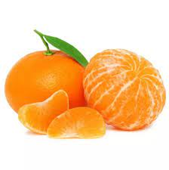
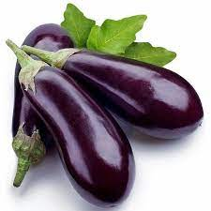
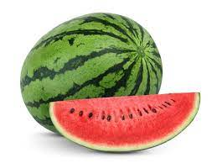

Slide 7
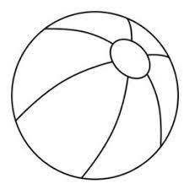
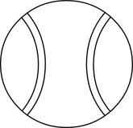


Class Assignments (20.09.21):
Draw the pictures in your notebook and colour the one which is different:

Slide 8








Home Assignments (20.09.21):
Match the objects with their shadows:

Slide 9

THANKING YOU
ODM EDUCATIONAL GROUP

