Slide 1

WELCOME TO ODM ONLINE CLASS
CLASS-UKG
SUBJECT-RHYME
T0PIC- REVISION

Slide 2
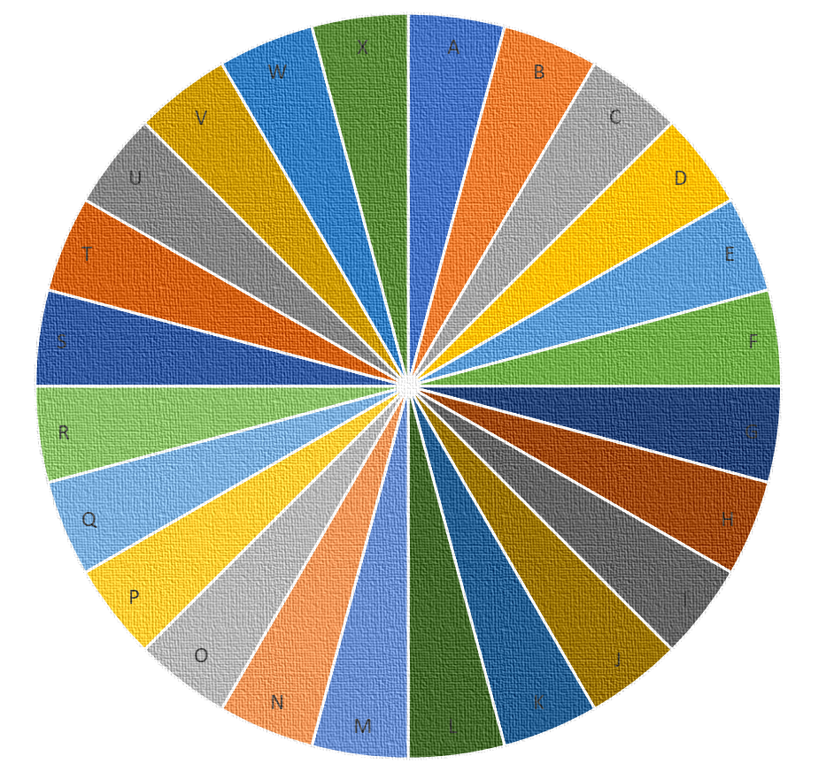
Spin the wheel and recite the given rhyme-
A. CHOTA SA GHAR
B. I AM MR RECTANGLE
C. I AM A BEAUTIFUL TRIANGLE
D. KABUTAR HUN MEIN
E. PHONIC RHYME
F. EK DO TIN CHAR
G. BAPA BOU KAHANTI MOTE
H. SURAJ GOL CHANDA GOL
I. BACKWARD COUNTING
J. THIA PUCHI NARANGA
K. EKA DUE TINI CHARI
L. THUMAK THUMAK
M. ACTION RHYME
N. COCK CROWS GAY BAKRI
O.COLOUR RHYME
P. CHOTA SA GHAR
Q. I AM MR RECTANGLE
R. I AM A BEAUTIFUL TRIANGLE
S. KABUTAR HUN MEIN
T. PHONIC RHYME
U. EK DO TIN CHAR
V. BAPA BOU KAHANTI MOTE
W. SURAJ GOL CHANDA GOL
X. BACKWARD COUNTING
Y. THIA PUCHI NARANGA
Z. EKA DUE TINI CHARI

