Slide 1


CLASS : NURSERY
DATE : 24.08.2021
SUBJECT :
RHYMES
CHAPTER NUMBER-BK PG NO-15

Slide 2



CLOUD
BADAL

Slide 3
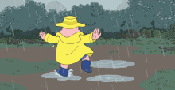

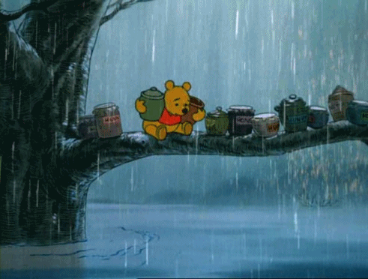
RAIN
MEGHA

Slide 4
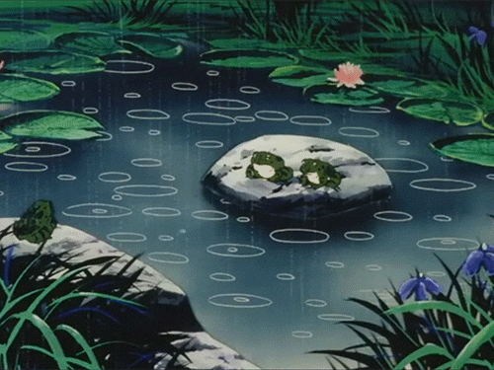
Tupuru Tupuru Megha Barasila

Slide 5
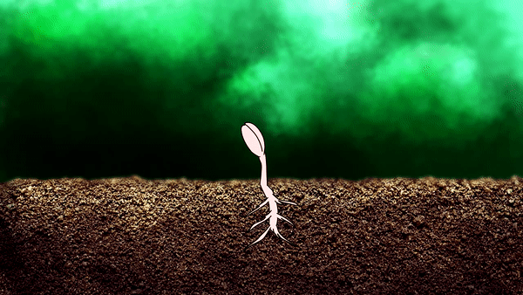
Kesura Maila Gaja.

Slide 6
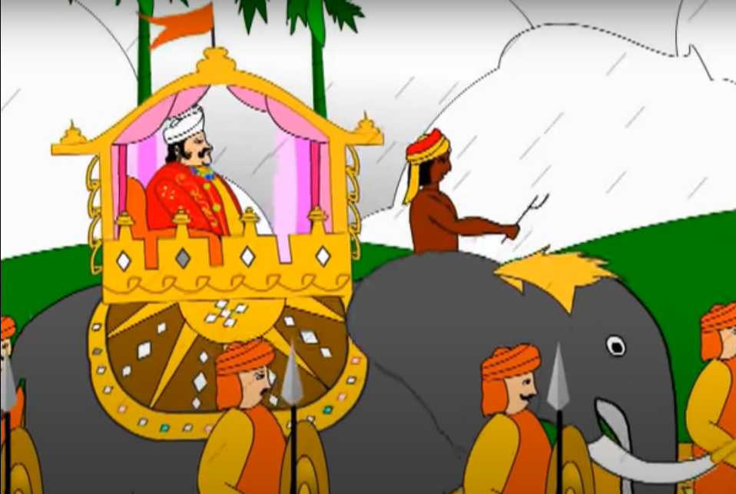
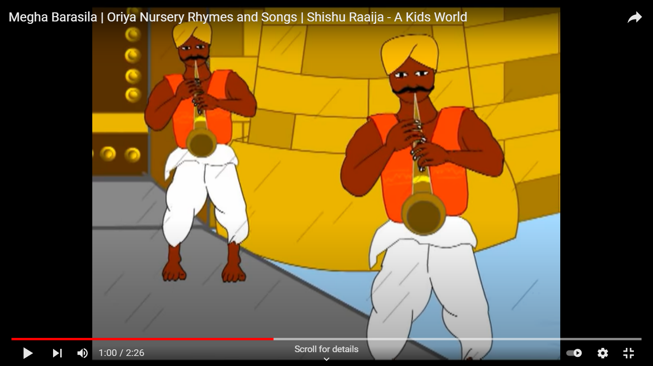
Keu Raije Rahile Mo Raja
Telingi Baida Baja.

Slide 7
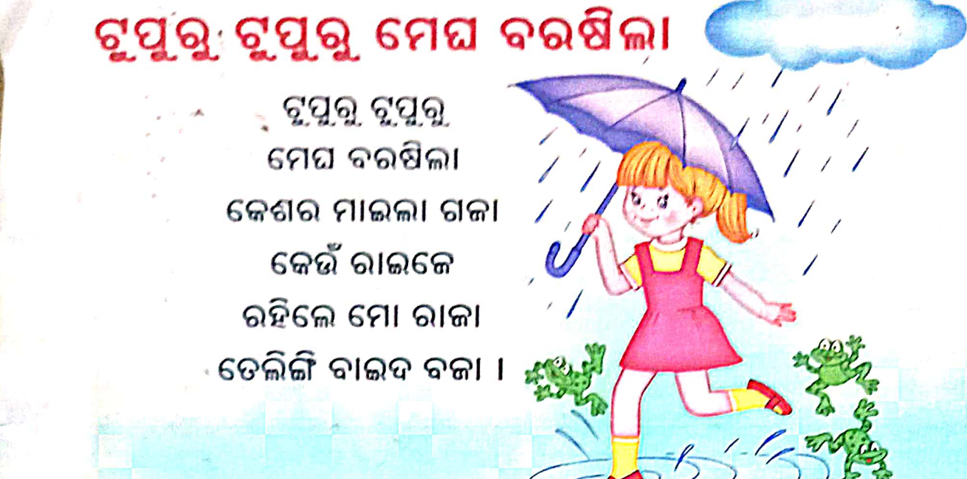

Slide 8
THANKING YOU
ODM EDUCATIONAL GROUP
THANKING YOU
ODM EDUCATIONAL GROUP

